Slide 1

LOGO
ABOUT US
SHEJI
Pour away the
ocean and sweep up the wood;
For nothing now can
ever come to any good
The demo title
Click here to enter the text of this section
https://www.jpppt.com

Slide 2

About us
Pour away the
ocean and sweep up the wood;
For nothing now can
ever come to any good
establish
plan
My working week
and my Sunday rest, My noon
my midnight
my talk, my song
S u b t I t l e

Slide 3
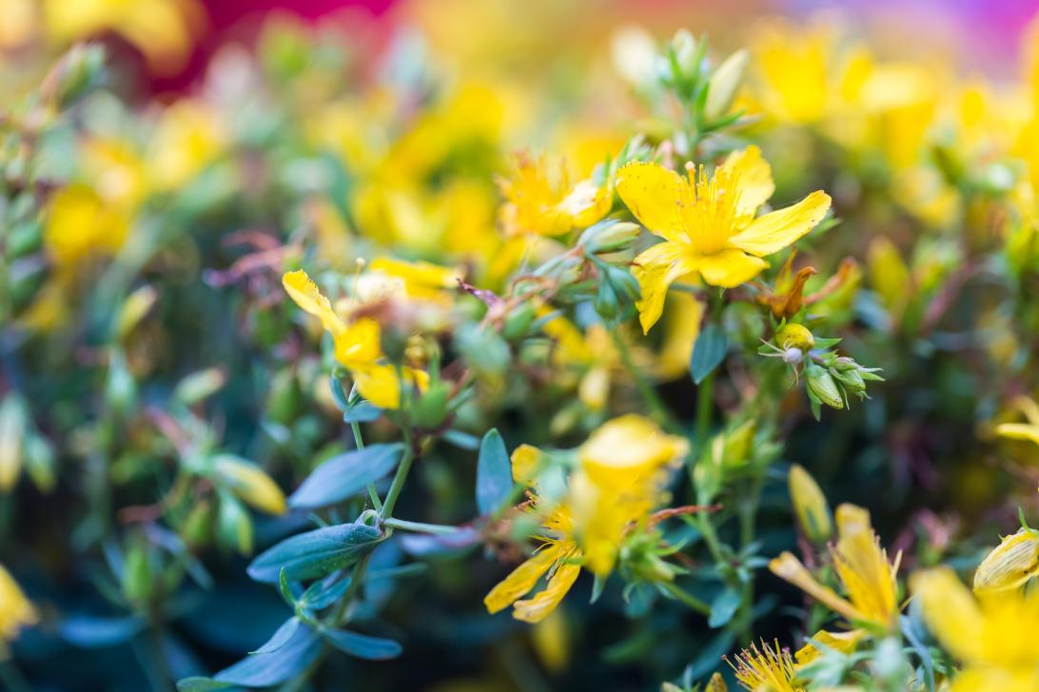
The stars are not wanted now: put out every one;
Pack up the moon and dismantle the sun;
For nothing now can
ever come to any good.
Title 4 here
Title 3 here
Title 2 here
Title 1 here
The stars are not wanted now:
put out every one;
Pack up the moon and dismantle the sun;
HeadlInes
put out every one; Pack up the moon and dismantle the sun;

Slide 4

The title of this section
Click here to enter the text of this section
Chapters separate pages
It's a little cool
Click here to enter the text of this section

Slide 5

Pour away the
ocean and sweep up the wood
For nothing now can
ever come to any good
My working week
and my Sunday rest, My noon
my midnight
my talk, my song

Slide 6
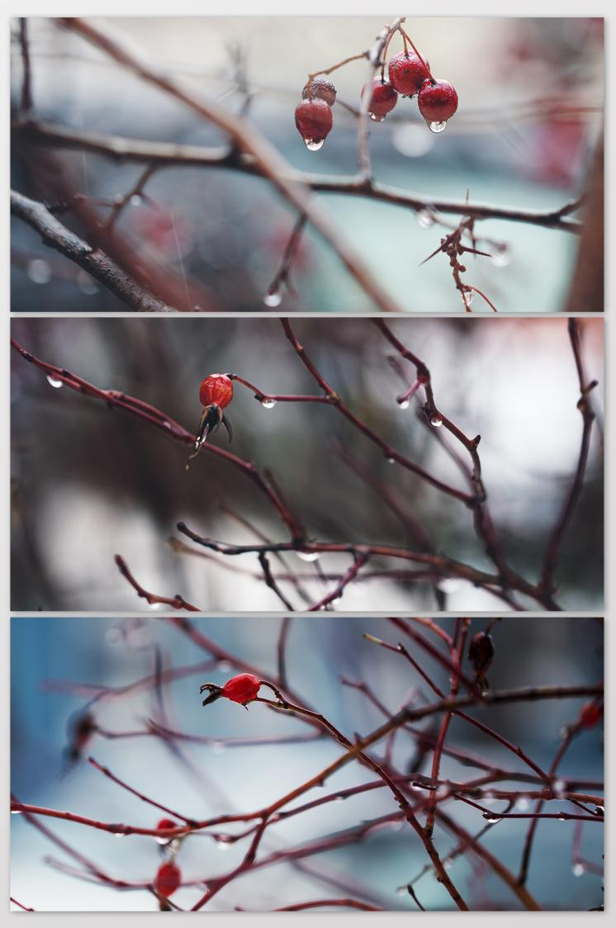
Click here to input
the replacement text and suggest replacing it with this speech
Title here
My working week
and my Sunday rest,
My noon,
my midnight, my talk,
my song; I thought that love
would last forever;
I was wrong.

Slide 7
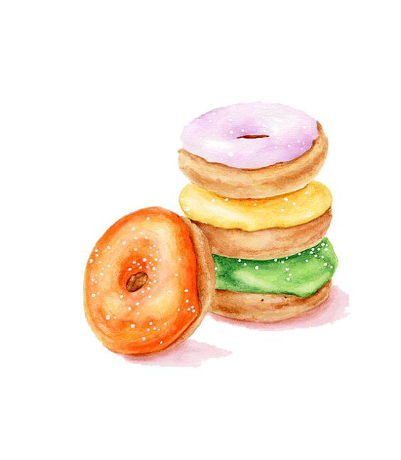
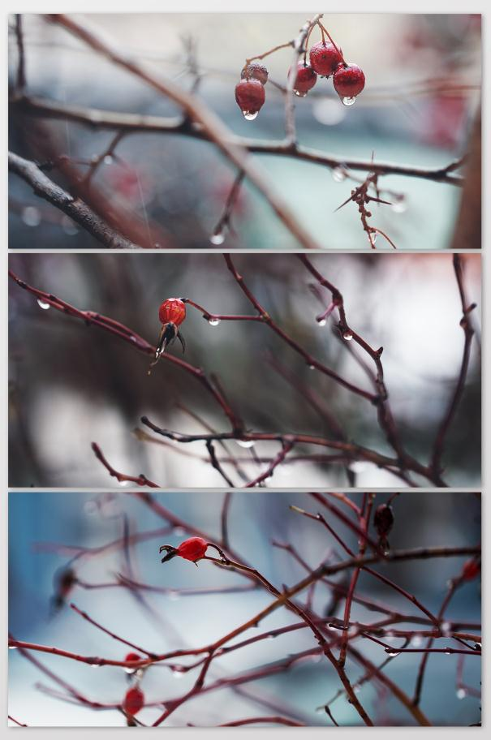

Subtitle
Subtitle
Subtitle
Subtitle
Subtitle
Subtitle

Slide 8

My working week
and my Sunday rest,
My noon,
my midnight, my talk,
my song; I thought that love
would last forever;
I was wrong.

Slide 9

The title of this section
Chapters separate pages
Click here to enter the text of this section
It's a little cool
Click here to enter the text of this section

Slide 10
Click here to input the
replacement text and suggest replacing
it with this speech
Click here to input the
replacement text and suggest replacing it with this speech
My working week and
my Sunday rest, My noon
my midnight,
my talk my song
60%
I thought that love forever
My working
week and my Sunday rest,
My noon, my midnight, my talk, my song;
I thought that love would last forever;
I was wrong.

Slide 11

It's a little cool
Put crepe bows round the
white necks of public doves,
Let the traffic
policemen wear black cotton gloves.
He was my North,
my South, my East and West.
My working week and my Sunday rest, My noon, my midnight, my talk, my song;
I thought that love would last forever; I was wrong.

Slide 12
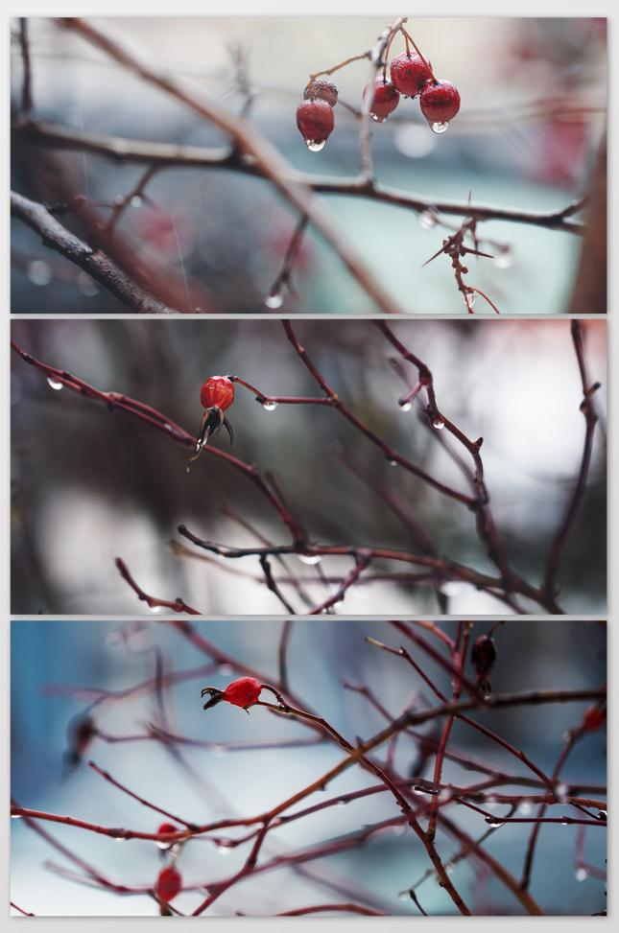
Click here to input the
replacement text and suggest replacing
it with this speech
HeadlInes
This is the subject
Put crepe bows round the
white necks of public doves,
Let the traffic
policemen wear black cotton gloves.
He was my North,
my South, my East and West.

Slide 13
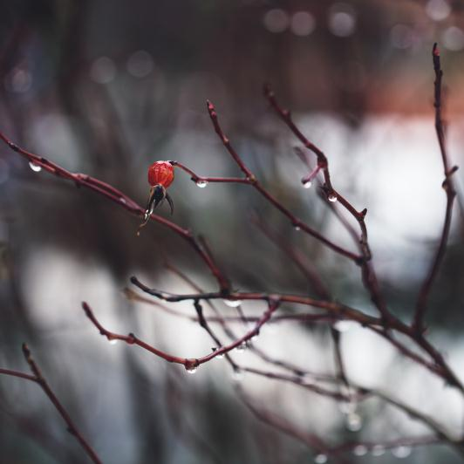
The title of this section
Chapters separate pages
Click here to enter the text of this section
It's a little cool
Click here to enter the text of this section
PPTtemplate http://www.1ppt.com/moban/

Slide 14
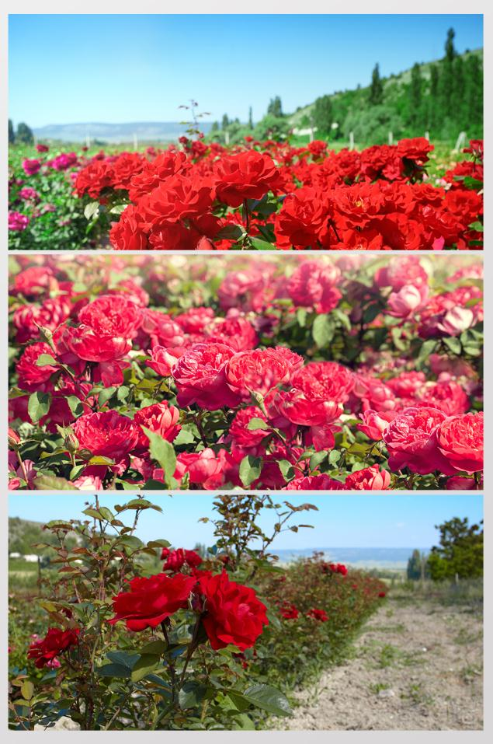
Sweet
Click here to enter the text of this section
Click here to
enter the text of this section
The stars are not wanted now: put out every one; Pack up the moon and dismantle the sun; Pour away the ocean and sweep up the wood; For nothing now can ever come to any good.

Slide 15
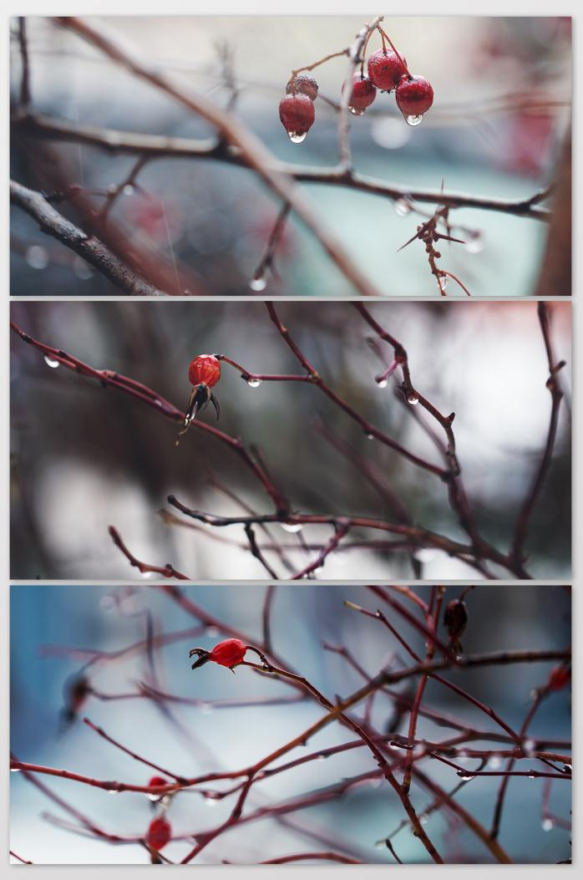
text
text
text
text
Click here to input the
replacement text and suggest
replacing it with this speech.
Click here to enter the text of section

Slide 16

Yu Xiang
The stars are not wanted now:
put out every one; Pack up the moon and dismantle
the sun; Pour away the ocean
and sweep up the wood; For nothing now
can ever come to any good.

Slide 17

Subtitle
The stars are not wanted now:
put out every one; Pack up the moon and dismantle
the sun; Pour away the ocean
and sweep up the wood; For nothing now
can ever come to any good.
07

Slide 18

A little
Cool
The title of this section
My working week
and my Sunday rest, My noon
my midnight
my talk, my song
The stars are not wanted now:
put out every one; Pack up the moon and dismantle
the sun; Pour away the ocean
and sweep up the wood; For nothing now
can ever come to any good.

Slide 19
The stars are not wanted now:
put out every one; Pack up the moon and dismantle
the sun; Pour away the ocean
and sweep up the wood; For nothing now
can ever come to any good.
flourishingsummer
Click here to enter the text of this section

Slide 20
LOGO
Thank you
https://www.jpppt.com

