Slide 1
LOGO
EUROPEAN MINIMALISM
Anyone can make you smile. Many people can make you cry. But it takes someone really special to make you smile with tears in your eyes.
https://www.freeppt7.com

Slide 2
CONTENT
01.MANY
02.SPECIAL
03.ANYONE
04.SMILE

Slide 3
PART.01
01.MANY
Anyone can make you smile. Many people can make you cry. But it takes someone really special to make you smile with tears in your eyes.

Slide 4
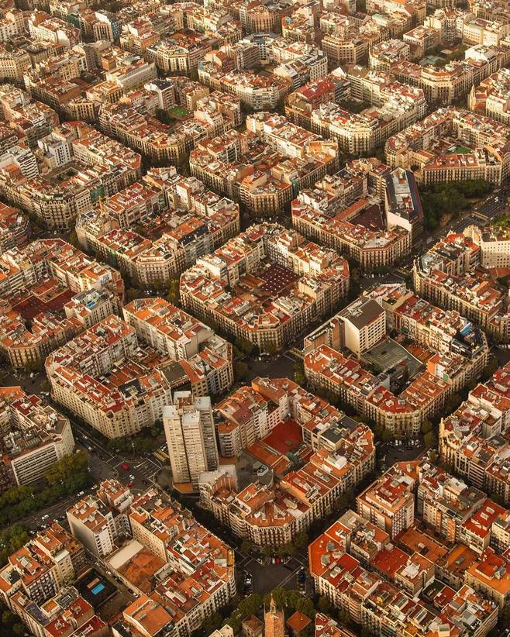
EUROPEAN
Anyone can make you smile. Many people can make you cry. But it takes someone really special to make you smile with tears in your eyes.
Anyone can make you smile. Many people can make you cry. But it takes someone really special to make you smile with tears in your eyes.
Anyone can make you smile. Many people can make you cry. But it takes someone really special to make you smile with tears in your eyes.

Slide 5
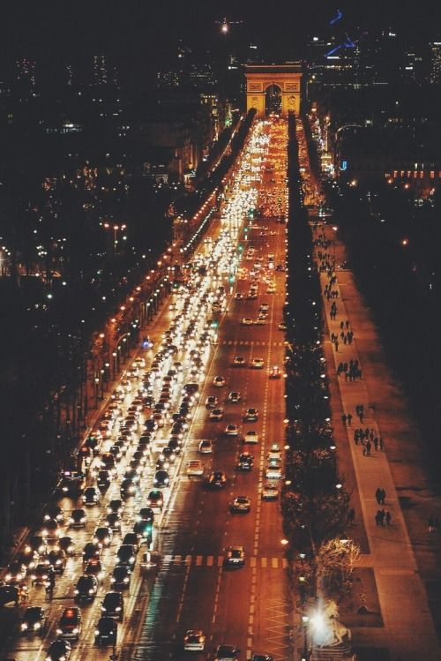
EUROPEAN
Anyone can make you smile. Many people can make you cry. But it takes someone really special to make you smile with tears in your eyes.
Anyone can make you smile. Many people can make you cry. But it takes someone really special to make you smile with tears in your eyes.

Slide 6
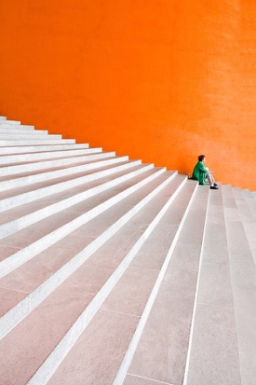
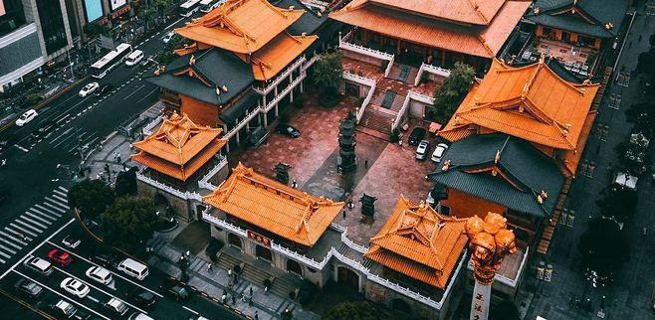
MINIMALISM
Anyone can make you smile. Many people can make you cry. But it takes someone really special to make you smile with tears in your eyes.
Anyone can make you smile. Many people can make you cry. But it takes someone really special to make you smile with tears in your eyes.

Slide 7
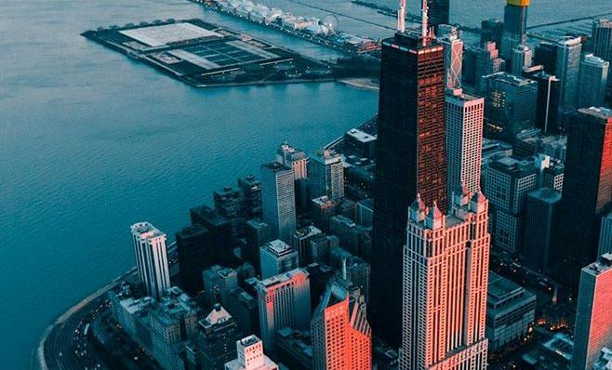
MINIMALISM
MINIMALISM
Anyone can make you smile. Many people can make you cry. But it takes someone really special to make you smile with tears in your eyes.
Anyone can make you smile. Many people can make you cry. But it takes someone really special to make you smile with tears in your eyes.

Slide 8
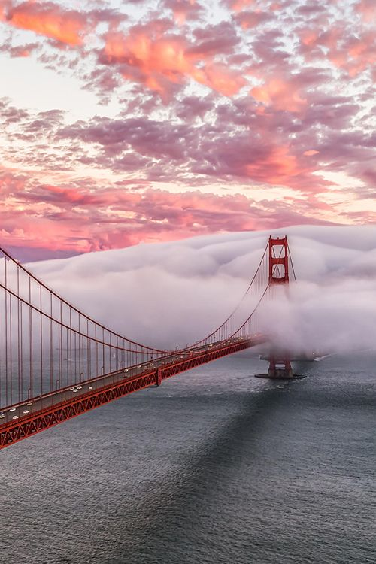
PART.02
02.SPECIAL
Anyone can make you smile. Many people can make you cry. But it takes someone really special to make you smile with tears in your eyes.

Slide 9
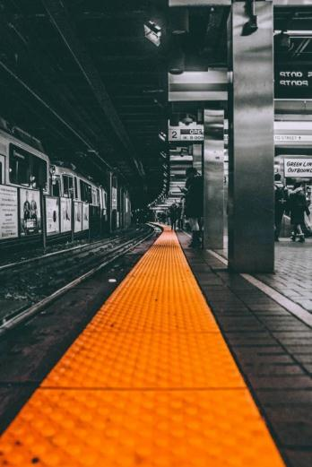
EUROPEAN
SPECIAL
Anyone can make you smile. Many people can make you cry. But it takes someone really special to make you smile with tears in your eyes.
Anyone can make you smile. Many people can make you cry. But it takes someone really special to make you smile with tears in your eyes.

Slide 10
MINIMALISM
Anyone can make you smile. Many people can make you cry. But it takes someone really special to make you smile with tears in your eyes.
EUROPEAN
Anyone can make you smile. Many people can make you cry. But it takes someone really special to make you smile with tears in your eyes.

Slide 11
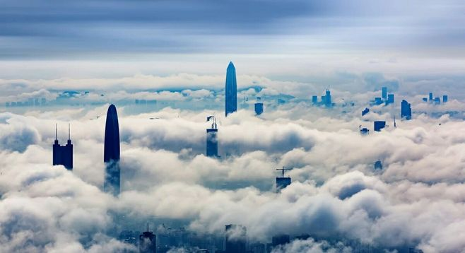
Anyone can make you smile. Many people can make you cry. But it takes someone really special to make you smile with tears in your eyes.
EUROPEAN
Anyone can make you smile. Many people can make you cry. But it takes someone really special to make you smile with tears in your eyes.

Slide 12
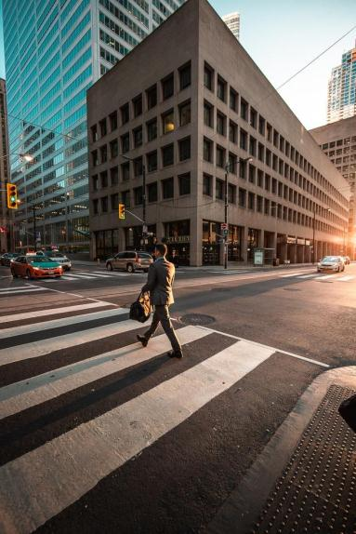
EUROPEAN
Anyone can make you smile. Many people can make you cry. But it takes someone really special to make you smile with tears in your eyes.
Anyone can make you smile. Many people can make you cry. But it takes someone really special to make you smile with tears in your eyes.

Slide 13
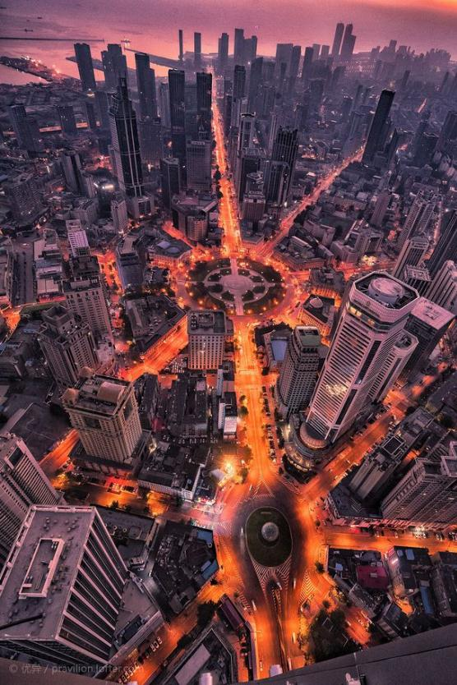
PART.03
03.ANYONE
Anyone can make you smile. Many people can make you cry. But it takes someone really special to make you smile with tears in your eyes.

Slide 14
ANYONE
Anyone can make you smile. Many people can make you cry. But it takes someone really special to make you smile with tears in your eyes.
EUROPEAN
Anyone can make you smile. Many people can make you cry. But it takes someone really special to make you smile with tears in your eyes.

Slide 15
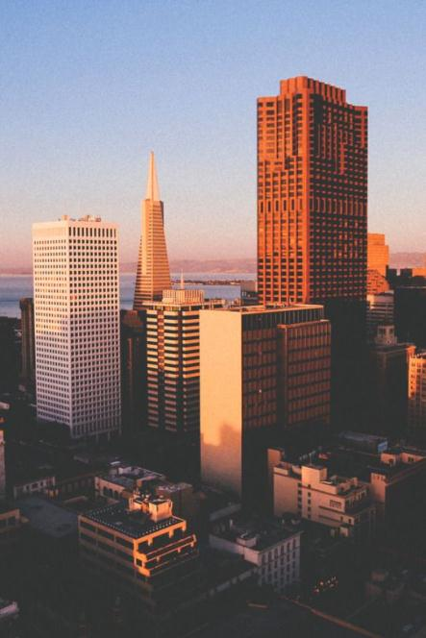
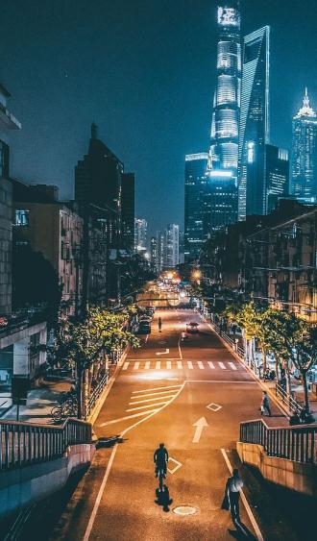
EUROPEAN
Anyone can make you smile. Many people can make you cry. But it takes someone really special to make you smile with tears in your eyes.

Slide 16
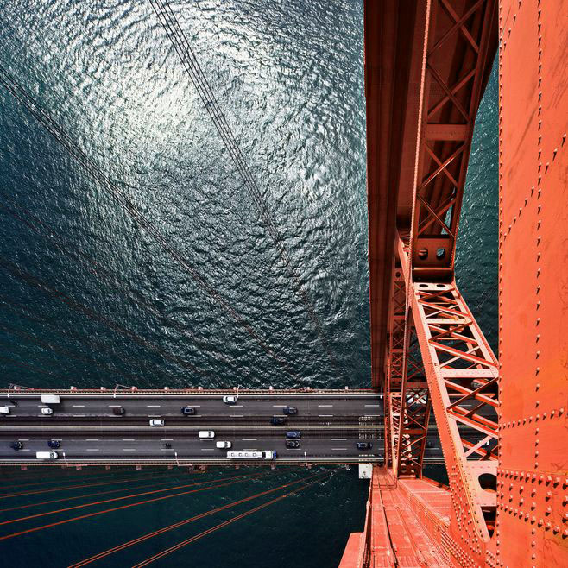
EUROPEAN
Anyone can make you smile. Many people can make you cry. But it takes someone really special to make you smile with tears in your eyes.
Anyone can make you smile. Many people can make you cry. But it takes someone really special to make you smile with tears in your eyes.

Slide 17
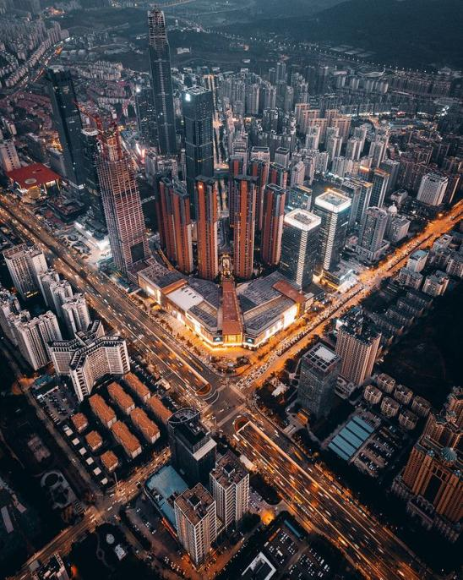
MINIMALISM
Anyone can make you smile. Many people can make you cry. But it takes someone really special to make you smile with tears in your eyes.
Anyone can make you smile. Many people can make you cry. But it takes someone really special to make you smile with tears in your eyes.

Slide 18
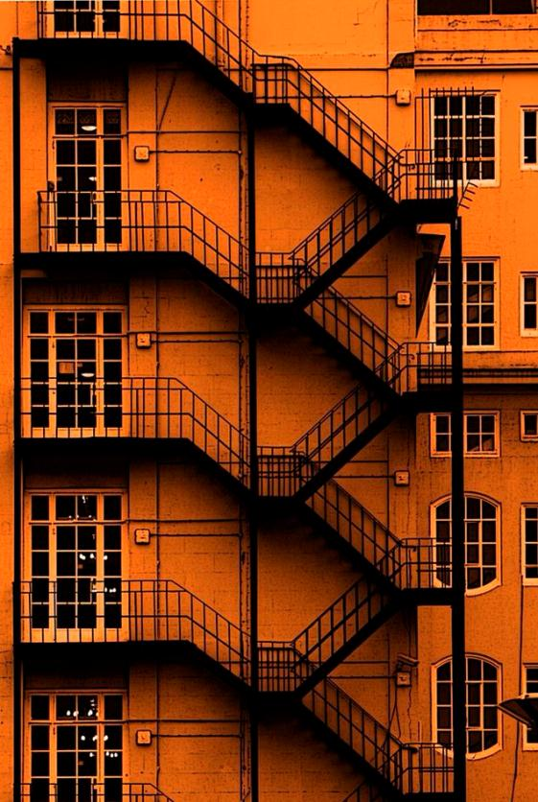
PART.04
04.SMILE
Anyone can make you smile. Many people can make you cry. But it takes someone really special to make you smile with tears in your eyes.
PPT模板 http://www.1ppt.com/moban/

Slide 19
EUROPEAN
Anyone can make you smile. Many people can make you cry. But it takes someone really special to make you smile with tears in your eyes.
Anyone can make you smile. Many people can make you cry. But it takes someone really special to make you smile with tears in your eyes.
MINIMALISM

Slide 20
MINIMALISM
Anyone can make you smile. Many people can make you cry. But it takes someone really special to make you smile with tears in your eyes.

Slide 21
04.SMILE
Anyone can make you smile. Many people can make you cry. But it takes someone really special to make you smile with tears in your eyes.
EUROPEAN
Anyone can make you smile. Many people can make you cry. But it takes someone really special to make you smile with tears in your eyes.
Anyone can make you smile. Many people can make you cry. But it takes someone really special to make you smile with tears in your eyes.

Slide 22
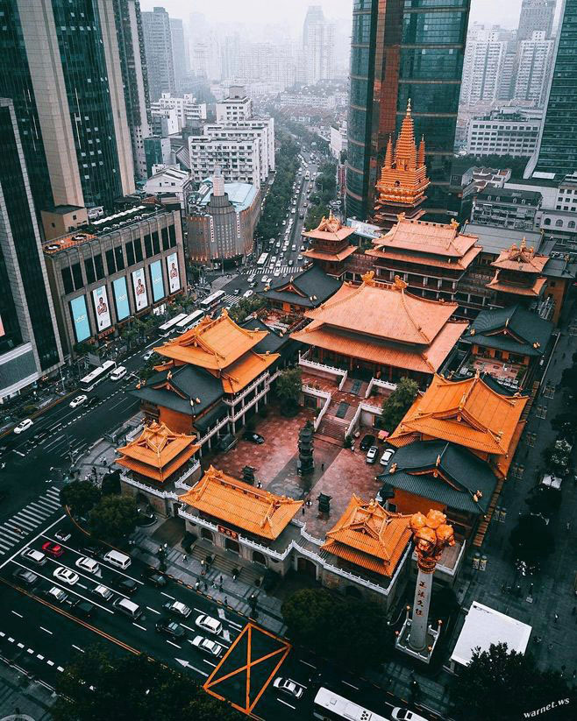
EUROPEAN
Anyone can make you smile. Many people can make you cry. But it takes someone really special to make you smile with tears in your eyes.
Anyone can make you smile. Many people can make you cry. But it takes someone really special to make you smile with tears in your eyes.

Slide 23
LOGO
THANK
YOU
Anyone can make you smile. Many people can make you cry. But it takes someone really special to make you smile with tears in your eyes.
https://www.freeppt7.com

