Slide 1



LOGO
Free
Hello
June
PPT
templates
Fading is true while flowering is past.
https://www.freeppt7.com

Slide 2

Click here to enter the title text
Click here to add your title
CONTENTS
Click here to enter the title text
Click here to add your title
Click here to enter the title text
Click here to add your title
Click here to enter the title text
Click here to add your title

Slide 3

Part.01
Click here to enter the title text
When a cigarette falls in love with a match,it is destined to be hurt. When a cigarette falls in love with a match,it is destined to be hurt.

Slide 4

Click here to enter The title text
Click to enter the title
Click to enter the title
One needs 3 things to be truly happy living in the world: some thing to do, some one to love, some thing to hope for.
One needs 3 things to be truly happy living in the world: some thing to do, some one to love, some thing to hope for.
Click to enter the title
Click to enter the title
One needs 3 things to be truly happy living in the world: some thing to do, some one to love, some thing to hope for.
One needs 3 things to be truly happy living in the world: some thing to do, some one to love, some thing to hope for.
Click here
Enter the text
Click to enter the title
Click to enter the title
One needs 3 things to be truly happy living in the world: some thing to do, some one to love, some thing to hope for.
One needs 3 things to be truly happy living in the world: some thing to do, some one to love, some thing to hope for.

Slide 5


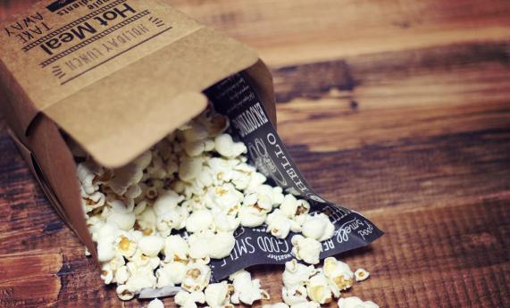
Click here to enter The title text
Click here to enter the title
Click here to enter the title
Click here to enter the title
No one indebted for others,while many people don't know how to cherish others. No one indebted for others,while many people don't know how to cherish others.
No one indebted for others,while many people don't know how to cherish others. No one indebted for others,while many people don't know how to cherish others.
No one indebted for others,while many people don't know how to cherish others. No one indebted for others,while many people don't know how to cherish others.

Slide 6
Click here to enter The title text
1
2
3
4
title
title
title
title
No one indebted for others,while many people don't know how to cherish others.
No one indebted for others,while many people don't know how to cherish others.
No one indebted for others,while many people don't know how to cherish others.
No one indebted for others,while many people don't know how to cherish others.
Enter the title
Enter the title
Enter the title
Enter the title
No one indebted for others,while many people don't know how to cherish others.
No one indebted for others,while many people don't know how to cherish others.
No one indebted for others,while many people don't know how to cherish others.
No one indebted for others,while many people don't know how to cherish others.

Slide 7
Click here to enter The title text
Click to enter the title
No one indebted for others,while many people don't know how to cherish others. No one indebted for others,while many people don't know how to cherish others.
When a cigarette falls in love with a match.
When a cigarette falls in love with a match.
When a cigarette falls in love with a match.
When a cigarette falls in love with a match.
When a cigarette falls in love with a match.
No one indebted for others,while many people don't know how to cherish others.
No one indebted for others,while many people don't know how to cherish others.
No one indebted for others,while many people don't know how to cherish others.
No one indebted for others,while many people don't know how to cherish others.
No one indebted for others,while many people don't know how to cherish others.

Slide 8
Part.02
Click here to enter the title text
When a cigarette falls in love with a match,it is destined to be hurt. When a cigarette falls in love with a match,it is destined to be hurt.

Slide 9
Click here to enter The title text
Enter the title
No one indebted for others,while many people don't know how to cherish others.
Enter the title
Enter the title
No one indebted for others,while many people don't know how to cherish others.
No one indebted for others,while many people don't know how to cherish others.
No one indebted for others,while many people don't know how to cherish others.
Enter the title

Slide 10
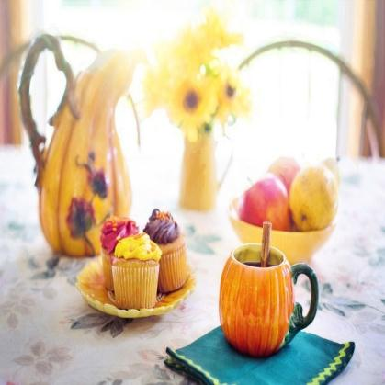
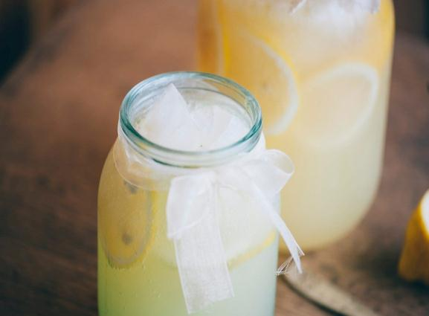
Click here to enter The title text
A guy who whispers in your ears, saying ” It’s alright, I’m here.” Holds you when you’re sad, and treasures everything about you. That’s the guy I want to give my heart to.
A guy who whispers in your ears, saying ” It’s alright, I’m here.” Holds you when you’re sad, and treasures everything about you. That’s the guy I want to give my heart to.
PPTtemplate http://www.1ppt.com/moban/

Slide 11
Click here to enter The title text
Click to enter the title
Click to enter the title
Click to enter the title
When a cigarette falls in love with a match.
When a cigarette falls in love with a match.
When a cigarette falls in love with a match.
When a cigarette falls in love with a match.
When a cigarette falls in love with a match.
When a cigarette falls in love with a match.
Click to enter the title
Click to enter the title
Click to enter the title
No one indebted for others,while many people don't know how to cherish others. No one indebted for others,while many people don't know how to cherish others. No one indebted for others,while many people don't know how to cherish others. No one indebted for others,while many people don't know how to cherish others.

Slide 12
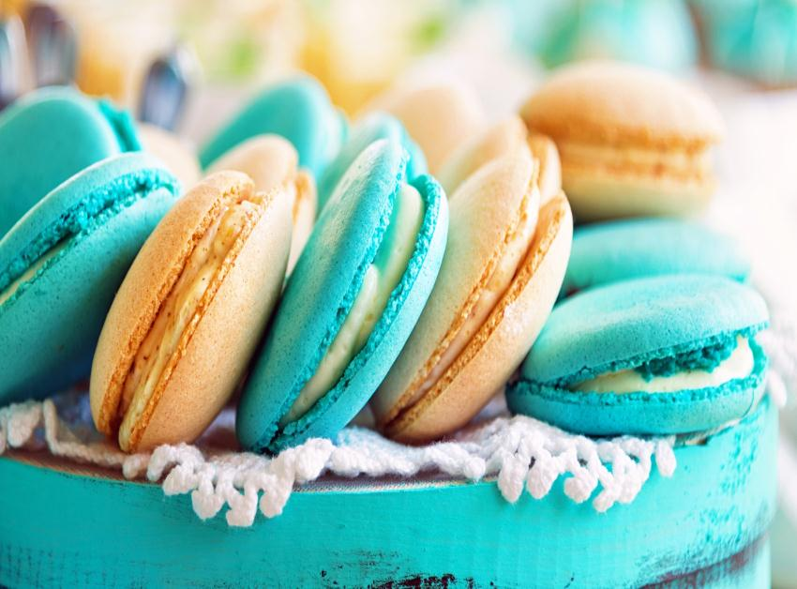
Click here to enter The title text
Click here to enter text
No one indebted for others,while many people don't know how to cherish others. No one indebted for others,while many people don't know how to cherish others.
No one indebted for others,while many people don't know how to cherish others. No one indebted for others,while many people don't know how to cherish others. No one indebted for others,while many people don't know how to cherish others. No one indebted for others,while many people don't know how to cherish others.

Slide 13
Click here to enter The title text
Click to enter the text
Click to enter the text
Click to enter the text
Click to enter the text
No one indebted for others,while many people don't know how to cherish others. No one indebted for others,while many people don't know how to cherish others.
No one indebted for others,while many people don't know how to cherish others. No one indebted for others,while many people don't know how to cherish others.
No one indebted for others,while many people don't know how to cherish others. No one indebted for others,while many people don't know how to cherish others.
No one indebted for others,while many people don't know how to cherish others. No one indebted for others,while many people don't know how to cherish others.

Slide 14
Part.03
Click here to enter the title text
When a cigarette falls in love with a match,it is destined to be hurt. When a cigarette falls in love with a match,it is destined to be hurt.

Slide 15
Click here to enter The title text
Click to enter the title
If they throw stones at you, don’t throw back, use them to build your own foundation instead.
If they throw stones at you, don’t throw back, use them to build your own foundation instead.
Click to enter the title
If they throw stones at you, don’t throw back, use them to build your own foundation instead.
Click to enter the title
If they throw stones at you, don’t throw back, use them to build your own foundation instead.
Click to enter the title

Slide 16


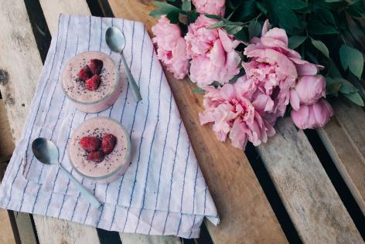
Click here to enter The title text
Click to enter the text
Click to enter the text
Click to enter the text
No one indebted for others,while many people don't know how to cherish others. No one indebted for others,while many people don't know how to cherish others.
No one indebted for others,while many people don't know how to cherish others. No one indebted for others,while many people don't know how to cherish others.
No one indebted for others,while many people don't know how to cherish others. No one indebted for others,while many people don't know how to cherish others.
VIEW MORE
VIEW MORE
VIEW MORE

Slide 17
Click here to enter The title text
Click here to enter text
Click here to enter text
If they throw stones at you, don’t throw back, use them to build your own foundation instead.
If they throw stones at you, don’t throw back, use them to build your own foundation instead.
Click here to enter text
Click here to enter text
If they throw stones at you, don’t throw back, use them to build your own foundation instead.
If they throw stones at you, don’t throw back, use them to build your own foundation instead.
Click here to enter text
Click here to enter text
If they throw stones at you, don’t throw back, use them to build your own foundation instead.
If they throw stones at you, don’t throw back, use them to build your own foundation instead.

Slide 18

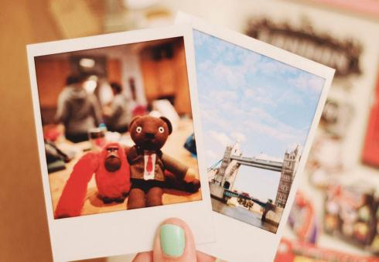


Click here to enter The title text
Click to enter the title
No one indebted for others,while many people don't know how to cherish others. No one indebted for others,while many people don't know how to cherish others.
Click to enter the title
No one indebted for others,while many people don't know how to cherish others. No one indebted for others,while many people don't know how to cherish others.

Slide 19
Click here to enter The title text
1
If you leave me, please don't comfort me because each sewing has to meet stinging pain.
2
If you leave me, please don't comfort me because each sewing has to meet stinging pain.
3
If you leave me, please don't comfort me because each sewing has to meet stinging pain.
4
If you leave me, please don't comfort me because each sewing has to meet stinging pain.

Slide 20
Part.04
Click here to enter the title text
When a cigarette falls in love with a match,it is destined to be hurt. When a cigarette falls in love with a match,it is destined to be hurt.

Slide 21
Click here to enter The title text
Enter the title
Enter the title
Enter the title
Enter the title
No one indebted for others,while many people don't know how to cherish others. No one indebted for others,while many people don't know how to cherish others.
No one indebted for others,while many people don't know how to cherish others. No one indebted for others,while many people don't know how to cherish others.
No one indebted for others,while many people don't know how to cherish others. No one indebted for others,while many people don't know how to cherish others.
No one indebted for others,while many people don't know how to cherish others. No one indebted for others,while many people don't know how to cherish others.

Slide 22
Click here to enter The title text
Enter the title
Enter the title
Click to enter the title
No one indebted for others,while many people don't know how to cherish others. No one indebted for others,while many people don't know how to cherish others.
No one indebted for others,while many people don't know how to cherish others. No one indebted for others,while many people don't know how to cherish others.
No one indebted for others,while many people don't know how to cherish others. No one indebted for others,while many people don't know how to cherish others.

Slide 23

Click here to enter The title text
Click to enter the title
Click to enter the title
Click to enter the title
No one indebted for others,while many people don't know how to cherish others. No one indebted for others,while many people don't know how to cherish others.
No one indebted for others,while many people don't know how to cherish others. No one indebted for others,while many people don't know how to cherish others.
No one indebted for others,while many people don't know how to cherish others. No one indebted for others,while many people don't know how to cherish others.

Slide 24
Click here to enter The title text
Click to enter the title
Click to enter the title
One needs 3 things to be truly happy living in the world: some thing to do, some one to love, some thing to hope for.
One needs 3 things to be truly happy living in the world: some thing to do, some one to love, some thing to hope for.
Click here to add text
Click to enter the title
Click to enter the title
One needs 3 things to be truly happy living in the world: some thing to do, some one to love, some thing to hope for.
One needs 3 things to be truly happy living in the world: some thing to do, some one to love, some thing to hope for.

Slide 25
LOGO
Thank you
Insert the Subtitle of Your Presentation
https://www.freeppt7.com

