Slide 1
Free PPT templates
Insert the Subtitle of Your Presentation

Slide 2
Whoa!
This can be the part of the presentation where you introduce yourself, write your email…

Slide 3
Table of contents
About us
Find a theme
01
02
Group guidelines
Contact us
03
04
You can describe the topic of the section here
You can describe the topic of the section here
You can describe the topic of the section here
You can describe the topic of the section here

Slide 4
01
About us
You can enter a subtitle here if you need it

Slide 5
Introduction
You can give a brief description of the topic you want to talk about here. For example, if you want to talk about Mercury, you can say that it’s the smallest planet in the entire Solar System

Slide 6
About our book club
Mercury
Venus
Mars
It’s the closest planet to the Sun and the smallest one in the Solar System
Venus has a beautiful name and is the second planet from the Sun
Despite being red, Mars is actually a cold place. It’s full of iron oxide dust

Slide 7
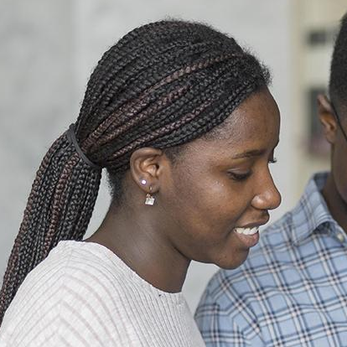
Member file
Information
Preferred books
Gender:
Female
Book name here
Book name here
Book name here
Book name here
Book name here
Book name here
Book name here
Age:
25
Location:
Barcelona
Jenna Lewis
Hobbies:
You can speak a bit about this person here
Mercury
Jupiter
Neptune

Slide 8
9h 55m 23s
333,000.000
386,000 km
Is Jupiter's rotation period
Earths is the Sun’s mass
Distance between Earth and the Moon

Slide 9
Pick your book
Step 2
Step 4
Venus is the second planet from the Sun
Jupiter is the biggest planet of them all
Step 1
Step 3
Saturn is a gas giant with several rings
Mars is actually a very cold place

Slide 10
Find a theme
Mercury
Venus
It’s the closest planet to the Sun and the smallest one in the Solar System
Venus has a beautiful name and is the second planet from the Sun

Slide 11
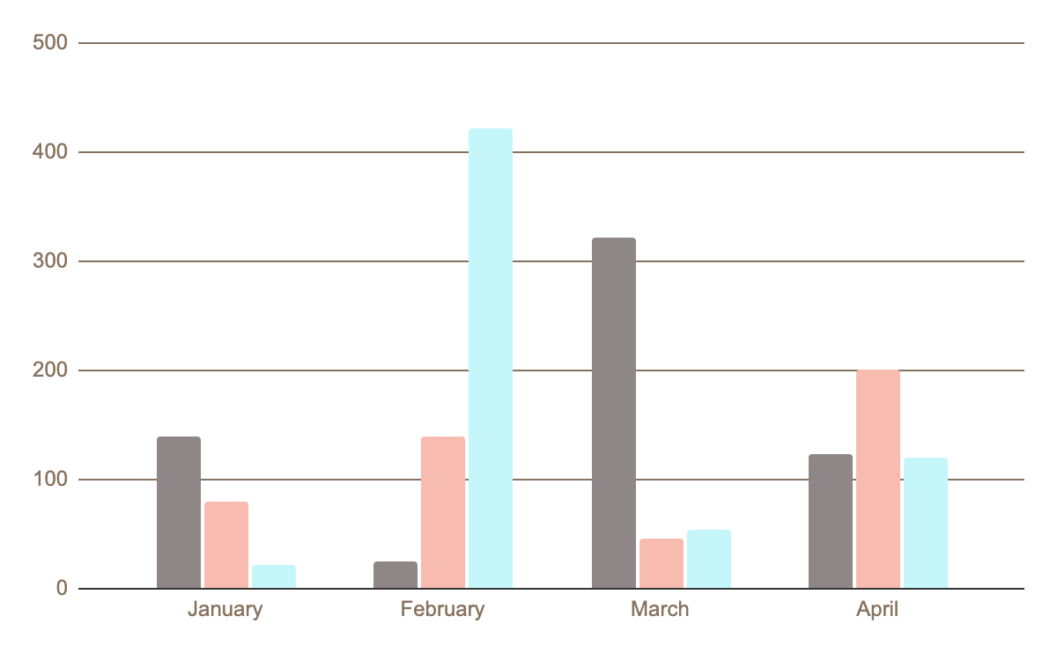
Best book themes
Classics
Mercury is the closest planet to the Sun and the smallest one
Fantasy
Venus is the second planet from the Sun
Romance
Follow the link in the graph to modify its data and then paste the new one here. For more info, click here
Despite being red, Mars is actually a cold place

Slide 12
Top bestsellers
Mercury
01
Venus
02
Mars
03
It’s the closest planet to the Sun and the smallest one
Venus is the second planet from the Sun. It’s hot there
Despite being red, Mars is actually a very cold place

Slide 13
130,000,000
Big numbers catch your audience’s attention

Slide 14
Set up the discussion
Mercury
It’s the closest planet to the Sun
Venus
Venus is the second planet from the Sun
Mars
Mars is actually a very cold place

Slide 15
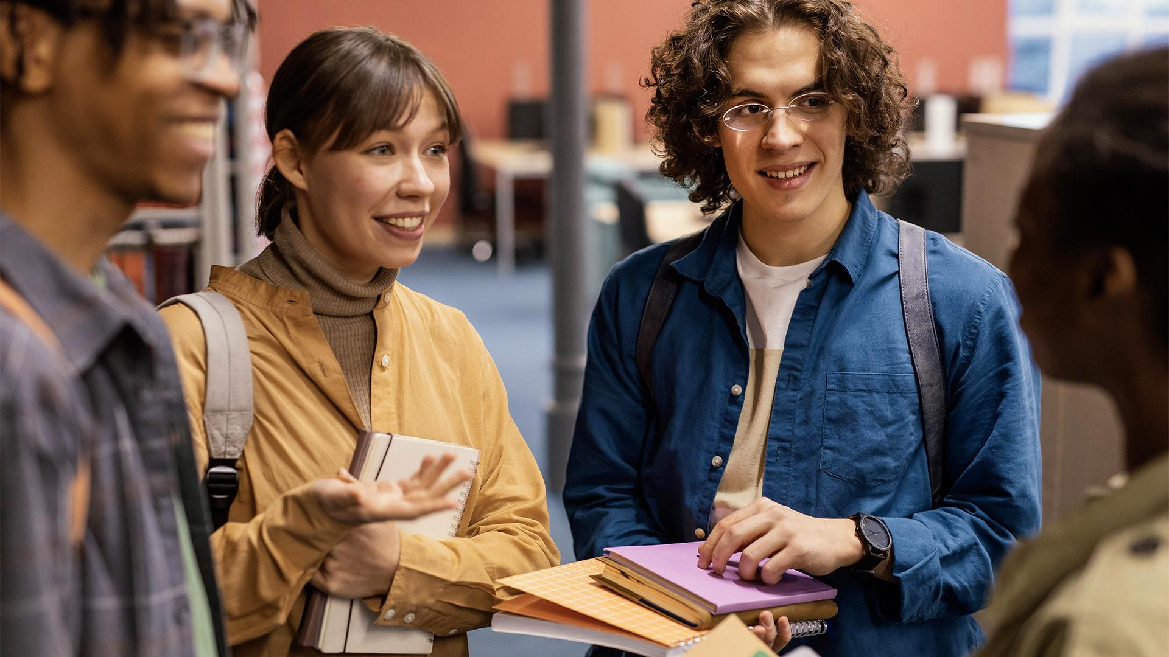
A picture is worth a thousand words

Slide 16

Opinions on the last book
Mercury
Jupiter
19,0%
It’s the closest planet to the Sun
Jupiter is the biggest planet of them all
44,0%
17,6%
Mars
Neptune
19,4%
Despite being red, Mars is a cold place
It’s the farthest planet from the Sun
Follow the link in the graph to modify its data and then paste the new one here. For more info, click here

Slide 17
Find a reading routine
Mercury
Venus
Mars
Saturn
It’s the closest planet to the Sun and the smallest one in the Solar System
Venus has a beautiful name and is the second planet from the Sun
Despite being red, Mars is actually a cold place. It’s full of iron oxide dust
Saturn is a gas giant and has several rings. It’s composed of hydrogen and helium

Slide 18
Meeting schedule - 2021
Time | Mon | Tue | Wed | Thu | Fri
9 a.m. |  | Video chat |  | Meeting
10 a.m. | Reading |  |  |  | Emma’s house
11 a.m.
12 p.m.

Slide 19
Recommendations and guidelines
Do you know what helps you make your point clear?
Lists like this one:
They’re simple
You can organize your ideas clearly
You’ll never forget to buy milk!
And the most important thing: the audience won’t miss the point of your presentation

Slide 20
Proposals of the month
01
02
Neptune
Mars
03
04
05
Jupiter
Mercury
Venus
It’s the farthest planet from the Sun
Despite being red, Mars is actually a cold place
Jupiter is the biggest planet of them all
It’s the closest planet to the Sun and the smallest one
Venus is the second planet from the Sun

Slide 21
This is a map
Mercury
30%
It’s the closest planet to the Sun
Venus
60%
Venus is the second planet from the Sun
Mars
10%
Mars is actually a very cold place

Slide 22
Awesome words

Slide 23
Group guidelines
Mercury
Venus
Mars
Jupiter
Saturn
Neptune
It’s the closest planet to the Sun and the smallest one
Venus is the second planet from the Sun
Despite being red, Mars is actually a cold place
Jupiter is the biggest planet of them all
It’s composed of hydrogen and helium
It’s the farthest planet from the Sun

Slide 24
Books of the month
Books discussing | Opinion
Book title | Jupiter is a gas giant and the biggest planet in the Solar System. It's the fourth-brightest object in the night sky
Book title | Saturn is a gas giant and has several rings. It's composed mostly of hydrogen and helium
Book title | Neptune is the farthest planet from the Sun. It's also the fourth-largest object by diameter in the Solar System

Slide 25
—Someone Famous
“This is a quote, words full of wisdom that someone important said and can make the reader get inspired.”

Slide 26
When you should read
10%
40%
50%
Mercury is the closest planet to the Sun
Venus is the second planet from the Sun
Despite being red, Mars is actually a cold place

Slide 27
Books I would like to read
Book title | Year | Author
Book title | 1949 | Author name
Book title | 1953 | Author name
Book title | 1957 | Author name
Book title | 1964 | Author name

Slide 28
Tips for the good reader
Mercury
Mars
It’s the closest planet to the Sun
Despite being red, Mars is a cold place
Venus
Saturn
Venus is the second planet from the Sun
It’s a gas giant and has several rings

Slide 29


Our Team
John Doe
Lisa Smith
You can speak a bit about this person here
You can speak a bit about this person here

Slide 30

Desktop software
You can replace the image on the screen with your own work. Just right-click on it and select “Replace image”

Slide 31
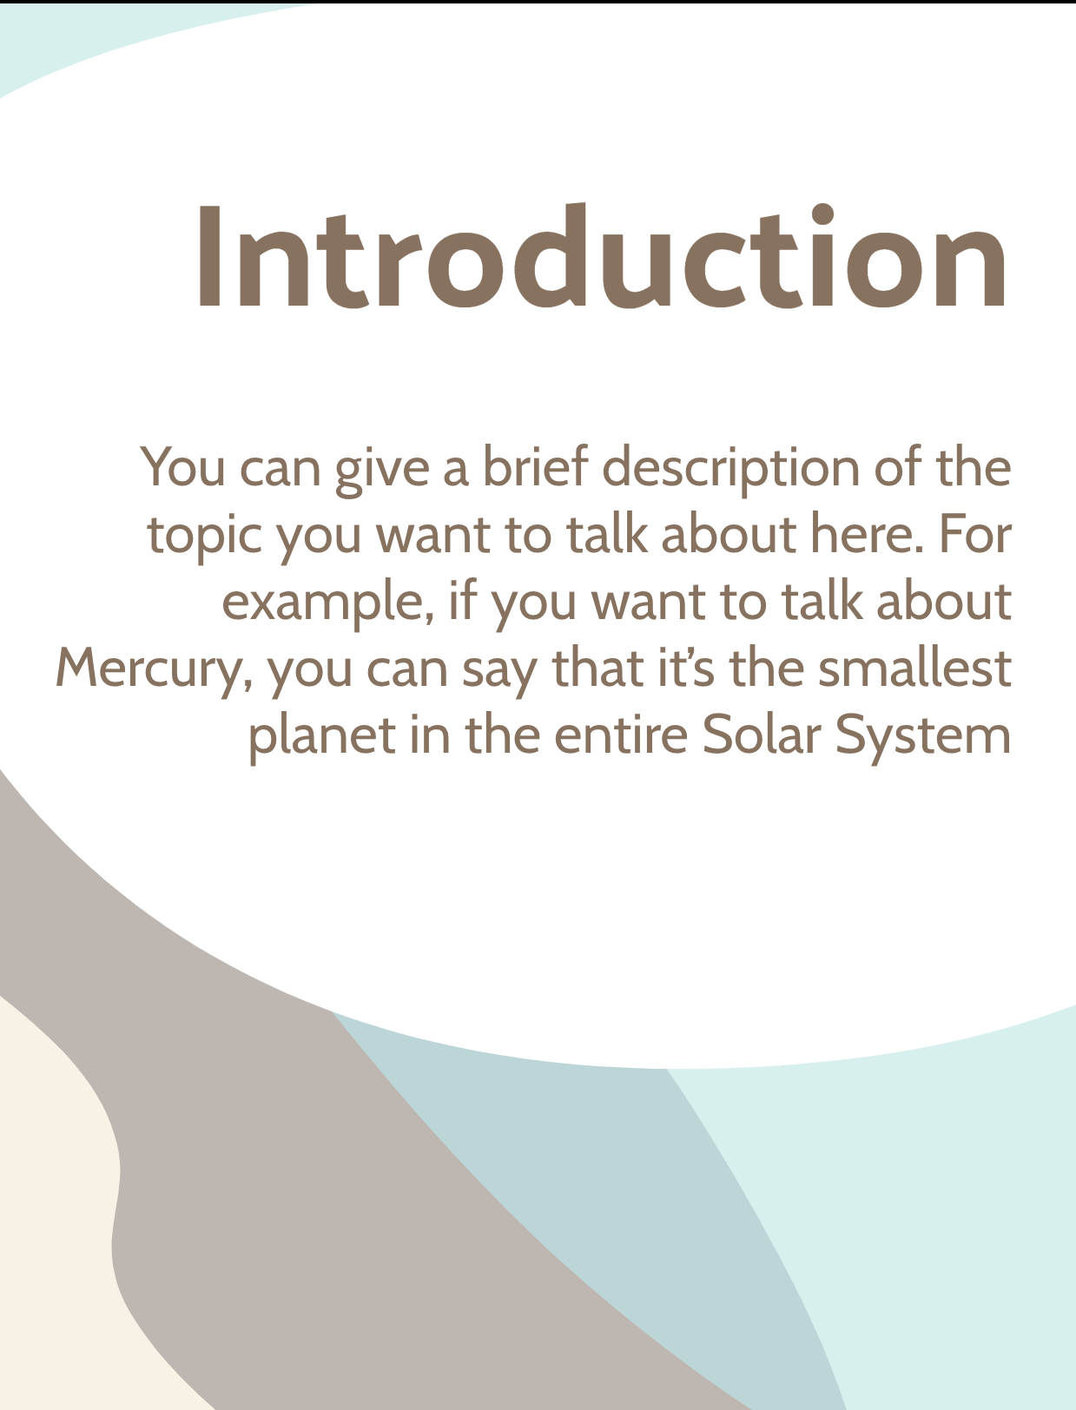
Tablet app
You can replace the image on the screen with your own work. Just right-click on it and select “Replace image”

Slide 32
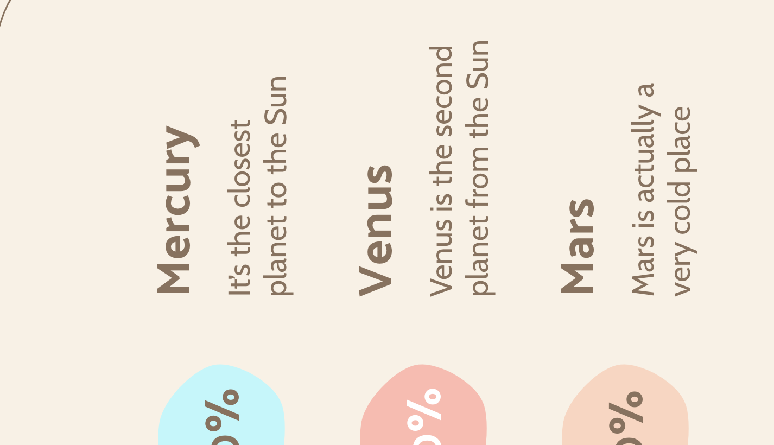
Mobile app
You can replace the image on the screen with your own work. Just right-click on it and select “Replace image”

Slide 33
Contact us!
Address
Phone
Email
Cell phone
Your address here
+00 000 000 000
Your email address here
+00 000 000 000

Slide 34
Thanks!
Do you have any questions?
youremail@freepik.com
+91 620 421 838
yourcompany.com
Please keep this slide for attribution

Slide 35
Academy icon pack

Slide 36
Alternative Resources

