Slide 1

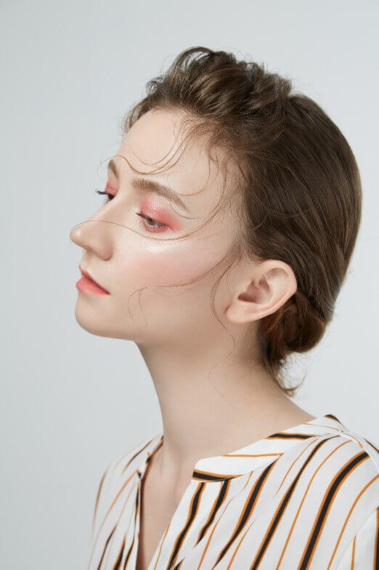
Powerpoint
Keynote
Google Slides
Free
PPT templates
>
FASHION REPORT

Slide 2
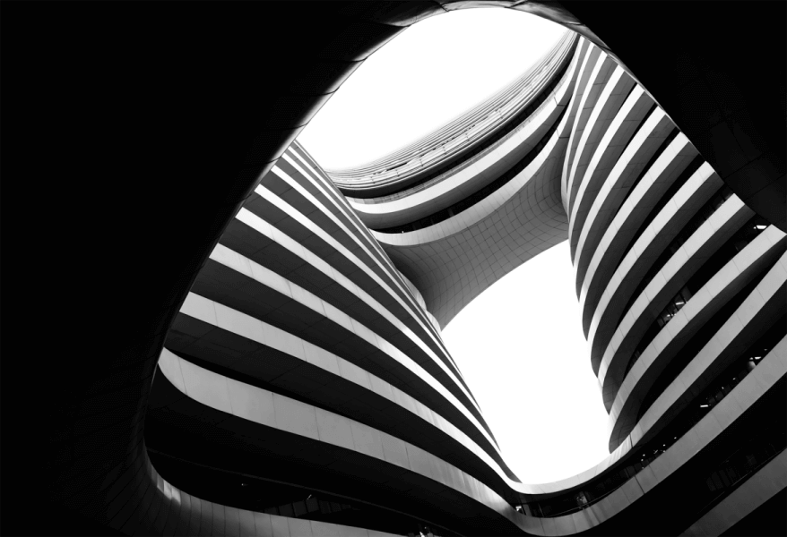
Contents
01
02
03
04
Text here
Text here
Text here
Text here

Slide 3
SOON
ONE
Unified fonts make reading more fluent.
Theme color makes PPT more convenient to change.
Adjust the spacing to adapt to Chinese typesetting, use the reference line in PPT.
>

Slide 4

Unified fonts make reading more fluent.
Theme color makes PPT more convenient to change.
Adjust the spacing to adapt to Chinese typesetting, use the reference line in PPT.
01.Text here
02.Text here
Copy paste fonts. Choose the only option to retain text.
……
Copy paste fonts. Choose the only option to retain text.
……

Slide 5

Unified fonts make reading more
fluent.
Theme color makes PPT more convenient to change.
Adjust the spacing to adapt to Chinese typesetting, use the reference line in PPT.
Copy paste fonts. Choose the only option to retain text……
Copy paste fonts. Choose the only option to retain text……
Copy paste fonts. Choose the only option to retain text……

Slide 6





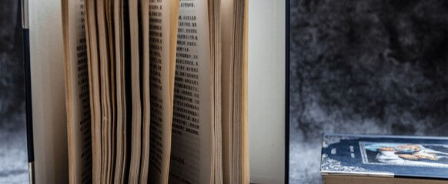
Text here
Text here
Text here
Copy paste fonts. Choose the only option to retain text……
Copy paste fonts. Choose the only option to retain text……
Copy paste fonts. Choose the only option to retain text……
Text here
Text here
Text here
Copy paste fonts. Choose the only option to retain text……
Copy paste fonts. Choose the only option to retain text……
Copy paste fonts. Choose the only option to retain text……

Slide 7

Unified fonts make reading more fluent. Theme color makes PPT more convenient to change. Adjust the spacing to adapt to Chinese typesetting, use the reference line in PPT……
Unified fonts make reading more fluent. Theme color makes PPT more convenient to change. Adjust the spacing to adapt to Chinese typesetting, use the reference line in PPT……
Unified fonts make reading more fluent. Theme color makes PPT more convenient to change. Adjust the spacing to adapt to Chinese typesetting, use the reference line in PPT……

Slide 8
SOON
TWO
Unified fonts make reading more fluent.
Theme color makes PPT more convenient to change.
Adjust the spacing to adapt to Chinese typesetting, use the reference line in PPT.
>

Slide 9

Unified fonts make reading more fluent.
Theme color makes PPT more convenient to change.
Adjust the spacing to adapt to Chinese typesetting, use the reference line in PPT.
03.Text here
02.Text here
Copy paste fonts. Choose the only option to retain text.
……
01.Text here
Copy paste fonts. Choose the only option to retain text.
……
Copy paste fonts. Choose the only option to retain text.
……

Slide 10

Supporting text here.
Unified fonts make reading
more fluent.
01
02
03
Text here
Text here
Text here
Copy paste fonts. Choose the only option to retain text.
……
Copy paste fonts. Choose the only option to retain text.
……
Copy paste fonts. Choose the only option to retain text.
……

Slide 11

Text
Text
Text
Text
Text
Text
Unified fonts make reading more fluent.
Theme color makes PPT more convenient to change.
Adjust the spacing to adapt to Chinese typesetting, use the reference line in PPT.

Slide 12
Unified fonts make reading more fluent.
Text here
Copy paste fonts. Choose the only option to retain text.….
Text here
Copy paste fonts. Choose the only option to retain text.….

Slide 13
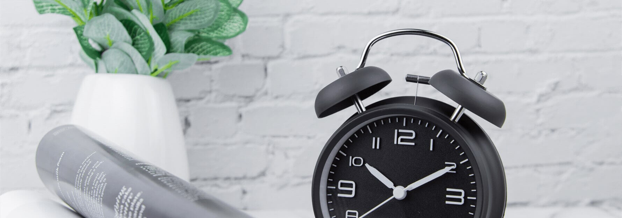
Unified fonts make
reading more fluent.
Unified fonts make reading more fluent. Theme color makes PPT more convenient to change. Adjust the spacing to adapt to Chinese typesetting, use the reference line in PPT……
Unified fonts make reading more fluent. Theme color makes PPT more convenient to change. Adjust the spacing to adapt to Chinese typesetting, use the reference line in PPT……
Unified fonts make reading more fluent. Theme color makes PPT more convenient to change. Adjust the spacing to adapt to Chinese typesetting, use the reference line in PPT……

Slide 14
SOON
THREE
Unified fonts make reading more fluent.
Theme color makes PPT more convenient to change.
Adjust the spacing to adapt to Chinese typesetting, use the reference line in PPT.
>

Slide 15
Unified fonts make reading more fluent.
Text here
Text here
Text here
Text here
Copy paste fonts. Choose the only option to retain text.
……
Copy paste fonts. Choose the only option to retain text.
……
Copy paste fonts. Choose the only option to retain text.
……
Copy paste fonts. Choose the only option to retain text.
……

Slide 16

Unified fonts make reading more fluent.
Theme color makes PPT more convenient to change.Adjust the spacing to adapt to Chinese typesetting, use the reference line in PPT.
……
01.Text here
02.Text here
Copy paste fonts. Choose the only option to retain text.
……
Copy paste fonts. Choose the only option to retain text.
……
Copy paste fonts. Choose the only option to retain text.
……
Copy paste fonts. Choose the only option to retain text.
……

Slide 17

Unified fonts make reading more fluent.
Theme color makes PPT more convenient to change.
Adjust the spacing to adapt to Chinese typesetting, use the reference line in PPT.
Supporting text here.
Text here
Copy paste fonts. Choose the only option to retain text.
……
Text here
Copy paste fonts. Choose the only option to retain text.
……

Slide 18

Unified fonts make reading
more fluent.
01.Text here
Copy paste fonts. Choose the only option to retain text.
……
02.Text here
Copy paste fonts. Choose the only option to retain text.
……

Slide 19
SOON
FOUR
Unified fonts make reading more fluent.
Theme color makes PPT more convenient to change.
Adjust the spacing to adapt to Chinese typesetting, use the reference line in PPT.
>

Slide 20
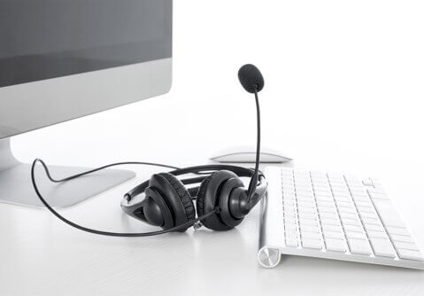



Unified fonts make
reading more fluent.
Theme color makes PPT more convenient to change.
Adjust the spacing to adapt to Chinese typesetting, use the reference line in PPT.
Text here
Text here
Text here
Text here
Supporting text here.
……
Supporting text here.
……
Text here
Text here

Slide 21
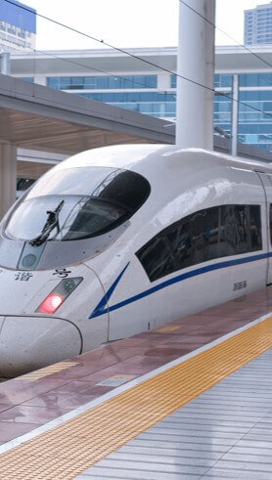
Text here
Text here
Copy paste fonts. Choose the only option to retain text.
……
Copy paste fonts. Choose the only option to retain text.
……
Copy paste fonts. Choose the only option to retain text.
……
Copy paste fonts. Choose the only option to retain text.
……
220,526K
360,789K

Slide 22
Unified fonts make reading more fluent.
30,000K
50,000K
60,000K
80,000K
2018 Q1
2018 Q2
2018 Q3
2018 Q4
Text here
Text here
Text here
Text here
Copy paste fonts. Choose the only option to retain text.
…...
Copy paste fonts. Choose the only option to retain text.
…...
Copy paste fonts. Choose the only option to retain text.
…...
Copy paste fonts. Choose the only option to retain text.
…...
PPT模板 http://www.1ppt.com/moban/

Slide 23
Unified fonts make reading more fluent.
Theme color makes PPT more convenient to change.
Adjust the spacing to adapt to Chinese typesetting, use the reference line in PPT.
Text here
Text here
Text here
Text here
Copy paste fonts. Choose the only option to retain text.
……
Copy paste fonts. Choose the only option to retain text.
……
Copy paste fonts. Choose the only option to retain text.
……
Copy paste fonts. Choose the only option to retain text.
……

Slide 24

Text here
Text here
Text here
$40/month
$20/month
$15/month
Copy paste fonts. Choose the only option to retain text.
……
Copy paste fonts. Choose the only option to retain text.
……
Copy paste fonts. Choose the only option to retain text.
……

Slide 25
Powerpoint
Keynote
Google Slides
Thanks
>
FASHION REPORT

Slide 26
Please follow us for more information:
https://www.jpppt.com/
www.freeppt7.com
Pics: www.Pixabay.com
If you liked the presentation and want to thank, you can follow me on social networks ☺
https://www.instagram.com/slidesfree/
https://www.facebook.com/freeppt7/
https://www.facebook.com/groups/best.PowerPoint.templates
https://www.youtube.com/channel/UCdDW77rhEfG4hzWmlBBnfTQ
https://twitter.com/freeppt7_com

Slide 27
Fully Editable Icon Sets: A

Slide 28
Fully Editable Icon Sets: B

Slide 29
Fully Editable Icon Sets: C

