Slide 1
C
LOGO
High-end
FREE PPT TEMPLATE
Insert the Subtitle of Your Presentation
Report : jpppt.com
https://www.freeppt7.com

Slide 2
Content
1
Add the title text
2
Add the title text
3
Add the title text
4
Add the title text

Slide 3
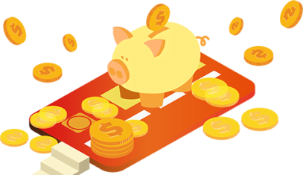
1
Financial investment
Gentle to have, but not compromise, I want to be in quiet, not strong. The life most of the time, commitments equals to constrain, reluctantly we yearn for bound.
FINANCIAL

Slide 4
The text title
Gentle to have, but not compromise, I want to be in quiet, not strong. The life most of the time, commitments equals to constrain.
title
title
I'm just a sunflower, waiting for belong to me only sunshine.
I'm just a sunflower, waiting for belong to me only sunshine.

Slide 5
Enter the title
subheading
Gentle to have, but not compromise, I want to be in quiet, not strong. The life most of the time.
Enter the title
subheading
Gentle to have, but not compromise, I want to be in quiet, not strong. The life most of the time.

Slide 6
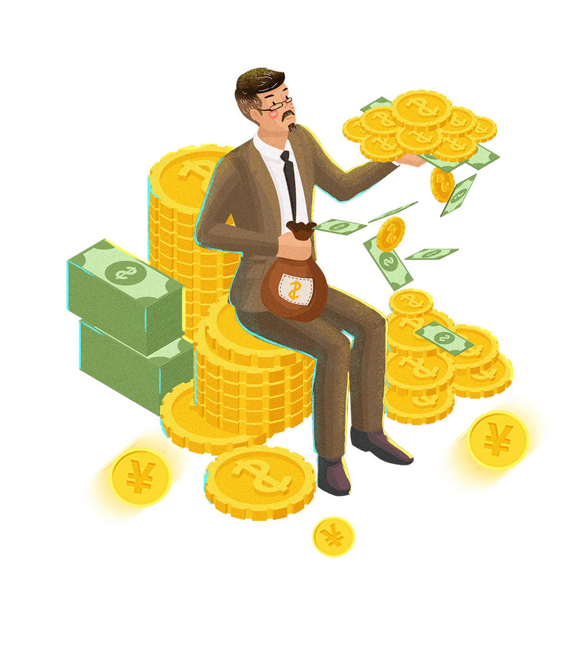
Enter the title
Enter the title
I'm just a sunflower, waiting for belong to me only sunshine.
I'm just a sunflower, waiting for belong to me only sunshine.
Enter the title
Enter the title
I'm just a sunflower, waiting for belong to me only sunshine.
I'm just a sunflower, waiting for belong to me only sunshine.

Slide 7
The title text
45
01
Gentle to have, but not compromise, I want to be in quiet, not strong. The life most of the time.
55
60
02
The life most of the time, commitments equals to constrain, reluctantly we yearn for bound.
40
25
The life most of the time, commitments equals to constrain, reluctantly we yearn for bound.
03
75

Slide 8
2
Introduction to Financial Management
Gentle to have, but not compromise, I want to be in quiet, not strong. The life most of the time, commitments equals to constrain, reluctantly we yearn for bound.
FINANCIAL

Slide 9
01
02
03
04
Enter the title
Enter the title
Enter the title
Enter the title
I'm just a sunflower, waiting for belong to me only sunshine.
I'm just a sunflower, waiting for belong to me only sunshine.
I'm just a sunflower, waiting for belong to me only sunshine.
I'm just a sunflower, waiting for belong to me only sunshine.

Slide 10
The title text
The life most of the time, commitments equals to constrain, reluctantly we yearn for bound.
The title text
The life most of the time, commitments equals to constrain, reluctantly we yearn for bound.

Slide 11
The title text
The life most of the time, commitments equals to constrain, reluctantly we yearn for bound.

Slide 12
Enter the title
Gentle to have, but not compromise, I want to be in quiet, not strong. The life most of the time, commitments equals to constrain, reluctantly we yearn for bound.
The title text
The title text
The title text
The title text
01
02
03
04
05
06
07
Enter the title
Enter the title
Enter the title
Enter the title
I'm just a sunflower, waiting for belong to me only sunshine.
I'm just a sunflower, waiting for belong to me only sunshine.
I'm just a sunflower, waiting for belong to me only sunshine.
I'm just a sunflower, waiting for belong to me only sunshine.

Slide 13
3
Financial management study
Gentle to have, but not compromise, I want to be in quiet, not strong. The life most of the time, commitments equals to constrain, reluctantly we yearn for bound.
FINANCIAL

Slide 14
Enter the title
The life most of the time, commitments equals to constrain, reluctantly we.
Enter the title
The life most of the time, commitments equals to constrain, reluctantly we.
Enter the title
The life most of the time, commitments equals to constrain, reluctantly we.

Slide 15
The title text
Gentle to have, but not compromise, I want to be in quiet, not strong. The life most of the time.
Enter the title
Enter the title
I'm just a sunflower, waiting for belong to me only sunshine.
I'm just a sunflower, waiting for belong to me only sunshine.

Slide 16
The title text
The title text
The title text
Gentle to have, but not compromise, I want to be in quiet, not strong. The life most of the time.
Gentle to have, but not compromise, I want to be in quiet, not strong. The life most of the time.
Gentle to have, but not compromise, I want to be in quiet, not strong. The life most of the time.

Slide 17
80%
60%
25%
Gentle to have, but not compromise, I want to be in quiet, not strong. The life most of the time.
Gentle to have, but not compromise, I want to be in quiet, not strong. The life most of the time.
The life most of the time, commitments equals to constrain, reluctantly we yearn for bound.

Slide 18
4
Financial summary
Gentle to have, but not compromise, I want to be in quiet, not strong. The life most of the time, commitments equals to constrain, reluctantly we yearn for bound.
FINANCIAL

Slide 19
The title text
Gentle to have, but not compromise, I want to be in quiet, not strong. The life most of the time.
Subheading
90%
Subheading
75%
Subheading
45%

Slide 20
57%
Gentle to have, but not compromise, I want to be in quiet, not strong. The life most of the time.
43%
Gentle to have, but not compromise, I want to be in quiet, not strong. The life most of the time.

Slide 21
The title text
Click here to add content that matches the title.
Gentle to have, but not compromise, I want to be in quiet, not strong. The life most of the time.
Gentle to have, but not compromise, I want to be in quiet, not strong. The life most of the time.

Slide 22
The title text
Gentle to have, but not compromise, I want to be in quiet, not strong. The life most of the time.

Slide 23
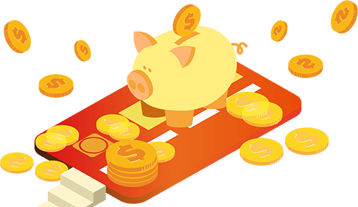
Enter the title
Enter the title
Enter the title
I'm just a sunflower, waiting for belong to me only sunshine.
I'm just a sunflower, waiting for belong to me only sunshine.
I'm just a sunflower, waiting for belong to me only sunshine.
1
3
5
2
4
Enter the title
Enter the title
I'm just a sunflower, waiting for belong to me only sunshine.
I'm just a sunflower, waiting for belong to me only sunshine.

Slide 24
Enter the title
Enter the title
The life most of the time, commitments equals to constrain, reluctantly we.
The life most of the time, commitments equals to constrain, reluctantly we.
Enter the title
The life most of the time, commitments equals to constrain, reluctantly we.
Enter the title
The life most of the time, commitments equals to constrain, reluctantly we.
industryPPTtemplatehttp://www.1ppt.com/hangye/

Slide 25
C
LOGO
THANK YOU！
https://www.freeppt7.com

