Slide 1

LOGO
Free PPT templates
Insert the Subtitle of Your Presentation
as
https://www.freeppt7.com

Slide 2

Contents
Synergistically utilize technically sound portals with, Synergistically utilize technically sound, Synergistically
02
Synergistically utilize technically sound portals with, Synergistically utilize technically sound, Synergistically
01
Synergistically utilize technically sound portals with, Synergistically utilize technically sound, Synergistically
04
Synergistically utilize technically sound portals with, Synergistically utilize technically sound, Synergistically
03

Slide 3
Tittle text
01
Copy paste fonts. Choose the only opt ion to retain text.
Synergistically utilize technically sound portals with, Synergistically utilize technically sound, Synergistically

Slide 4
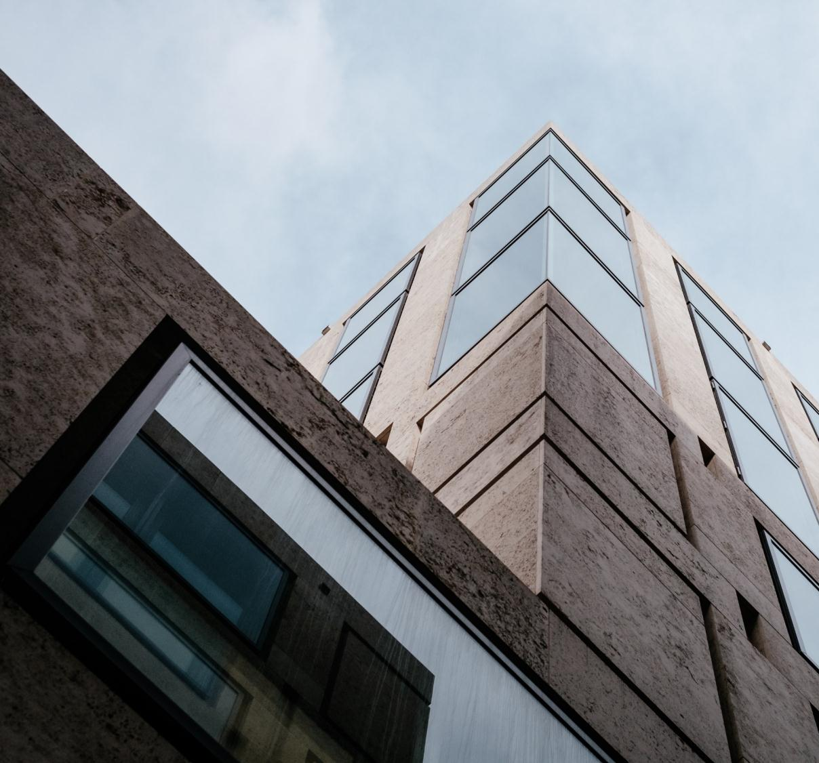
Tittle text
25%
Synergistically utilize technically sound portals with, Synergistically utilize technically sound, Synergistically utilize, Synergistically utilize
Synergistically utilize technically sound portals with, Synergistically utilize technically sound, Synergistically utilize, Synergistically utilize
25%
Synergistically utilize technically sound portals with, Synergistically utilize technically sound, Synergistically utilize, Synergistically utilize
Synergistically utilize technically sound portals with, Synergistically utilize technically sound, Synergistically utilize, Synergistically utilize
25%
Synergistically utilize technically sound portals with, Synergistically utilize technically sound, Synergistically utilize, Synergistically utilize
Synergistically utilize technically sound portals with, Synergistically utilize technically sound, Synergistically utilize, Synergistically utilize

Slide 5

Tittle text
Synergistically utilize technically sound portals with, Synergistically utilize technically sound, Synergistically utilize
Synergistically utilize technically sound portals with, Synergistically utilize technically sound, Synergistically utilize，Synergistically utilize technically sound portals with, Synergistically utilize technically
Synergistically utilize technically sound portals with, Synergistically utilize technically sound, Synergistically utilize

Slide 6
Tittle text
Synergistically utilize technically sound portals with, Synergistically, Synergistically utilize technically sound portals with, Synergistically，Synergistically
01
Synergistically utilize technically sound portals with, Synergistically, Synergistically utilize technically sound portals with, Synergistically，Synergistically
Synergistically utilize technically sound portals with, Synergistically, Synergistically utilize technically sound portals with, Synergistically，Synergistically

Slide 7

Tittle text
Tittle text
Tittle text
Tittle text
Tittle text
Synergistically utilize technically sound portals with, Synergistically utilize technically sound
Synergistically utilize technically sound portals with, Synergistically utilize technically sound
Synergistically utilize technically sound portals with, Synergistically utilize technically sound
Synergistically utilize technically sound portals with, Synergistically utilize technically sound

Slide 8
Tittle text
25%
Synergistically utilize technically sound portals with, Synergistically utilize technically sound, Synergistically utilize, Synergistically utilize
Synergistically utilize technically sound portals with, Synergistically utilize technically sound, Synergistically utilize, Synergistically utilize
Tittle text
45%
25%
Synergistically utilize technically sound portals with, Synergistically utilize technically sound, Synergistically utilize, Synergistically utilize
Synergistically utilize technically sound portals with, Synergistically utilize technically sound, Synergistically utilize, Synergistically utilize
65%
25%
25%
Synergistically utilize technically sound portals with, Synergistically utilize technically sound, Synergistically utilize, Synergistically utilize
Synergistically utilize technically sound portals with, Synergistically utilize technically sound, Synergistically utilize, Synergistically utilize

Slide 9
Tittle text
Synergistically utilize technically sound portals with, Synergistically utilize technically sound, Synergistically utilize, Synergistically utilize
Synergistically utilize technically sound portals with, Synergistically utilize technically sound, Synergistically utilize, Synergistically utilize
Synergistically utilize technically sound portals with, Synergistically utilize technically sound, Synergistically utilize, Synergistically utilize
Synergistically utilize technically sound portals with, Synergistically utilize technically sound, Synergistically utilize, Synergistically utilize
Synergistically utilize technically sound portals with, Synergistically utilize technically sound, Synergistically utilize, Synergistically utilize
Synergistically utilize technically sound portals with, Synergistically utilize technically sound, Synergistically utilize, Synergistically utilize

Slide 10
Tittle text
Synergistically utilize technically sound portals with, Synergistically, Synergistically
February
March
Synergistically utilize technically sound portals with, Synergistically, Synergistically
April
Synergistically utilize technically sound portals with, Synergistically, Synergistically
May
June
Synergistically utilize technically sound portals with, Synergistically, Synergistically
0
10
15
20
25
30

Slide 11
Tittle text
02
Copy paste fonts. Choose the only opt ion to retain text.
Synergistically utilize technically sound portals with, Synergistically utilize technically sound, Synergistically

Slide 12
Tittle text
Synergistically utilize technically sound portals with, Synergistically utilize technically sound, Synergistically utilize, Synergistically utilize
Synergistically utilize technically sound portals with, Synergistically utilize technically sound, Synergistically utilize, Synergistically utilize
Synergistically utilize technically sound portals with, Synergistically utilize technically sound, Synergistically utilize, Synergistically utilize
Synergistically utilize technically sound portals with, Synergistically utilize technically sound, Synergistically utilize, Synergistically utilize

Slide 13
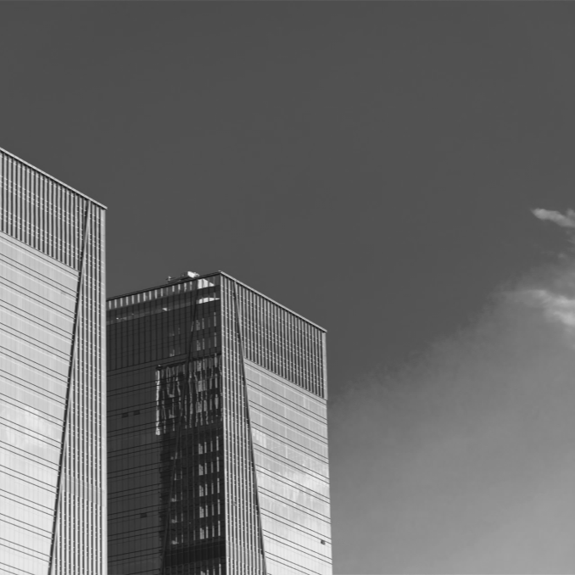
Tittle text
5,000
Synergistically utilize technically sound portals with, Synergistically utilize technically，Synergistically
Synergistically utilize technically sound portals with, Synergistically utilize technically，Synergistically
Synergistically utilize technically sound portals with, Synergistically utilize technically，Synergistically

Slide 14
Tittle text
Location
Hour
Mars
100%
10%
00-06
Venus
75%
60%
07-12
Mercury
60%
75%
13-18
Saturn
10%
100%
19-24
Synergistically utilize technically sound portals with, Synergistically utilize technically，Synergistically utilize technically sound portals with, Synergistically utilize technically
Synergistically utilize technically sound portals with, Synergistically utilize technically，Synergistically utilize technically sound portals with, Synergistically utilize technically
01
02

Slide 15
Tittle text
03
Copy paste fonts. Choose the only opt ion to retain text.
Synergistically utilize technically sound portals with, Synergistically utilize technically sound, Synergistically

Slide 16



Tittle text
Synergistically utilize technically sound portals with, Synergistically utilize technically sound, Synergistically utilize, Synergistically utilize
Synergistically utilize technically sound portals with, Synergistically utilize technically sound, Synergistically utilize, Synergistically utilize
Synergistically utilize technically sound portals with, Synergistically utilize technically sound, Synergistically utilize, Synergistically utilize

Slide 17
Tittle text
Synergistically utilize technically sound portals with, Synergistically utilize technically sound, Synergistically utilize, Synergistically utilize
Synergistically utilize technically sound portals with, Synergistically utilize technically sound, Synergistically utilize, Synergistically utilize
Synergistically utilize technically sound portals with, Synergistically utilize technically sound, Synergistically utilize, Synergistically utilize
Synergistically utilize technically sound portals with, Synergistically utilize technically sound, Synergistically utilize, Synergistically utilize
Synergistically utilize technically sound portals with, Synergistically utilize technically sound, Synergistically utilize, Synergistically utilize

Slide 18

10
9
8
7
6
5
4
3
2
1
Category 1
Category 2
Category 3
Category 4
Category 5

Slide 19
Tittle text
01
02
03
04
Synergistically utilize technically sound portals with
Synergistically utilize technically sound portals with
Synergistically utilize technically sound portals with
Synergistically utilize technically sound portals with
05
06
07
08
Synergistically utilize technically sound portals with
Synergistically utilize technically sound portals with
Synergistically utilize technically sound portals with
Synergistically utilize technically sound portals with

Slide 20
Tittle text
04
Copy paste fonts. Choose the only opt ion to retain text.
Synergistically utilize technically sound portals with, Synergistically utilize technically sound, Synergistically

Slide 21

Synergistically utilize technically sound portals with, Synergistically utilize technically sound, Synergistically. Synergistically utilize technically sound portals with, Synergistically utilize technically sound
Synergistically utilize technically sound portals with, Synergistically utilize technically sound, Synergistically. Synergistically utilize technically sound portals with, Synergistically utilize technically sound
Synergistically utilize technically sound portals with, Synergistically utilize technically sound, Synergistically. Synergistically utilize technically sound portals with, Synergistically utilize technically sound

Slide 22

Tittle text
Synergistically utilize technically sound portals with, Synergisticall
Synergistically utilize technically sound portals with, Synergistically utilize technically，Synergistically utilize technically sound portals with, Synergistically utilize technically
01
Synergistically utilize technically sound portals with, Synergisticall
Synergistically utilize technically sound portals with, Synergistically utilize technically，Synergistically utilize technically sound portals with, Synergistically utilize technically
02

Slide 23
Tittle text
Synergistically utilize technically sound portals with, Synergistically, Synergistically utilize technically sound portals with, Synergistically，Synergistically
02
Synergistically utilize technically sound portals with, Synergistically, Synergistically utilize technically sound portals with, Synergistically，Synergistically
01
Synergistically utilize technically sound portals with, Synergistically, Synergistically utilize technically sound portals with, Synergistically，Synergistically
Synergistically utilize technically sound portals with, Synergistically, Synergistically utilize technically sound portals with, Synergistically，Synergistically
03
04

Slide 24
Tittle text
01
02
03
04
Synergistically utilize technically sound portals with, Synergistically, Synergistically utilize technically sound portals with, Synergistically，Synergistically
Synergistically utilize technically sound portals with, Synergistically, Synergistically utilize technically sound portals with, Synergistically，Synergistically
Synergistically utilize technically sound portals with, Synergistically, Synergistically utilize technically sound portals with, Synergistically，Synergistically
Synergistically utilize technically sound portals with, Synergistically, Synergistically utilize technically sound portals with, Synergistically，Synergistically

Slide 25
LOGO
Thank you
Copy paste fonts. Choose the only opt ion to retain text.
as
https://www.freeppt7.com

