Slide 1
LOGO
Home
Portfolio
About us
Contact us
20XX
FLOWER
Title text
Unified fonts make reading more fluent.Theme color makes PPT more convenient to change.
Report ：jpppt.com
https://www.freeppt7.com

Slide 2
content
01.PART ONE
04.PART FOUR
02.PART TWO
05.PART FIVE
03.PART THREE

Slide 3
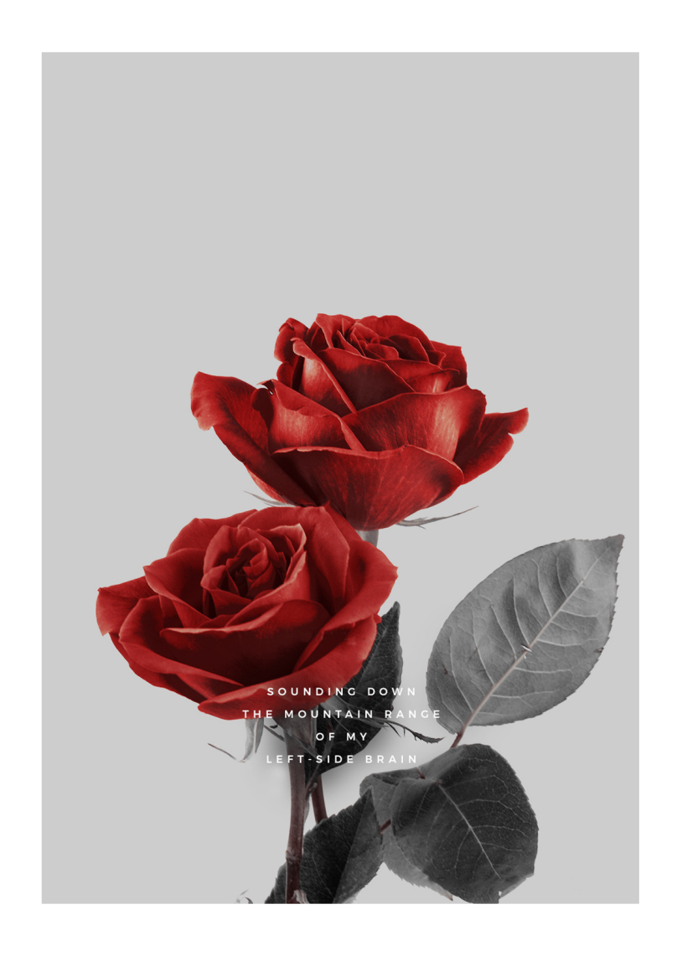
FLOWER
PART ONE
Unified fonts make reading more fluent.Theme color makes PPT more convenient to change.Adjust the spacing to adapt to Chinese typesetting, use the reference line in PPT……

Slide 4
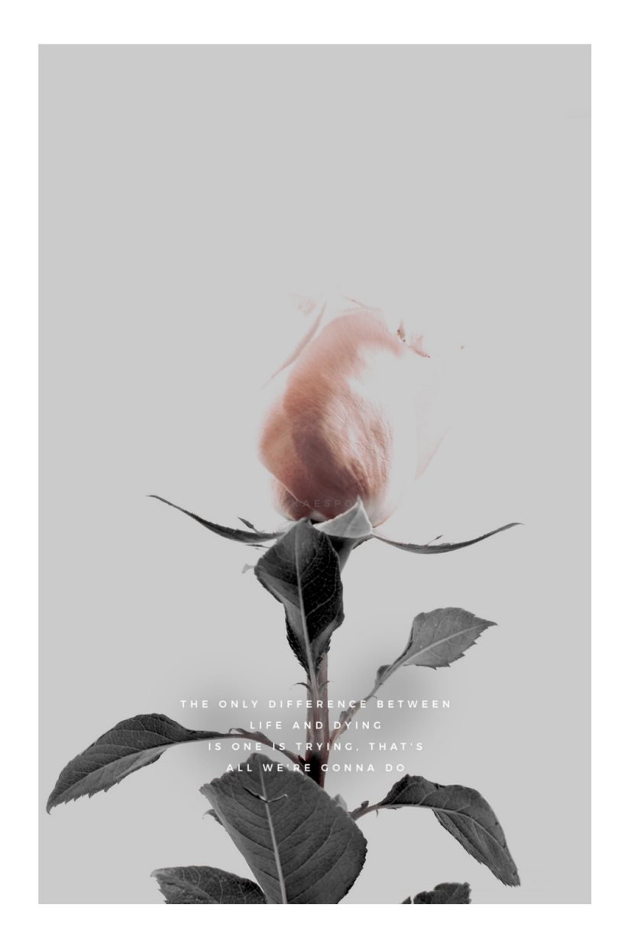
WINNER
“
Unified fonts make reading more fluent.Theme color makes PPT more convenient to change.Adjust the spacing to adapt to Chinese typesetting, use the reference line in PPT……
“

Slide 5
WINNER
Theme color makes PPT more convenient to change.
Adjust the spacing to adapt to Chinese typesetting, use the reference line in PPT.
Copy paste fonts. Choose the only option to retain text.
……

Slide 6
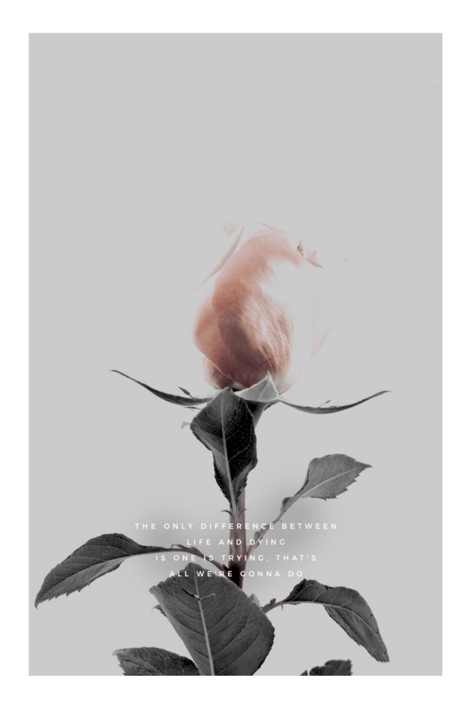
$285
Copy paste fonts. Choose the only option to retain text……
Copy paste fonts. Choose the only option to retain text……
Copy paste fonts. Choose the only option to retain text……

Slide 7
FLOWER
PART TWO
Unified fonts make reading more fluent.Theme color makes PPT more convenient to change.Adjust the spacing to adapt to Chinese typesetting, use the reference line in PPT……

Slide 8
WINNER
Theme color makes PPT more convenient to change.
Adjust the spacing to adapt to Chinese typesetting, use the reference line in PPT.
Theme color makes PPT more convenient to change.
Adjust the spacing to adapt to Chinese typesetting, use the reference line in PPT.

Slide 9
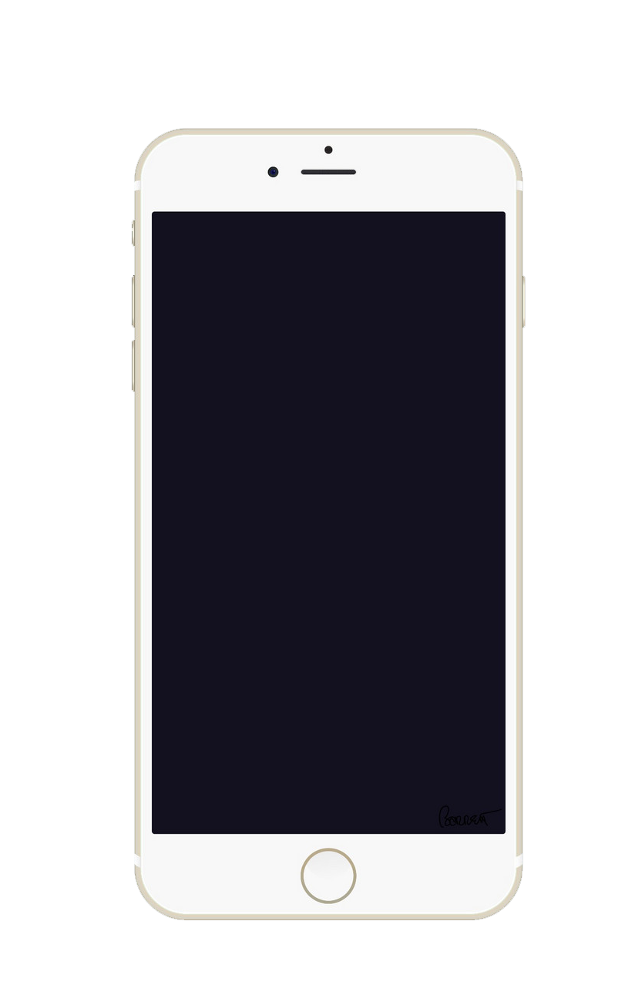
winner
Theme color makes PPT more convenient to change.
Adjust the spacing to adapt to Chinese typesetting, use the reference line in PPT.
Sed ut perspiciatis
62%
Sed ut perspiciatis
92%
Sed ut perspiciatis
84%
Sed ut perspiciatis
90%

Slide 10
Text here
Text here
Text here
Text here
Text here
79%
79%
57%
84%
62%
TEXT HERE
Supporting text here

Slide 11
FLOWER
PART THREE
Unified fonts make reading more fluent.Theme color makes PPT more convenient to change.Adjust the spacing to adapt to Chinese typesetting, use the reference line in PPT……

Slide 12
36%
50%
Text here
Text here
Copy paste fonts. Choose the only option to retain text…...
Copy paste fonts. Choose the only option to retain text…...
Text here
Text here
Copy paste fonts. Choose the only option to retain text…...
Copy paste fonts. Choose the only option to retain text…...
46%
15%
Text here
Text here
Copy paste fonts. Choose the only option to retain text…...
Copy paste fonts. Choose the only option to retain text…...

Slide 13
01
02
03

Slide 14
Text here
01
Copy paste fonts. Choose the only option to retain text…...
Text here
02
Copy paste fonts. Choose the only option to retain text…...
Text here
03
Copy paste fonts. Choose the only option to retain text…...
Text here
04
Copy paste fonts. Choose the only option to retain text…...

Slide 15
FLOWER
PART FOUR
Unified fonts make reading more fluent.Theme color makes PPT more convenient to change.Adjust the spacing to adapt to Chinese typesetting, use the reference line in PPT……

Slide 16
strengths
“
Unified fonts make reading more fluent.Theme color makes PPT more convenient to change.Adjust the spacing to adapt to Chinese typesetting, use the reference line in PPT……

Slide 17
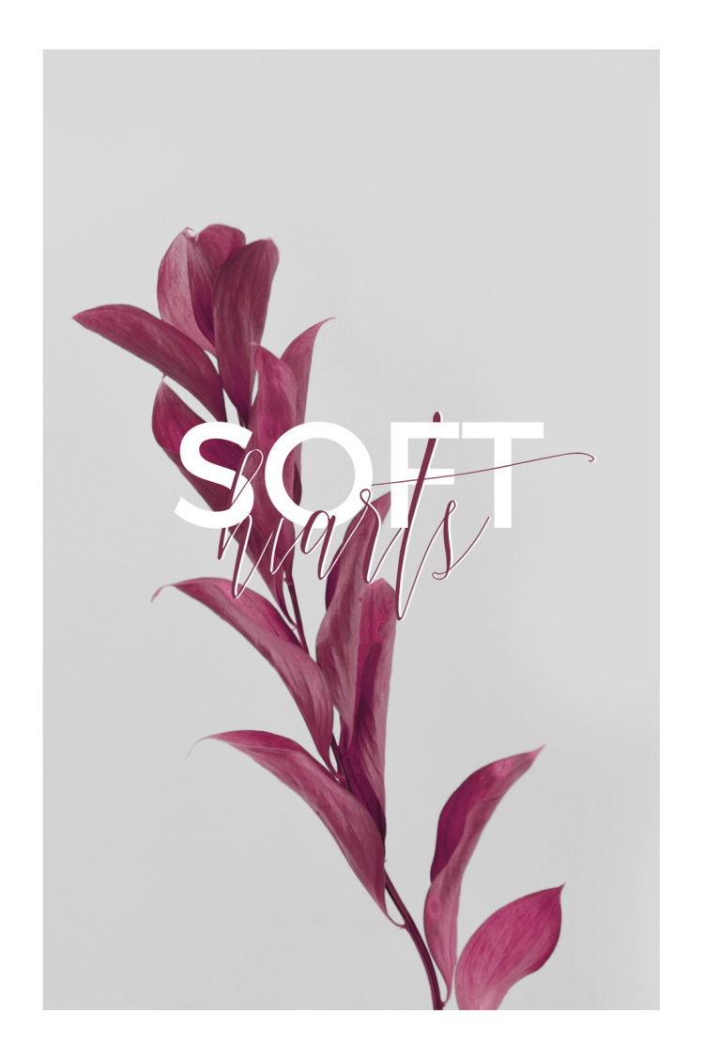
weaknesses
Unified fonts make reading more fluent.Theme color makes PPT more convenient to change.Adjust the spacing to adapt to Chinese typesetting, use the reference line in PPT……
“
PPT模板 http://www.1ppt.com/moban/

Slide 18
opportunities
65%
45%
69%
54%

Slide 19
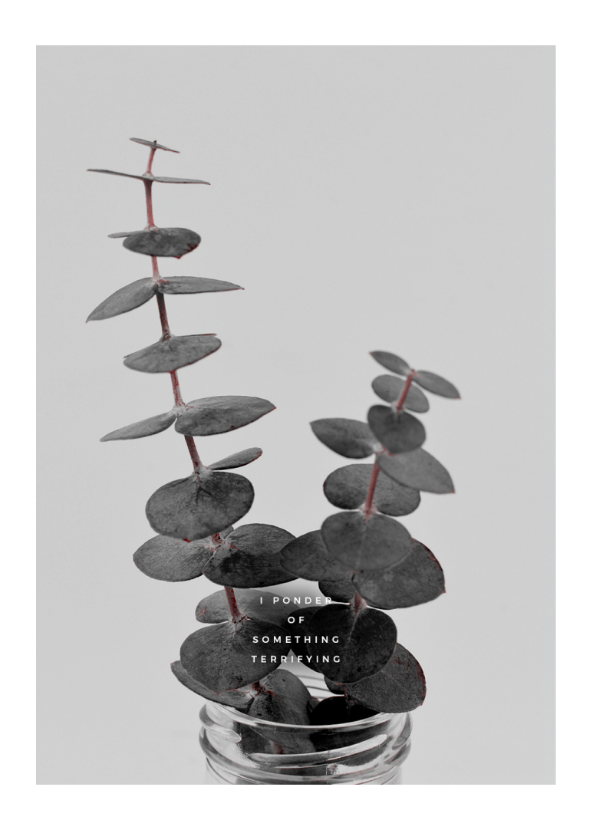
threats
Unified fonts make reading more fluent.Theme color makes PPT more convenient to change.Adjust the spacing to adapt to Chinese typesetting, use the reference line in PPT……
20XX

Slide 20
20XX
WINNER
2016
2015
2014
Unified fonts make reading more fluent.Theme color makes PPT more convenient to change.Adjust the spacing to adapt to Chinese typesetting, use the reference line in PPT……
2013

Slide 21
FLOWER
PART FIVE
Unified fonts make reading more fluent.Theme color makes PPT more convenient to change.Adjust the spacing to adapt to Chinese typesetting, use the reference line in PPT……

Slide 22
1
Text here
FLOWER
Copy paste fonts. Choose the only option to retain text……
2
Text here
Copy paste fonts. Choose the only option to retain text……
3
Text here
Copy paste fonts. Choose the only option to retain text……

Slide 23
Text here
Unified fonts make reading more fluent.
Theme color makes PPT more convenient to change.
Adjust the spacing to adapt to Chinese typesetting, use the reference line in PPT.
Text here
Copy paste fonts. Choose the only option to retain text.
……
Text here
Copy paste fonts. Choose the only option to retain text.
……

Slide 24
Text here
Unified fonts make reading more fluent. Theme color makes PPT more convenient to change. Adjust the spacing to adapt to Chinese typesetting, use the reference line in PPT……

Slide 25
LOGO
Home
Portfolio
About us
Contact us
FLOWER
THANK
YOU
20XX
https://www.freeppt7.com

Slide 26
Please follow us for more information:
https://www.jpppt.com/
www.freeppt7.com
Pics: www.Pixabay.com
If you liked the presentation and want to thank, you can follow me on social networks ☺
https://www.youtube.com/c/Slidesfree
https://www.instagram.com/slidesfree/
https://www.facebook.com/freeppt7/
https://www.facebook.com/groups/best.PowerPoint.templates
https://twitter.com/freeppt7_com

Slide 27
Fully Editable Icon Sets: A

Slide 28
Fully Editable Icon Sets: B

Slide 29
Fully Editable Icon Sets: C

