Slide 1




LOGO
JAPANESE STYLE PPT TEMPLATE
Insert the Subtitle of Your Presentation
https://www.freeppt7.com

Slide 2

CONTENTS
Add title text
Click here to add your title
Add title text
Click here to add your title
Add title text
Click here to add your title
Add title text
Click here to add your title

Slide 3
01
Add title text
Good love makes you see the whole world from one person while bad love makes you abandon the whole world for one person.

Slide 4
Add title text
Add title text
Add title text
Add title text
Add title text
When a cigarette falls in love with a match,it is destined to be hurt.When a cigarette falls in love with a match,it is destined to be hurt.
When a cigarette falls in love with a match,it is destined to be hurt.When a cigarette falls in love with a match,it is destined to be hurt.
When a cigarette falls in love with a match,it is destined to be hurt.When a cigarette falls in love with a match,it is destined to be hurt.
When a cigarette falls in love with a match,it is destined to be hurt.When a cigarette falls in love with a match,it is destined to be hurt.

Slide 5
Add title text
If they throw stones at you, don’t throw back, use them to build your own foundation instead.
01
If they throw stones at you, don’t throw back, use them to build your own foundation instead.
If they throw stones at you, don’t throw back, use them to build your own foundation instead.
05
02
Add title text
If they throw stones at you, don’t throw back, use them to build your own foundation instead.
04
03
If they throw stones at you, don’t throw back, use them to build your own foundation instead.

Slide 6


Add title text
Add title text
If they throw stones at you, don’t throw back, use them to build your own foundation instead.
Add title text
If they throw stones at you, don’t throw back, use them to build your own foundation instead.
Add title text
If they throw stones at you, don’t throw back, use them to build your own foundation instead.

Slide 7
Add title text
Add title
Add title text
When a cigarette falls in love with a match,it is destined to be hurt.
Add title text
If they throw stones at you, don’t throw back, use them to build your own foundation instead.
If they throw stones at you, don’t throw back, use them to build your own foundation instead.If they throw stones at you, don’t throw back, use them to build your own foundation instead.
Add title text
When a cigarette falls in love with a match,it is destined to be hurt.

Slide 8
02
Add title text
Good love makes you see the whole world from one person while bad love makes you abandon the whole world for one person.
PPT模板 http://www.1ppt.com/moban/

Slide 9
Add title text
Add title text
Add title text
If they throw stones at you, don’t throw back, use them to build your own foundation instead.
If they throw stones at you, don’t throw back, use them to build your own foundation instead.
Add title text
Add title text
Add title text
If they throw stones at you, don’t throw back, use them to build your own foundation instead.
If they throw stones at you, don’t throw back, use them to build your own foundation instead.

Slide 10
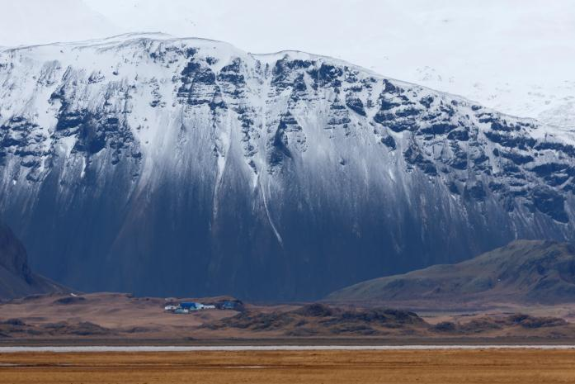
Add title text
Add title text
If they throw stones at you, don’t throw back, use them to build your own foundation instead.
Add title text
If they throw stones at you, don’t throw back, use them to build your own foundation instead.
Add title text
If they throw stones at you, don’t throw back, use them to build your own foundation instead.

Slide 11
Add title text
If they throw stones at you, don’t throw back, use them to build your own foundation instead.
If they throw stones at you, don’t throw back, use them to build your own foundation instead.
Add title
Add title
Add title
Add title
If they throw stones at you, don’t throw back, use them to build your own foundation instead.
If they throw stones at you, don’t throw back, use them to build your own foundation instead.

Slide 12

Add title text
Add title text
If they throw stones at you, don’t throw back, use them to build your own foundation instead.If they throw stones at you, don’t throw back, use them to build your own foundation instead.If they throw stones at you, don’t throw back, use them to build your own foundation instead.

Slide 13
Add title text
Add title text
A
If they throw stones at you, don’t throw back, use them to build your own foundation instead.
Add title text
B
If they throw stones at you, don’t throw back, use them to build your own foundation instead.
C
Add title text
If they throw stones at you, don’t throw back, use them to build your own foundation instead.

Slide 14
03
Add title text
Good love makes you see the whole world from one person while bad love makes you abandon the whole world for one person.

Slide 15
Add title text
Add title text
Add title text
If they throw stones at you, don’t throw back, use them to build your own foundation instead.
If they throw stones at you, don’t throw back, use them to build your own foundation instead.
Add title text
Add title text
If they throw stones at you, don’t throw back, use them to build your own foundation instead.
If they throw stones at you, don’t throw back, use them to build your own foundation instead.
Add title text
Add title text
If they throw stones at you, don’t throw back, use them to build your own foundation instead.
If they throw stones at you, don’t throw back, use them to build your own foundation instead.

Slide 16

Add title text
If they throw stones at you, don’t throw back, use them to build your own foundation instead.
If they throw stones at you, don’t throw back, use them to build your own foundation instead.
Add title text
If they throw stones at you, don’t throw back, use them to build your own foundation instead.

Slide 17
Add title text
Add title
Add title
Add title
Add title
TITLE
TITLE
TITLE
TITLE
If they throw stones at you, don’t throw back, use them to build your own foundation instead.
If they throw stones at you, don’t throw back, use them to build your own foundation instead.
If they throw stones at you, don’t throw back, use them to build your own foundation instead.
If they throw stones at you, don’t throw back, use them to build your own foundation instead.

Slide 18


Add title text
Add title text
If they throw stones at you, don’t throw back, use them to build your own foundation instead.
Add title text
If they throw stones at you, don’t throw back, use them to build your own foundation instead.
Add title text
If they throw stones at you, don’t throw back, use them to build your own foundation instead.

Slide 19
Add title text
Add title
Add title
Add title
If they throw stones at you, don’t throw back, use them to build your own foundation instead.
If they throw stones at you, don’t throw back, use them to build your own foundation instead.
If they throw stones at you, don’t throw back, use them to build your own foundation instead.

Slide 20
04
Add title text
Good love makes you see the whole world from one person while bad love makes you abandon the whole world for one person.

Slide 21
Add title text
START
If they throw stones at you, don’t throw back, use them to build your own foundation instead.If they throw stones at you, don’t throw back, use them to build your own foundation instead.
Add title text
Click here to add content that matches the title.
Add title text
Click here to add content that matches the title.
If they throw stones at you, don’t throw back, use them to build your own foundation instead.If they throw stones at you, don’t throw back, use them to build your own foundation instead.

Slide 22



Add title text
If they throw stones at you, don’t throw back, use them to build your own foundation instead.If they throw stones at you, don’t throw back, use them to build your own foundation instead.
If they throw stones at you, don’t throw back, use them to build your own foundation instead.If they throw stones at you, don’t throw back, use them to build your own foundation instead.
If they throw stones at you, don’t throw back, use them to build your own foundation instead.If they throw stones at you, don’t throw back, use them to build your own foundation instead.

Slide 23
Add title text
If they throw stones at you, don’t throw back, use them to build your own foundation instead.If they throw stones at you, don’t throw back, use them to build your own foundation instead.
Add title text
Click here to add content that matches the title.
Add title text
Click here to add content that matches the title.
If they throw stones at you, don’t throw back, use them to build your own foundation instead.If they throw stones at you, don’t throw back, use them to build your own foundation instead.
END

Slide 24
Add title text
Add title text
Add title text
Add title text
If they throw stones at you, don’t throw back, use them to build your own foundation instead.
If they throw stones at you, don’t throw back, use them to build your own foundation instead.
If they throw stones at you, don’t throw back, use them to build your own foundation instead.

Slide 25
LOGO
THANK YOU
www.freeppt7.com
https://www.freeppt7.com

