Slide 1

LOGO
FREE PPT TEMPLATES
Insert the Subtitle of Your Presentation
Report ：name
Time ：20XX.X.X
https://www.freeppt7.com

Slide 2
CONTENTS
01
Add title text
02
Add title text
The user can demonstrate on a projector or computer, or presentation
The user can demonstrate on a projector or computer, or presentation
03
Add title text
04
Add title text
The user can demonstrate on a projector or computer, or presentation
The user can demonstrate on a projector or computer, or presentation

Slide 3
PART.01
Add title text
Each day is a new beginning Seize new opportunities from now on Each day is
a new beginning Seize new opportunities from now onEach day is a new beginning Seize new opportunities from now on

Slide 4
Add title text
Add title text
Add title text
Add title text
The user can demonstrate on a projector or computer, or presentation and make it film to be used in a wider field
The user can demonstrate on a projector or computer, or presentation and make it film to be used in a wider field

Slide 5

Add title text
The user can demonstrate on a projector or computer, or print the presentation and
Add title text
The user can demonstrate on a projector or computer, or print the presentation and
12
Add title text
%
The user can demonstrate on a projector or computer, or print the presentation and make it into a film to be used

Slide 7

Add title text
The user can demonstrate on a projector or computer, or print the presentation and make it into a film to be used
Add title text
The user can demonstrate on a projector or computer, or print the presentation and make it into a film to be used
PPT下载 http://www.1ppt.com/xiazai/

Slide 8
PART.02
Add title text
Each day is a new beginning Seize new opportunities from now on Each day is
a new beginning Seize new opportunities from now onEach day is a new beginning Seize new opportunities from now on

Slide 9
Add title text
Add
title
The user can demonstrate on a projector or computer, or presentation and make it film to be used in a wider field
Add title text
Add
title
The user can demonstrate on a projector or computer, or presentation and make it film to be used in a wider field

Slide 10
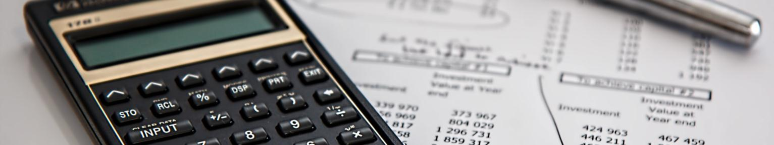
titleAdd
The user can demonstrate on a projector or computer, or print the presentation and make it into a film to be usedThe user can demonstrate on a projector or computer, or print the
titleAdd
The user can demonstrate on a projector or computer, or print the presentation and make it into a film to be usedThe user can demonstrate on a projector or computer, or print the

Slide 11
Add title text
The user can demonstrate on a projector or computer, or print the presentation and
Add title text
The user can demonstrate on a projector or computer, or print the presentation and
20XX
2021
2022
2020
Add title text
The user can demonstrate on a projector or computer, or print the presentation and
Add title text
The user can demonstrate on a projector or computer, or print the presentation and

Slide 12
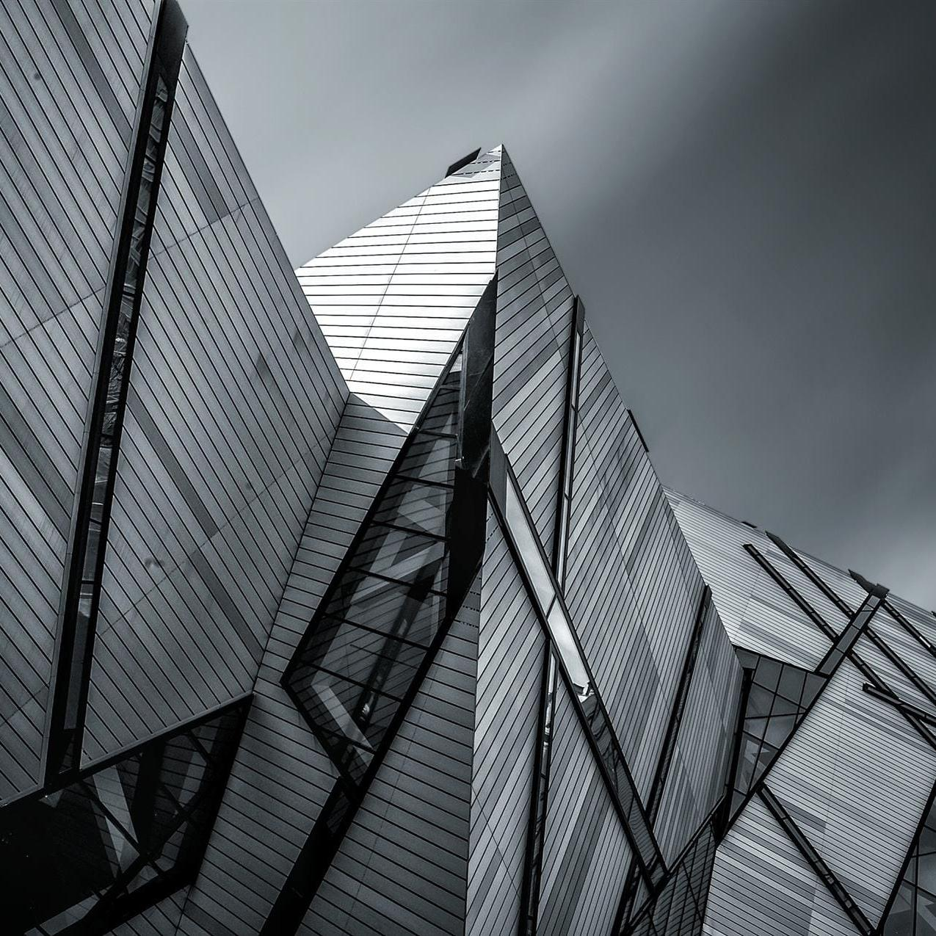
TO
Add title text
The user can demonstrate on a projector or computer, or presentation and make it film to be used in a wider field
Add title text
The user can demonstrate on a projector or computer, or presentation and make it film to be used in a wider field
Add title text
The user can demonstrate on a projector or computer, or presentation and make it film to be used in a wider field

Slide 13
PART.03
Add title text
Each day is a new beginning Seize new opportunities from now on Each day is
a new beginning Seize new opportunities from now onEach day is a new beginning Seize new opportunities from now on

Slide 14
Add title text
Add title text
The user can demonstrate on a projector or computer, or presentation and make it film to be used in a wider field
The user can demonstrate on a projector or computer, or presentation and make it film to be used in a wider field
Add title text
Add title text
The user can demonstrate on a projector or computer, or presentation and make it film to be used in a wider field
The user can demonstrate on a projector or computer, or presentation and make it film to be used in a wider field

Slide 15


Add title text
Add title text
The user can demonstrate on a projector or computer, or print the presentation and make it into a film to be used in a wider field. Using PowerPoint,
The user can demonstrate on a projector or computer, or print the presentation and make it into a film to be used in a wider field. Using PowerPoint,
Add title text:
Add title text:
The user can demonstrate on a projector or computer, or print the presentation and make it into a film to be used
The user can demonstrate on a projector or computer, or print the presentation and make it into a film to be used

Slide 16
Add title text
The user can demonstrate on a projector or computer, or presentation and make it film to be used in a wider field
100
80
78
Add title text
66
The user can demonstrate on a projector or computer, or presentation and make it film to be used in a wider field
60
52
40
35
Add title text
20
The user can demonstrate on a projector or computer, or presentation and make it film to be used in a wider field
Add title
Add title
Add title
Add title

Slide 17
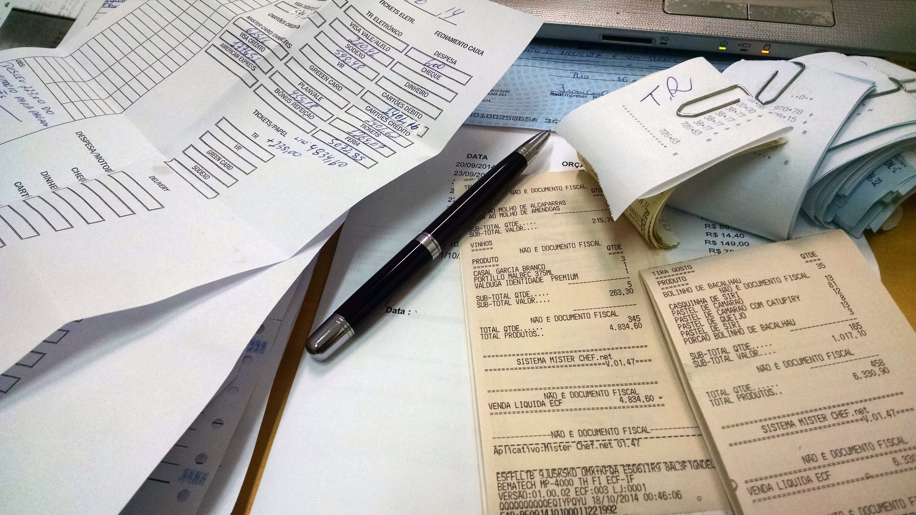
Add title text
The user can demonstrate on a projector or computer, or presentation and make it film to be used in a wider field
Add title text
The user can demonstrate on a projector or computer, or presentation and make it film to be used in a wider field
Add title text
Add title text
The user can demonstrate on a projector or computer, or presentation and make it film to be used in a wider field
The user can demonstrate on a projector or computer, or presentation and make it film to be used in a wider field

Slide 18
PART.04
Add title text
Each day is a new beginning Seize new opportunities from now on Each day is
a new beginning Seize new opportunities from now onEach day is a new beginning Seize new opportunities from now on

Slide 19
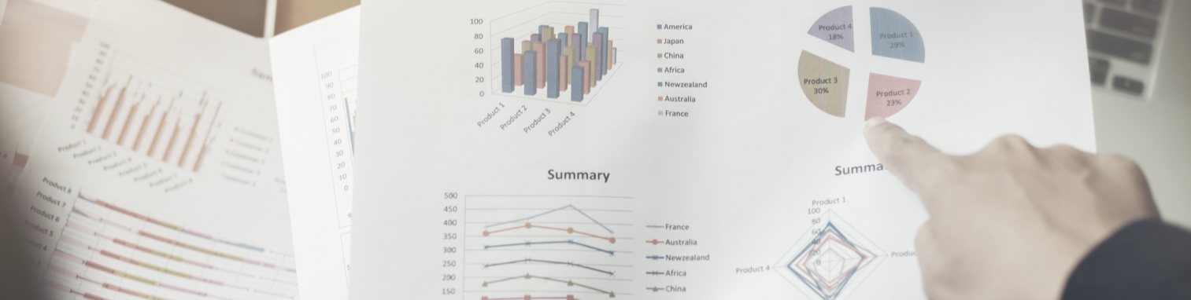
Add title text
Add title text
Add title text
Add title text
print the presentation and make it into a film to be used in a wider field
print the presentation and make it into a film to be used in a wider field
print the presentation and make it into a film to be used in a wider field
print the presentation and make it into a film to be used in a wider field

Slide 20
Add title text
The user can demonstrate on a projector or computer, or presentation and make it film to be used in a wider field
Add title text
The user can demonstrate on a projector or computer, or presentation and make it film to be used in a wider field
Add title text
The user can demonstrate on a projector or computer, or presentation and make it film to be used in a wider field

Slide 21
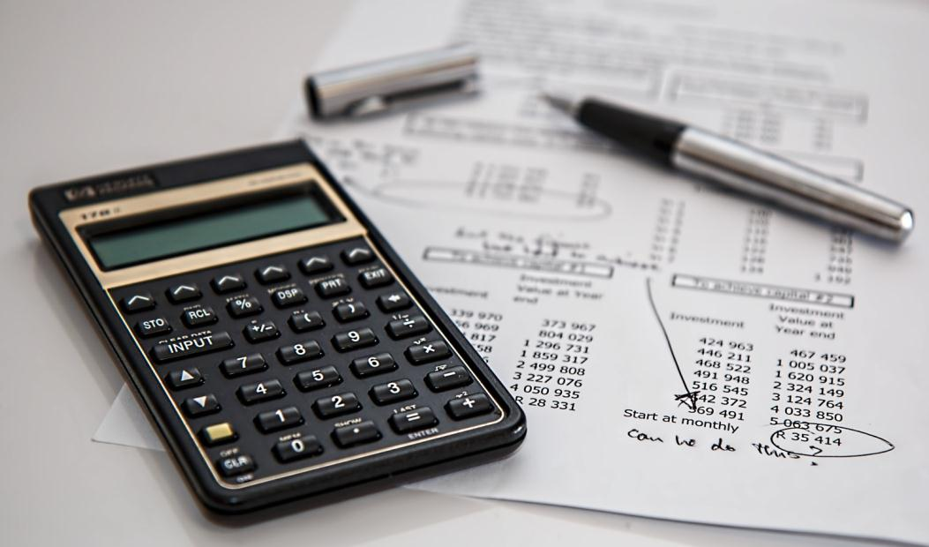
titleAdd
The user can demonstrate on a projector or computer, or print the presentation and make it into a film to be usedThe user can demonstrate on a projector or computer, or print the
titleAdd
The user can demonstrate on a projector or computer, or print the presentation and make it into a film to be usedThe user can demonstrate on a projector or computer, or print the

Slide 22
30%
70%
55%
90%
Add title text
Add title text
Add title text
Add title text
print the presentation and make it into a film to be used in a wider field
print the presentation and make it into a film to be used in a wider field
print the presentation and make it into a film to be used in a wider field
print the presentation and make it into a film to be used in a wider field

Slide 23
LOGO
THANK YOU
Report ：name
Time ：20XX.X.X
https://www.freeppt7.com

Slide 24
Please follow us for more information:
https://www.jpppt.com/
www.freeppt7.com
Pics: www.Pixabay.com
If you liked the presentation and want to thank, you can follow me on social networks ☺
https://www.youtube.com/c/Slidesfree
https://www.instagram.com/slidesfree/
https://www.facebook.com/freeppt7/
https://www.facebook.com/groups/best.PowerPoint.templates
https://twitter.com/freeppt7_com

Slide 25
Fully Editable Icon Sets: A

Slide 26
Fully Editable Icon Sets: B

Slide 27
Fully Editable Icon Sets: C

