Slide 1
LOGO
Free PPT templates
Insert the Subtitle of Your Presentation
https://www.freeppt7.com

Slide 2
CONTENTS
We are all "were", blurred our closest happiness.
1
Add title text
2
Add title text
Gentle to have, but not compromise, I want to be in quiet, not strong.
Gentle to have, but not compromise, I want to be in quiet, not strong.
3
Add title text
4
Add title text
Gentle to have, but not compromise, I want to be in quiet, not strong.
Gentle to have, but not compromise, I want to be in quiet, not strong.

Slide 3
PART ONE
Add title text
Gentle to have, but not compromise, I want to be in quiet, not strong.
The life most of the time, commitments equals to constrain, reluctantly we yearn for bound.
The life most of the time, commitments equals to constrain, reluctantly we yearn for bound.
BUSINESS
We are all "were", blurred our closest happiness.

Slide 4
01.Add title text
BUSINESS REPORT
Would a man running in the rain, also don't want to put into the arms of the false.
Life is not waiting for the storm in the past, but learning to dance in the wind and rain.

Slide 5
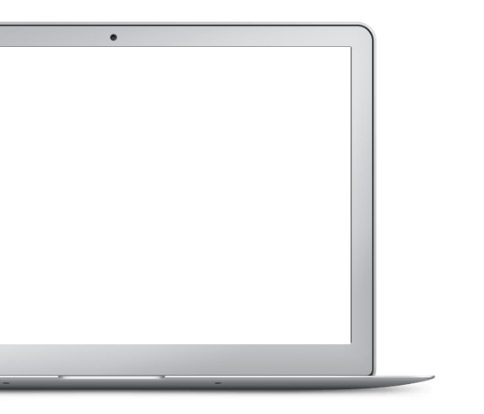
01.Add title text
Add title text
Add title text
Would a man running in the rain, also don't want to put into the.
Would a man running in the rain, also don't want to put into the.
Add title text
Add title text
Would a man running in the rain, also don't want to put into the.
Would a man running in the rain, also don't want to put into the.

Slide 6
01.Add title text
04
Add title text
Would a man running in the rain, also don't want to put into the arms of the false.
03
Life is not waiting for the storm in the past, but learning to dance in the wind and rain.
05
02
01
TITLE
TITLE
TITLE
TITLE
TITLE

Slide 7
01.Add title text
Add title text
Add title text
Would a man running in the rain, also don't want to put into the arms of the false.
Would a man running in the rain, also don't want to put into the arms of the false.
Add title text
Add title text
Would a man running in the rain, also don't want to put into the arms of the false.
Would a man running in the rain, also don't want to put into the arms of the false.

Slide 8
PART TWO
Add title text
Gentle to have, but not compromise, I want to be in quiet, not strong.
The life most of the time, commitments equals to constrain, reluctantly we yearn for bound.
The life most of the time, commitments equals to constrain, reluctantly we yearn for bound.
BUSINESS
We are all "were", blurred our closest happiness.

Slide 9
02.Add title text
Add title text
Add title text
Would a man running in the rain, also don't want to put into the arms of the false..
Would a man running in the rain, also don't want to put into the arms of the false..
Add title text
Add title text
Would a man running in the rain, also don't want to put into the arms of the false..
Would a man running in the rain, also don't want to put into the arms of the false..
PPT模板 http://www.1ppt.com/moban/

Slide 10
02.Add title text
Add title text
Would a man running in the rain, also don't want to put into the arms of the false. For short, do not remember every detail, every mood.
To give you a lot of freedom, may I let you have more.
To give you a lot of freedom, may I let you have more.
To give you a lot of freedom, may I let you have more.
To give you a lot of freedom, may I let you have more.

Slide 11
02.Add title text
Add
Title
Add title text
To give you a lot of freedom, may I let you have more waiting reason to leave.
Add
Title
Add
Title
Add
Title
Would a man running in the rain, also don't want to put into the arms of the false.
Add
Title
To give you a lot of freedom, may I let you have more waiting reason to leave.

Slide 12
02.Add title text
01
02
03
Add title text
Add title text
Add title text
Would a man running in the rain, also don't want to put into the arms of the false. Life is not waiting for the storm in the past.
Would a man running in the rain, also don't want to put into the arms of the false. Life is not waiting for the storm in the past.
Would a man running in the rain, also don't want to put into the arms of the false. Life is not waiting for the storm in the past.

Slide 13
PART THREE
Add title text
Gentle to have, but not compromise, I want to be in quiet, not strong.
The life most of the time, commitments equals to constrain, reluctantly we yearn for bound.
The life most of the time, commitments equals to constrain, reluctantly we yearn for bound.
BUSINESS
We are all "were", blurred our closest happiness.

Slide 14
03.Add title text
BUSINESS REPORT
TITLE
TITLE
TITLE
Would a man running in the rain, also don't want to put into.
Would a man running in the rain, also don't want to put into.
Would a man running in the rain, also don't want to put into.

Slide 15
03.Add title text
BUSINESS REPORT
Would a man running in the rain, also don't want to put into the arms of the false..
Add title text
Add title text
Add title text
Would a man running in the rain, also don't want to put into the arms of the false.
Would a man running in the rain, also don't want to put into the arms of the false.
Would a man running in the rain, also don't want to put into the arms of the false.

Slide 16
03.Add title text
BUSINESS REPORT
Would a man running in the rain, also don't want to put into the arms of the false..
Add title text
Add title text
Would a man running in the rain, also don't want to put into the arms of the false..
Would a man running in the rain, also don't want to put into the arms of the false..

Slide 17
03.Add title text
01
Add title text
Would a man running in the rain, also don't want to put into the arms of the false..
Would a man running in the rain, also don't want to put into the arms of the false.
Would a man running in the rain, also don't want to put into the arms of the false..
02
Add title text
Would a man running in the rain, also don't want to put into the arms of the false.
Would a man running in the rain, also don't want to put into the arms of the false..
03
Add title text
Would a man running in the rain, also don't want to put into the arms of the false..
Would a man running in the rain, also don't want to put into the arms of the false.

Slide 18
PART FOUR
Add title text
Gentle to have, but not compromise, I want to be in quiet, not strong.
The life most of the time, commitments equals to constrain, reluctantly we yearn for bound.
The life most of the time, commitments equals to constrain, reluctantly we yearn for bound.
BUSINESS
We are all "were", blurred our closest happiness.

Slide 19
04.Add title text
Would a man running in the rain, also don't want.
Would a man running in the rain, also don't want.
TITLE
TITLE
Add title text
Add title text
Add title text
Add title text
Would a man running in the rain, also don't want.
TITLE
Would a man running in the rain, also don't want.
TITLE

Slide 20
04.Add title text
BUSINESS
REPORT
Add title text
Would a man running in the rain, also don't want to put into the arms of the false.
Would a man running in the rain, also don't want to put into the arms of the false..
Would a man running in the rain, also don't want to put into the arms of the false..

Slide 21
04.Add title text
Add title text
The life most of the time, commitments equals to constrain, reluctantly we yearn for bound.
TITLE
TITLE
TITLE
Would a man running in the rain, also don't want to put into.
Would a man running in the rain, also don't want to put into.
Would a man running in the rain, also don't want to put into.
35%
60%
55%

Slide 22
04.Add title text
Add title text
Add title text
Would a man running in the rain, also don't want to put into the arms of the false..
Would a man running in the rain, also don't want to put into the arms of the false..
Add title text
Add title text
Would a man running in the rain, also don't want to put into the arms of the false..
Would a man running in the rain, also don't want to put into the arms of the false..

Slide 23
04.Add title text
Add title text
The life most of the time, commitments equals to constrain, reluctantly we yearn for bound.
Add title text
The life most of the time, commitments equals to constrain, reluctantly we yearn for bound.
Add title text
Add title text
The life most of the time, commitments equals to constrain, reluctantly we yearn for bound.
The life most of the time, commitments equals to constrain, reluctantly we yearn for bound.

Slide 24
04.Add title text
Add title text
The life most of the time, commitments equals to constrain, reluctantly we yearn for bound.
Add title text
Add title text
Add title text

Slide 25
LOGO
THANKS
Thank you
Report ：freeppt7.com
Time ：20XX.X
https://www.freeppt7.com

