Slide 1
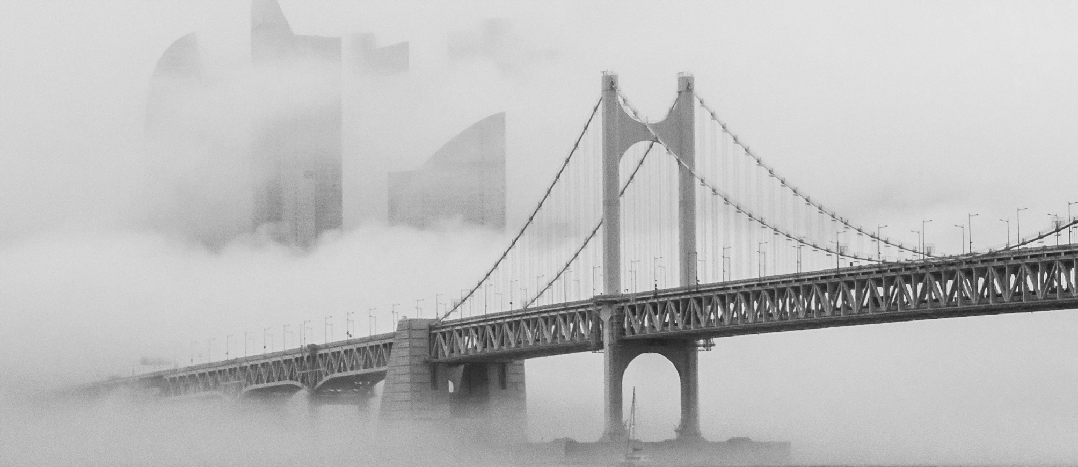
FREE PPT TEMPLATES
WORK PLAN
COMPLETION STATUS
PROBLEM SOLVING
Insert the Subtitle of Your Presentation
https://www.freeppt7.com

Slide 2
01
CONTENT
02
03
04
Add title text
Add title text
Add title text
Add title text

Slide 3
PART ONE
Add title text
Click here to add content, content to match the title.

Slide 4
1.Add title text
Add title text
Add title text
Add title text
WORK PLAN
WORK PLAN
WORK PLAN
Light from the darkness
Light from the darkness
Light from the darkness
Click here to add content, content to match the title.
Click here to add content, content to match the title.
Click here to add content, content to match the title.
PART ONE
PART TWO
PART THREE

Slide 5
1. Add title text
Add title text
Never forget what you are, for surely the world will not. Make it your strength. Then it can never be your weakness.
COMPLETION STATUS
PART ONE
Click here to add content, content to match the title.

Slide 6
1. Add title text
PROBLEM SOLVING
Never forget what you are, for surely the world will not. Make it your strength. Then it can never be your weakness.
Click here to add content, content to match the title.

Slide 7
1. Add title text
Never forget what you are, for surely the world will not.
Make it your strength. Then it can never be your weakness.
Add title text
Add title text
PROBLEM SOLVING
Add title text
Add title text
Never forget what you are, for surely the world will not.
Make it your strength. Then it can never be your weakness.

Slide 8
PART TWO
Add title text
Click here to add content, content to match the title.

Slide 9
2. Add title text
01
02
03
Click here to add content, content to match the title.
Click here to add content, content to match the title.
Click here to add content, content to match the title.
Add title text
Add title text
Add title text
PPT下载 http://www.1ppt.com/xiazai/

Slide 10
2. Add title text
PROBLEM SOLVING
Never forget what you are, for surely the world will not. Make it your strength. Then it can never be your weakness.
25%
Never forget what you are, for surely the world will not.
37%
Make it your strength. Then it can never be your weakness.

Slide 11
2. Add title text
15%
01
PART ONE
Never forget what you are, for surely the world will not.
PART TWO
25%
02
Never forget what you are, for surely the world will not.
PART THREE
35%
03
PART FOUR
Never forget what you are, for surely the world will not.

Slide 12
2. Add title text
01
02
03
04
Never forget what you are,
for surely the world will not. Make it your strength. Then it can never be your weakness.
Never forget what you are,
for surely the world will not. Make it your strength. Then it can never be your weakness.
Never forget what you are,
for surely the world will not. Make it your strength. Then it can never be your weakness.
Never forget what you are,
for surely the world will not. Make it your strength. Then it can never be your weakness.
Add title text
Add title text
Add title text
Add title text

Slide 13
PART THREE
Add title text
Click here to add content, content to match the title.

Slide 14
3. Add title text
ONE
TWO
THREE
FOUR
Add title text
Add title text
Add title text
Add title text
Click here to add content, content to match the title.
Click here to add content, content to match the title.
Click here to add content, content to match the title.
Click here to add content, content to match the title.

Slide 15
3. Add title text
PROBLEM SOLVING
Click here to add content, content to match the title.
Never forget what you are, for surely the world will not. Make it your strength. Then it can never be your weakness.

Slide 16
3. Add title text
Add title text
65%
Add title text
75%
Add title text
50%
Add title text
85%
Never forget what you are, for surely the world will not. Make it your strength. Then it can never be your weakness. Click here to add content, content to match the title.

Slide 17
3. Add title text
Add title
Add title
Add title
PROBLEM SOLVING
Never forget what you are, for surely the world will not. Make it your strength. Then it can never be your weakness.
COMPLETION STATUS
PART ONE
Click here to add content, content to match the title.

Slide 18
PART FOUR
Add title text
Click here to add content, content to match the title.

Slide 19
4. Add title text
PROBLEM SOLVING
Never forget what you are, for surely the world will not. Make it your strength. Then it can never be your weakness.
ONE
TWO
THREE
FOUR
FIVE
For surely the world will not
For surely the world will not
Never forget what you are
Never forget what you are
Never forget what you are

Slide 20
4. Add title text
Add title text
Add title text
Add title text
Click here to add content, content to match the title.
Click here to add content, content to match the title.
Click here to add content, content to match the title.

Slide 21
4. Add title text
Never forget what you are, for surely the world will not.
Make it your strength. Then it can never be your weakness.
Never forget what you are, for surely the world will not.
Make it your strength. Then it can never be your weakness.

Slide 22
4. Add title text
Add title text Never forget what you are,
for surely the world will not. Make it your strength.
Add title text Never forget what you are,
for surely the world will not. Make it your strength.
Add title text Never forget what you are,
for surely the world will not. Make it your strength.
Add title text Never forget what you are,
for surely the world will not. Make it your strength.

Slide 23
4. Add title text
Add title text
Add title text
Never forget what you are,
for surely the world will not. Make it your strength.
Never forget what you are,
for surely the world will not. Make it your strength.
01
02
03
04
Add title text
Add title text
Never forget what you are,
for surely the world will not. Make it your strength.
Never forget what you are,
for surely the world will not. Make it your strength.

Slide 24
4. Add title text
Add title text
Add title text
Add title text
Never forget what you are,
for surely the world will not. Make it your strength.
Never forget what you are,
for surely the world will not. Make it your strength.
Never forget what you are,
for surely the world will not. Make it your strength.

Slide 25
THANK YOU
WORK PLAN
COMPLETION STATUS
PROBLEM SOLVING
https://www.freeppt7.com

