Slide 1
merry christmas
Insert the Subtitle of Your Presentation
https://www.freeppt7.com

Slide 2
CONTENTS
Add title text
Add title text
Add title text
Add title text

Slide 3
Add title text
Click here to add content, content to match the title.

Slide 4
Add title text
December 25th is the day when most Christians around the world commemorate the birth of Jesus. The church didn't have Christmas at the beginning, and it didn't exist until about a hundred years after Jesus ascended to heaven. It is said that the first Christmas was held in 138 AD by the Bishop of Rome, St. Kerry Gate. The first Christmas in church history was in 336 AD. Since the Bible does not clearly record when Jesus was born, Christmas dates vary from place to place. It was not until AD 440 that December 25 was designated by the Holy See as Christmas.

Slide 5
Add title text
In 1607 AD, church leaders from all over the world gathered in Bethlehem to further confirm it. Since then, most Christians in the world regard December 25 as Christmas. In the nineteenth century, with the popularity of Christmas cards and the appearance of Santa Claus, Christmas also became popular. Because the Bible records that Jesus was born at night, the tradition says that the night of December 24 is "Christmas Eve" or "Christmas Eve".

Slide 6
Add title text
Add title text
Add title text
Add title text

Slide 7
Add title text
Santa Claus, also known as Saint Nick, Kris Kringle, Father Christmas or Santa (Santy in Irish English), is a mysterious figure who secretly gives gifts to children on Christmas Eve, and is one of the representative characters of the holiday theme. one. He is generally considered a derivative of the Christian saint, Saint Nicholas.
Legend has it that on the night of December 24th, a mysterious person will fly in the sky on a sleigh pulled by nine reindeer, enter the house through the chimney from door to door, and then secretly put gifts in the socks on the good boy's bedside.

Slide 8
Add title text
refers to an evergreen tree decorated with fir trees or foreign pine trees with candles and decorations. As one of the important elements of Christmas, Add title text originated in Germany in modern times, and gradually became popular all over the world, becoming one of the most famous traditions in Christmas celebration.

Slide 9
Add title text
December 25th is the day when most Christians around the world commemorate the birth of Jesus. The church didn't have Christmas at the beginning, and it didn't exist until about a hundred years after Jesus ascended to heaven.

Slide 10
Add title text
Click here to add content, content to match the title.

Slide 11
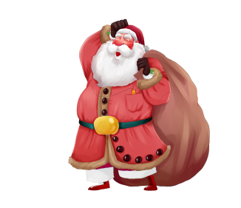
Add title text
Add title text
Click here to add content, content to match the title. Click here to add content, content to match the title. Click here to add content, content to match the title.
Add title text
Add title text
Click here to add content, content to match the title.
Click here to add content, content to match the title.

Slide 12
Add title text
Add title text
Add title text
Add title text
Add title text
Add title text
79%
79%
57%
84%
62%

Slide 13
Click here to add content, content to match the title.
Click here to add content, content to match the title.
Add title text
Click here to add content, content to match the title.
Click here to add content, content to match the title.
节日PPT模板 http://www.1ppt.com/jieri/

Slide 14
Add title text
Click here to add content, content to match the title.

Slide 15
Click here to add content, content to match the title.
Add title text
Click here to add content, content to match the title.

Slide 16
Add title text
Add title text
Add title text
Click here to add content, content to match the title. Click here to add content, content to match the title. Click here to add content, content to match the title.
Click here to add content, content to match the title.
Add title text
Click here to add content, content to match the title.

Slide 17
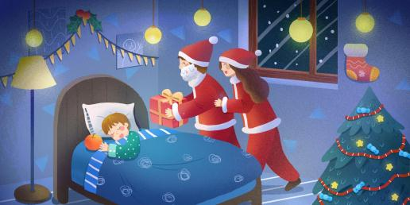
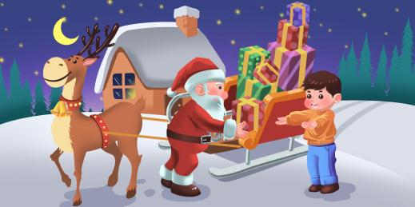
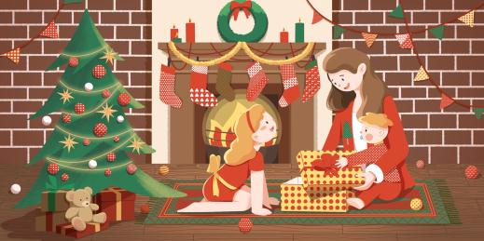
Add title text

Slide 18
Add title text
STEP 01
STEP 02
Replace icon in illustration
Replace icon in illustration
Replace icon in illustration
Click here to add content, content to match the title.
Click here to add content, content to match the title.
Click here to add content, content to match the title.

Slide 19
Add title text
Add title text
Supporting Add title text.
You can use the icon library in to filter and replace existing icon elements with one click.
Add title text
Unified fonts make reading more fluent.
Theme color makes PPT more convenient to change.
Supporting Add title text.
You can use the icon library in to filter and replace existing icon elements with one click.

Slide 20
Add title text
Add title text
Add title text
Click here to add content, content to match the title.
Click here to add content, content to match the title.

Slide 21
Add title text
Click here to add content, content to match the title.

Slide 22
Add title text
Add title text
Add title text
Add title text
Click here to add content, content to match the title.
Click here to add content, content to match the title.
Click here to add content, content to match the title.

Slide 23
Add title text
Add title text
Click here to add content, content to match the title.
Add title text
Click here to add content, content to match the title.

Slide 24
Add title text
Click here to add content, content to match the title.
Add title text
Add title text
Click here to add content, content to match the title.

Slide 25
THANKS
https://www.freeppt7.com

