Slide 1
…………
Free
PPT templates
Insert the Subtitle of Your Presentation
……
Report ：freeppt7.com
………

Slide 2
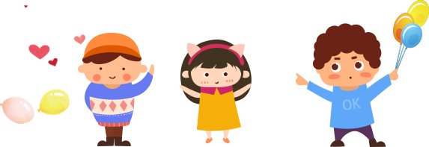
…………
Add title text
Add title text
ONE
TWO
Click here to add content, content to match the title.
Click here to add content, content to match the title.
Add title text
Add title text
……
THREE
FOUR
………
Click here to add content, content to match the title.
Click here to add content, content to match the title.

Slide 3
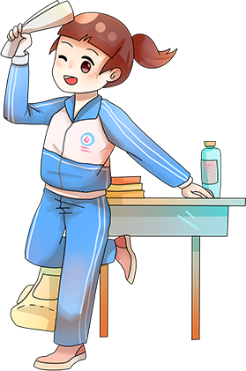
…………
ONE
Add title text
Click here to add content, content to match the title.
……
………

Slide 4
ONE Add title text
…………
Add title text
Click here to add content, content to match the title.
We are all too young, a lot of things don't yet know, don't put the wrong loves when gardeners.
……
………

Slide 5
ONE Add title text
…………
Add title text
We are all too young, a lot of things don't yet know, don't put the wrong loves when gardeners.
Add title text
Add title text
Add title text
……
Please allow me to small proud.
Please allow me to small proud.
Please allow me to small proud.
………
01
02
03

Slide 6
ONE Add title text
…………
Add title text
Add title text
Add title text
Add title text
Add title text
……
………
Add title text
We are all too young, a lot of things don't yet know.
We are all too young, a lot of things don't yet know.
We are all too young, a lot of things don't yet know.

Slide 7
ONE Add title text
…………
Add title text
Click here to add content, content to match the title.
……
………
We are all too young, a lot of things don’t
yet know, don't put the wrong loves when gardeners.

Slide 8
…………
TWO
Add title text
Click here to add content, content to match the title.
……
………

Slide 9
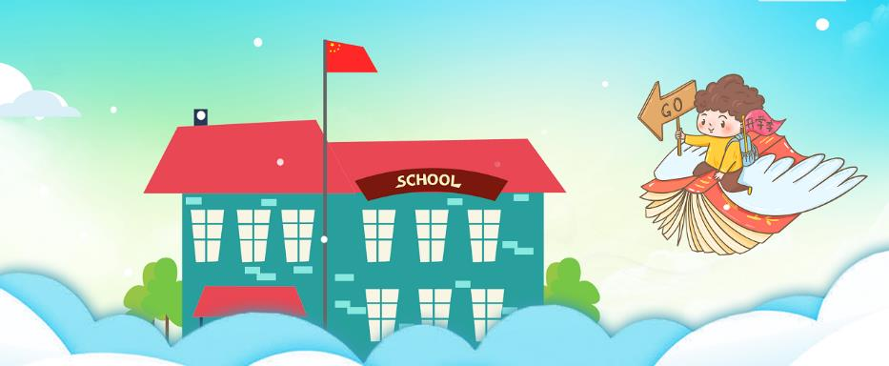
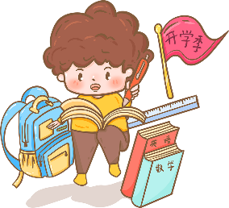
TWO Add title text
…………
……
Add title text
………
We are all too young, a lot of things don't yet know, don't put the wrong loves when gardeners. The life most of the time, commitments equals to constrain, reluctantly we yearn for bound.

Slide 10
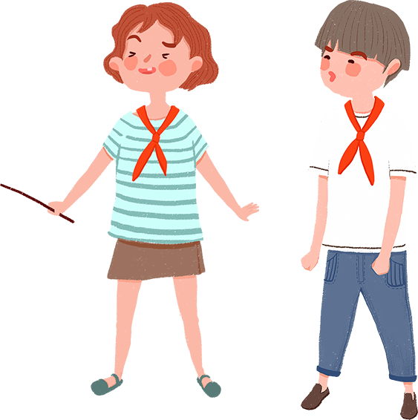
TWO Add title text
…………
Add title text
We are all too young, a lot of things don't yet know, don't put the wrong loves when gardeners.
……
………
The life most of the time, commitments equals to constrain, reluctantly we yearn for bound.
PPT模板 http://www.1ppt.com/moban/

Slide 11
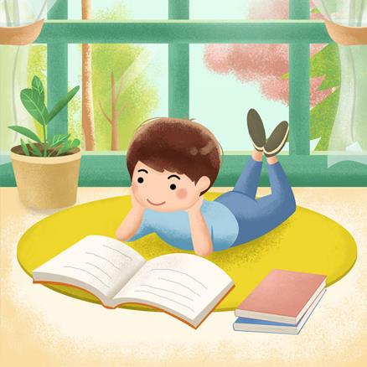
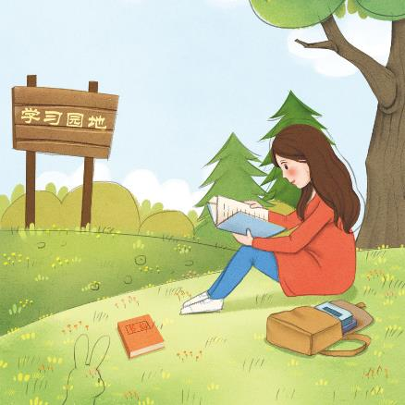
TWO Add title text
…………
Add title text
Click here to add content, content to match the title.
We are all too young, a lot of things don’t yet know, don't put the wrong loves when gardeners.
Add title text
We are all too young, a lot of things don’t yet know, don't put the wrong loves when gardeners.
……
………

Slide 12
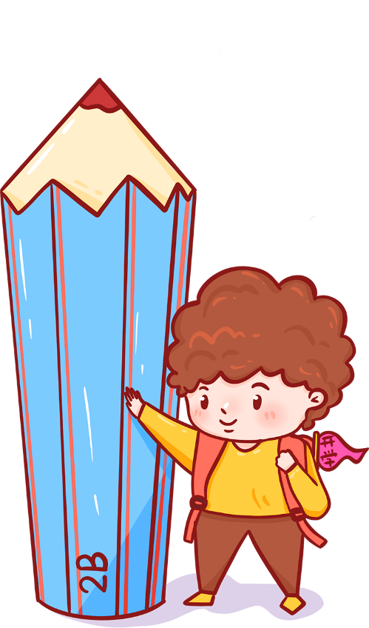
TWO Add title text
…………
Add title text
Click here to add content, content to match the title.
……
We are all too young, a lot of things don’t yet know.
………
Gentle to have, but not compromise, I want to be in quiet.
Click here to add content, content to match the title.

Slide 13
…………
THREE
Add title text
Click here to add content, content to match the title.
……
………

Slide 14
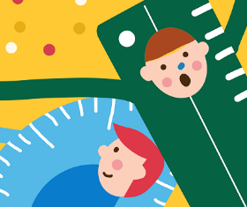
THREE Add title text
…………
Add title text
Click here to add content, content to match the title.
……
………
We are all too young, a lot of things don’t yet know,
don't put the wrong loves when gardeners.

Slide 15
THREE Add title text
…………
Add title text
Add title text
We are all too young, a lot of things don't yet know.
We are all too young, a lot of things don't yet know.
Add title text
Add title text
……
………
We are all too young, a lot of things don't yet know.
We are all too young, a lot of things don't yet know.

Slide 16
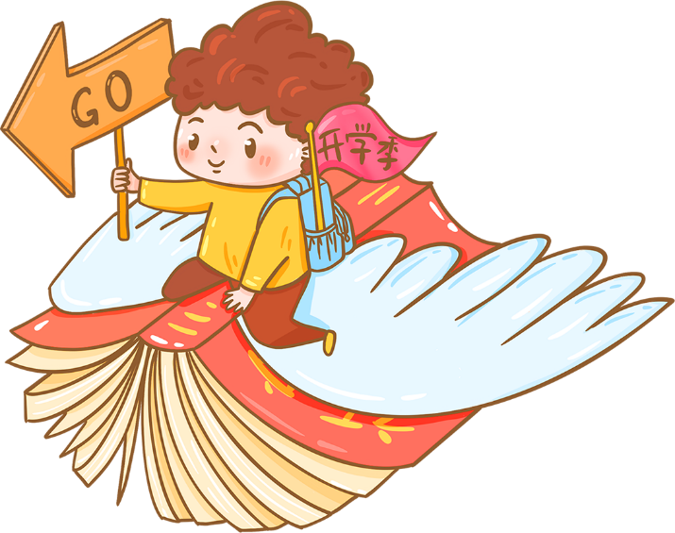
THREE Add title text
…………
01
02
Add title text
Add title text
We are all too young, a lot of things don’t yet know,
don't put the wrong loves when gardeners.
We are all too young, a lot of things don’t yet know,
don't put the wrong loves when gardeners.
……
………

Slide 17
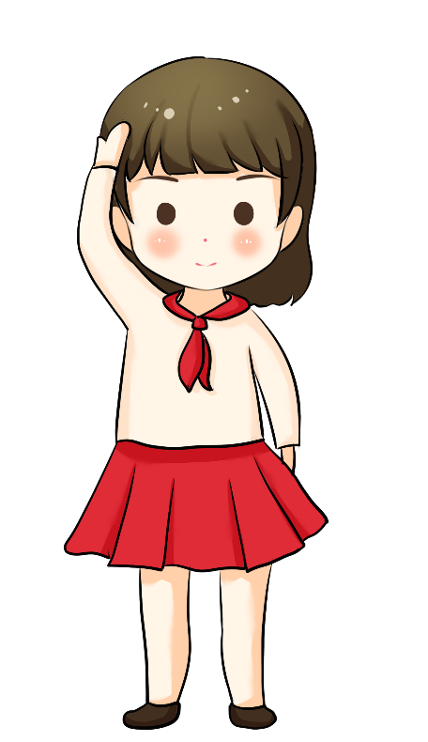
THREE Add title text
…………
We are all too young, a lot of things don’t yet know.
Add title text
We are all too young, a lot of things don’t yet know.
Add title text
We are all too young, a lot of things don’t yet know.
Add title text
……
………
We are all too young, a lot of things don’t yet know.
Add title text

Slide 18
…………
FOUR
Add title text
Click here to add content, content to match the title.
……
………

Slide 19
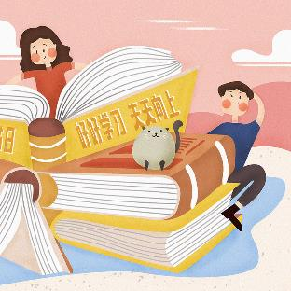
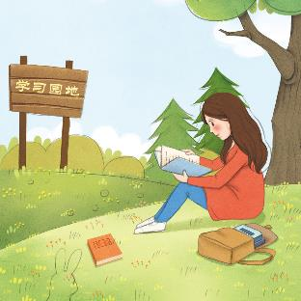
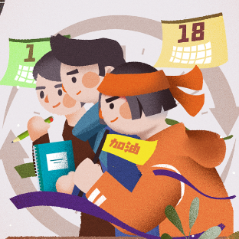
FOUR Add title text
…………
Add title text
Add title text
We are all too young, a lot of things don’t yet know.
We are all too young, a lot of things don’t yet know.
……
………
Add title text
Add title text
We are all too young, a lot of things don’t yet know.
We are all too young, a lot of things don’t yet know.

Slide 20
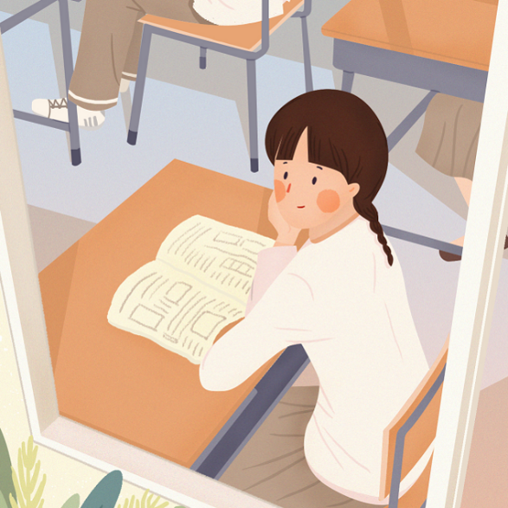
FOUR Add title text
…………
Add title text
We are all too young, a lot of things don’t yet know, don't put the wrong loves when gardeners.
……
Add title text
………
We are all too young, a lot of things don’t yet know, don't put the wrong loves when gardeners.

Slide 21
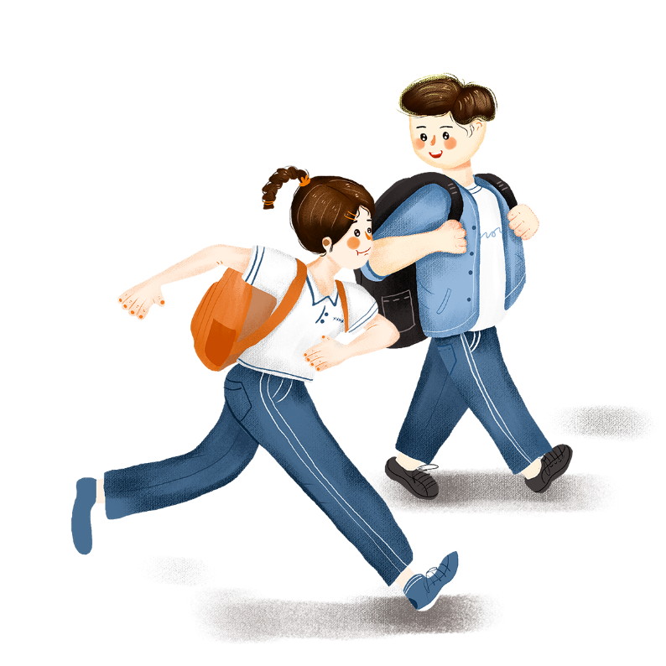
FOUR Add title text
…………
Add title text
Click here to add content, content to match the title.
……
………
We are all too young, a lot of things don’t yet know,
don't put the wrong loves when gardeners.

Slide 22
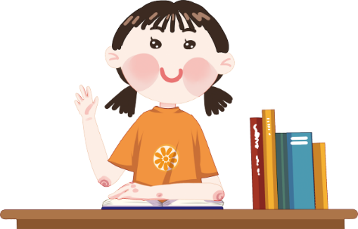
FOUR Add title text
…………
Add title text
Add title text
……
………
We are all too young, a lot of things
don’t yet know, don't put.
We are all too young, a lot of things
don’t yet know, don't put.

Slide 23
FOUR Add title text
…………
Add title text
Click here to add content, content to match the title.
……
We are all too young, a lot of things don’t
yet know, don't put the wrong loves when gardeners.
………

Slide 24
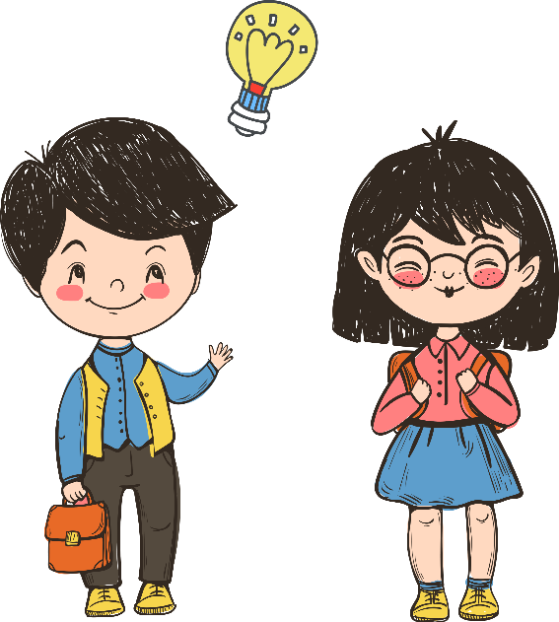
FOUR Add title text
…………
01
02
We are all too young, a lot of things don’t yet know, don't.
We are all too young, a lot of things don’t yet know, don't.
03
04
……
………
We are all too young, a lot of things don’t yet know, don't.
We are all too young, a lot of things don’t yet know, don't.

Slide 25
…………
THANK YOU
……
Report ：freeppt7.com
………

