Slide 1
NOTEBOOK LESSON
Here starts the lesson!

Slide 2
Table of contents!
Overview
Assignment
Topic features
About the topic
Describe here the topic of the section
Describe here the topic of the section
Describe here the topic of the section
Describe here the topic of the section

Slide 3
01
OVERVIEW
You can enter a subtitle here if you need it

Slide 4
Introduction
Neptune is the farthest planet from the Sun and also the fourth-largest by diameter in the entire Solar System

Slide 6
—Someone Famous
Book Title. P52
“This is a quote. Words full of wisdom that someone important said and can make the reader get inspired.”

Slide 8
What is this topic about?
You can explain here what is the topic about
You can explain here what is the topic about
You can explain here what is the topic about
You can explain here what is the topic about
You can explain here what is the topic about
You can replace this picture if you wish

Slide 10
Definition of concepts
Exam content
Mercury
Mars
Saturn
Venus
Mercury is the smallest planet
Despite being red, Mars is a cold place
It’s composed of hydrogen and helium
Venus is the second planet from the Sun

Slide 13
Features of the topic
Mercury
Jupiter
Mars
It’s the closest planet to the Sun
Jupiter is the biggest planet
Venus is the second planet from the Sun
Mars is actually a cold place

Slide 16
10%
50%
40%
Despite being red, Mars is a cold place
Saturn is the only planet
with rings
Venus has a beautiful name, but it’s hot

Slide 18
Practical uses of this subject
Mercury
Jupiter
Mercury is the closest planet to the Sun
Venus is the second planet from the Sun
Jupiter is the biggest planet of them all

Slide 19
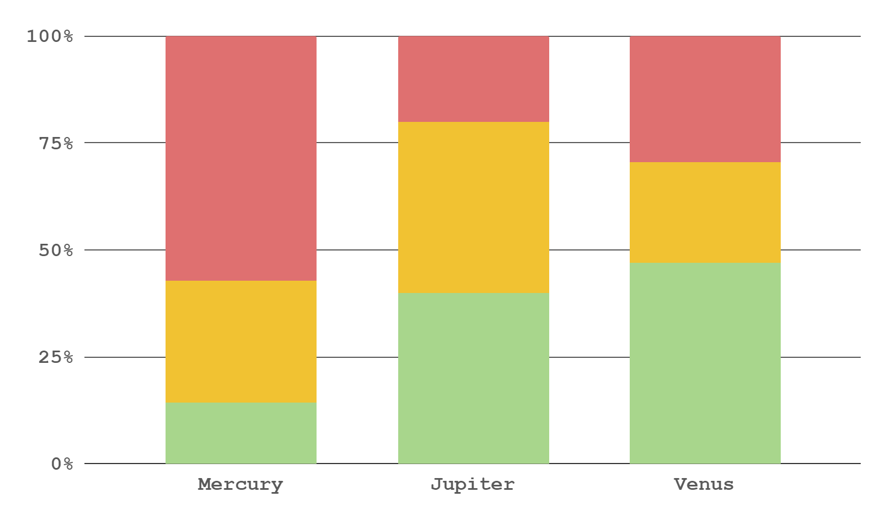
Did you know this?
35%
65%
To modify this graph, click on it, follow the link, change the data and replace this
Mercury is a small planet
Jupiter is a big planet
Factor 1
Factor 2
Factor 3

Slide 20
31,500
Big numbers catch your audience’s attention

Slide 22
Problem
Solution
Neptune is the fourth-largest planet in the Solar System
Jupiter is a gas giant and the biggest planet in the Solar System

Slide 24
Process
Mercury is the smallest planet
Saturn is the ringed planet
Step 1
Step 2
Step 3
Step 4
Venus has a beautiful name
Mars is a very cold place

Slide 28
Insert your multimedia content here
Despite being red, Mars is actually a cold place full of iron oxide dust

Slide 31
Overview diagram
30%
Mercury is a small planet
Venus is a hot planet
Mars is a cold place
Only Saturn has rings

Slide 41
Locations
Saturn is a gas giant
Mars is a cold place

Slide 42
A picture reinforces the concept

Slide 46
Data review
Study 1 | Study 2 | Study 3
0.3 | 1.2 | 4.5
1.4 | 0.6 | 7.8
Study 1 | Study 2 | Study 3
2.5 | 6.9 | 1.6
3.5 | 7.7 | 1.8

Slide 49
Review of concepts
Mercury
Venus
Mars
Jupiter
Saturn
Neptune
Mercury is the
Smallest planet
Venus has a
beautiful name
Mars is actually a cold place
Jupiter is the biggest planet
Saturn is the
ringed one
Neptune is very far from us

Slide 53
Exercise
Venus has a beautiful name and is the second planet from the Sun
Despite being red, Mars is actually a cold place

Slide 57
Assignment
Which planet has a beautiful name and is the second one from the Sun

Slide 59
Thanks!
Do you have any questions? youremail@freepik.com +91 620 421 838 yourcompany.com
Please keep this slide for attribution.

Slide 63
Alternative resources

Slide 65
Resources
Did you like the resources on this template? Get them for free at our other websites
PHOTOS:
Content youngster enjoying time
Teenage student sitting at table with notebook and writing
Side view woman working on laptop
Female teenager reading book in cafe near friends
Happy teen girl at lesson
Girl on armchair reading
Crop student writing in notepad

Slide 66
Resources
VECTORS:
Wooden background with checklist and pen
Open notebook with accessories
Notebook page vector
Collection of leaves and colored notes
Tablet background with hand-drawn learning items
Schedule with nice notes
ets of paper with sticky tape
Assortment of arrows highlighter
Pack of small sticky notes in realistic style

