Slide 1
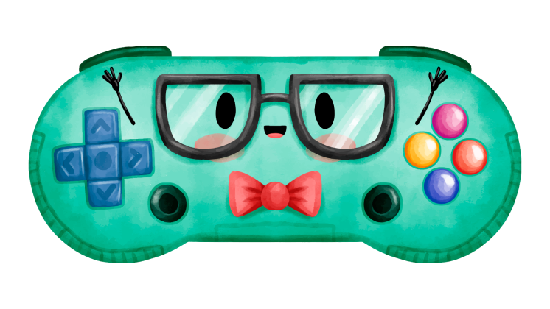
LET’S CELEBRATE
GEEK PRIDE DAY
GEEK
Here is where your presentation begins

Slide 2
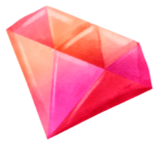
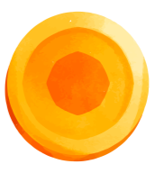
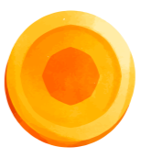
TABLE OF CONTENTS
01
02
GEEK STORY
THE FESTIVITY
04
A TRADITION
FINAL SECTION
03
行业PPT模板http://www.1ppt.com/hangye/
You can describe the topic of the section here
You can describe the topic of the section here
You can describe the topic of the section here
You can describe the topic of the section here

Slide 3
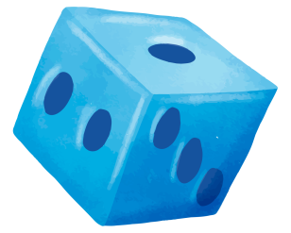
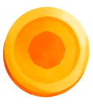
WHOA!
This can be the part of the presentation where you introduce yourself, write your email…

Slide 4
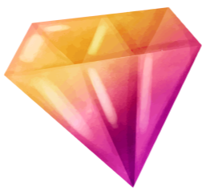
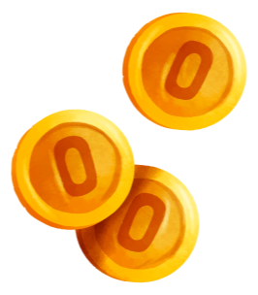
—SOMEONE FAMOUS
“This is a quote, words full of wisdom that someone important said and can make the reader get inspired.”

Slide 5
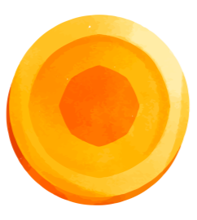
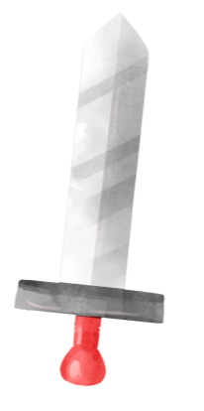
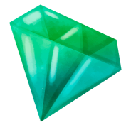
01
GEEK STORY
You can enter a subtitle here if you need it

Slide 6
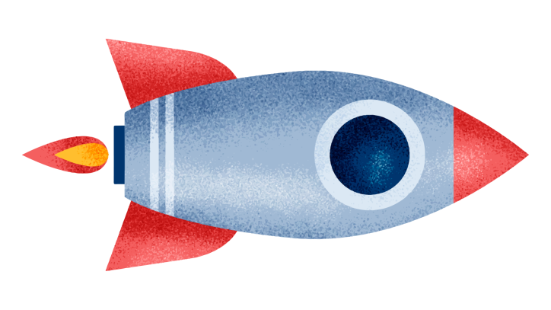
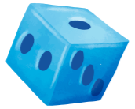
INTRODUCTION
Mercury is the closest planet to the Sun and the smallest one in the Solar System—it’s only a bit larger than the Moon. The planet’s name has nothing to do with the liquid metal

Slide 7
AWESOME WORDS

Slide 8
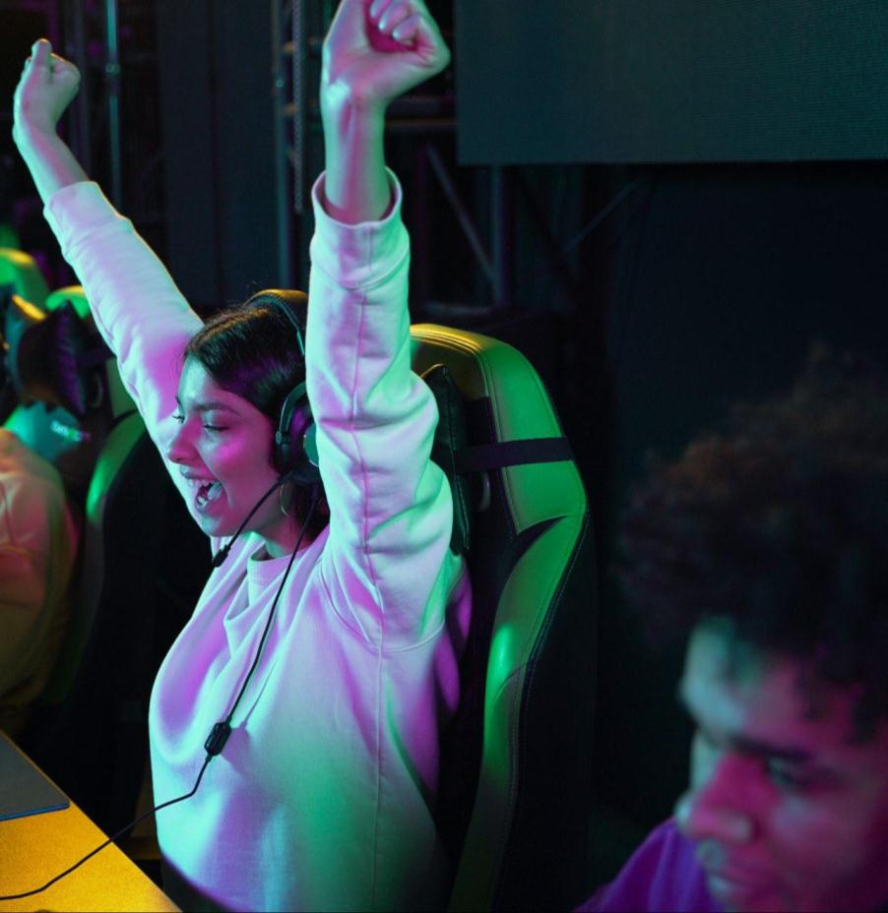
THE GEEK FESTIVITY
Do you know what helps you make your point clear? Lists like this one:
They’re simple
You can organize your ideas clearly
You’ll never forget to buy milk!
And the most important thing: the audience won’t miss the point of your presentation

Slide 9
A LITTLE BIT OF HISTORY
1st
2nd
3rd
4th
1994
2000
2020
202X
Venus is the second planet from the Sun
Despite being red, Mars is a very cold place
Saturn is a gas giant and has several rings
Neptune is the farthest planet from the Sun

Slide 10
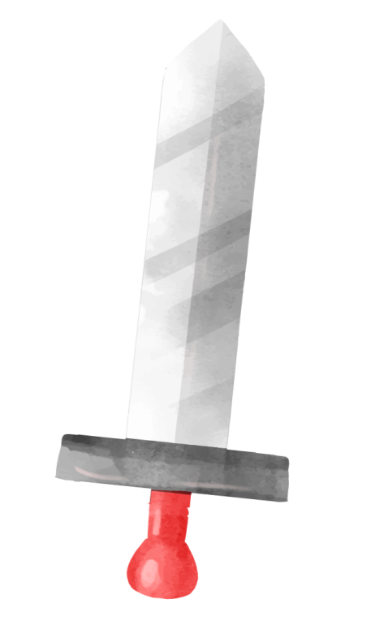
02
FESTIVITY
You can enter a subtitle here if you need it

Slide 11
MAIN EVENTS
MERCURY
VENUS
It’s the closest planet to the Sun and the smallest one in the Solar System
It has a beautiful name and is the second planet from the Sun

Slide 12
LET’S CELEBRATE
VENUS
JUPITER
MARS
SATURN
Venus is the second planet from the Sun
It’s the biggest planet in the Solar System
Despite being red, Mars is a cold place
Saturn is a gas giant and has several rings

Slide 13
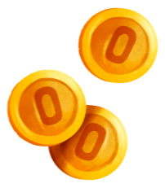
WHERE IS IT CELEBRATED?
MARS
Despite being red, Mars is actually a cold place. It’s full of iron oxide dust

Slide 14
A PICTURE IS WORTH A THOUSAND WORDS

Slide 15
25%
30%
50%
VENUS
MERCURY
MARS
It’s the second planet from the Sun
It’s the closest planet to the Sun
Mars is actually a very cold place

Slide 16
LET’S HAVE FUN
JUPITER
SATURN
MARS
It's the fourth-brightest object in the night sky
It's composed mostly of hydrogen and helium
Mars is actually a very cold place

Slide 17
The most popular holidays
SHOW YOUR GEEK DATA
MARS
JUPITER
30%
30%
Despite being red, Mars is a cold place
It’s the biggest planet in the Solar System
VENUS
SATURN
15%
25%
Venus is the second planet from the Sun
Saturn is a gas giant and has several rings
Follow the link in the graph to modify its data and then paste the new one here. For more info, click here

Slide 18
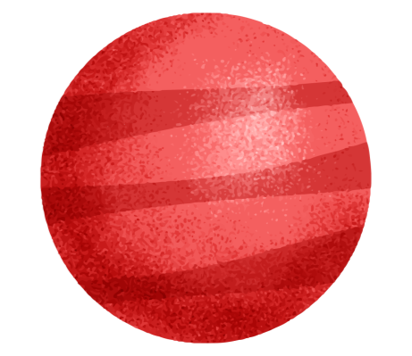
TRADITION
03
You can enter a subtitle here if you need it

Slide 19
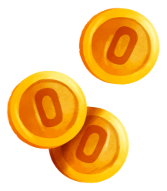
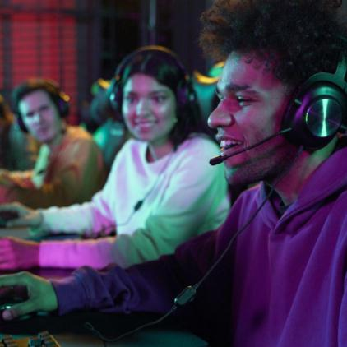
A GEEK TRADITION
VENUS
JUPITER
Venus is the second planet from the Sun
It’s the biggest planet in the Solar System
MARS
SATURN
Despite being red, Mars is a cold place
Saturn is a gas giant and has several rings

Slide 20
HOW TO CELEBRATE GEEK DAY
MERCURY
MARS
SATURN
VENUS
JUPITER
NEPTUNE
Mercury is the closest planet to the Sun
Despite being red, Mars is a cold place
Saturn is a gas giant and has several rings
Venus is the second planet from the Sun
It’s the biggest planet in the Solar System
It’s the farthest planet from the Sun

Slide 21
333,000
386,000 KM
The Sun’s mass compared to Earth’s
Distance between Earth and the Moon

Slide 22
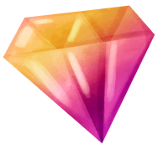
PARTS OF A GEEK ROCKET
JUPITER
It’s the biggest planet in the Solar System
SATURN
Saturn is a gas giant and has several rings

Slide 23
LET’S GO TO THE EVENT
MERCURY
VENUS
MARS
It’s the closest planet to the Sun and the smallest one of them all
It has a beautiful name and is the second planet from the Sun
Despite being red, Mars is actually a cold place. It’s full of iron oxide dust

Slide 24
100,000
Big numbers catch your audience’s attention

Slide 25
SECONDARY EVENTS
MERCURY
VENUS
MARS
JUPITER
SATURN
It’s the closest planet to the Sun
Venus is the second planet from the Sun
Mars is actually a very cold place
It’s the biggest planet of them all
Saturn is a gas giant and has rings

Slide 26
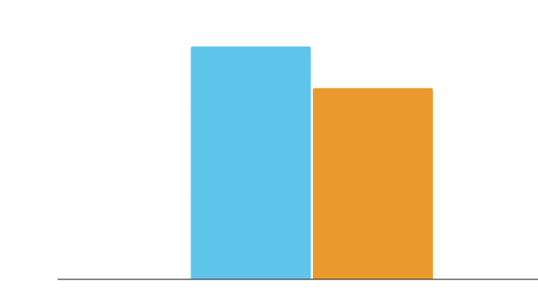
AN EGALITARIAN EVENT
55%
WOMEN
Mercury is the closest planet to the Sun
45%
MEN
Venus is the second planet from the Sun
Follow the link in the graph to modify its data and then paste the new one here. For more info, click here

Slide 27
A GALACTIC TRADITION
GEEK DAY
EARTH
JUPITER
VENUS
MARS
SATURN
NEPTUNE
Venus is the second planet from the Sun
Despite being red, Mars is a very cold place
Saturn is a gas giant and has several rings
Neptune is the farthest planet from the Sun

Slide 28
MAKE YOUR SCHEDULE
 | 10:00 | 12:00 | 14:00
MON. | Presentation | Movies | Meeting
TUES. | Meeting | Tournament | Premiere
WED. | Presentation | Movies | Meeting
THURS. | Tournament | Videogame | Premiere
FRI. | Presentation | Movies | Meeting

Slide 29
CHARACTERISTIC ELEMENTS
MARS
JUPITER
VENUS
SATURN
Despite being red, Mars is a cold place
It’s the biggest planet in the Solar System
Venus is the second planet from the Sun
Saturn is a gas giant and has several rings

Slide 30
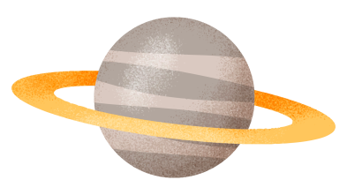
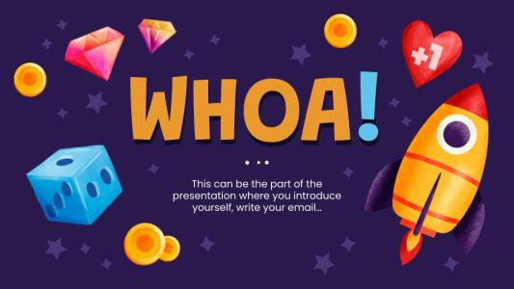
DESKTOP MOCKUP
You can replace the image on the screen with your own work. Just right-click on it and select “Replace image”

Slide 31
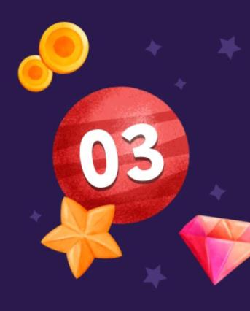
TABLET MOCKUP
You can replace the image on the screen with your own work. Just right-click on it and select “Replace image”

Slide 32
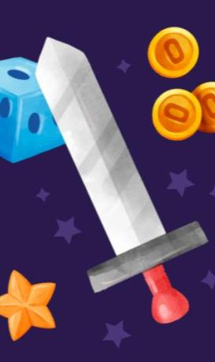
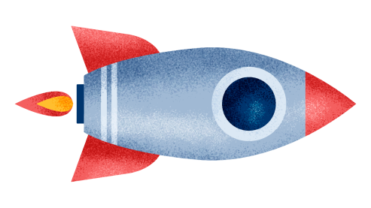
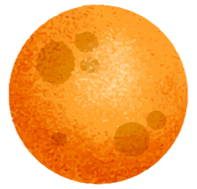
PHONE MOCKUP
You can replace the image on the screen with your own work. Just right-click on it and select “Replace image”

Slide 33
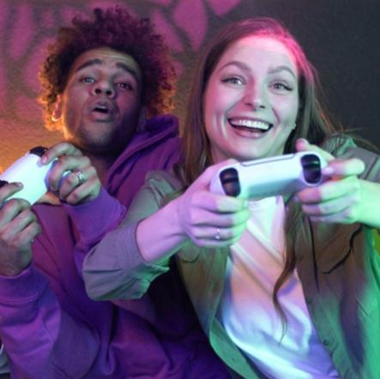
OUR GEEK TEAM
TIMMY JIMMY
STAR JONES
You can speak a bit about this person here
You can speak a bit about this person here

Slide 34
THANKS!
Do you have any questions?
addyouremail@freepik.com
+91 620 421 838
yourcompany.com

Slide 35
ICON PACK: NERD

Slide 36
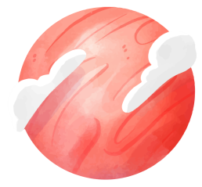
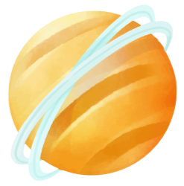
ALTERNATIVE RESOURCES
Vectors
Geometric start up landing page
Geometric start up landing page template

Slide 37
We respect your valuable time with freeppt7!
If you have any questions, please reach us
Do you have a design request, please visit our redesign page.
CREDIT: Freeppt7.com created this PowerPoint template.
Let this slide be kept for attribution.
www.freeppt7.com

