Slide 1

202X
PPT Templates
The user can demonstrate on a projector or computer, or print the presentation and make it into a film

Slide 2
行业PPT模板http://www.1ppt.com/hangye/
CONTENTS
Add title text
Add title text
The user can demonstrate on a projector or computer, or print the presentation and make it into a film
The user can demonstrate on a projector or computer, or print the presentation and make it into a film
Add title text
Add title text
The user can demonstrate on a projector or computer, or print the presentation and make it into a film
The user can demonstrate on a projector or computer, or print the presentation and make it into a film

Slide 3

01
Add title text
The user can demonstrate on a projector or computer, or print the presentation and make it into a film

Slide 4


Add title text
The user can demonstrate on a projector or computer, or print the presentation and make it into a film
Add title text
The user can demonstrate on a projector or computer, or print the presentation and make it into a filmThe user cademonstrate on a projector or computer, or print the presentation and make it into a filmThe user can demonstrate on a projector or computer, or print the presentation and make it into a film

Slide 5




Add title text
The user can demonstrate on a projector or computer, or print the presentation and make it into a film
Add title text
Add title text
Add title text
Add title text
The user can demonstrate on a projector or computer, or print the presentation and make it into a film
The user can demonstrate on a projector or computer, or print the presentation and make it into a film
The user can demonstrate on a projector or computer, or print the presentation and make it into a film
The user can demonstrate on a projector or computer, or print the presentation and make it into a film

Slide 6
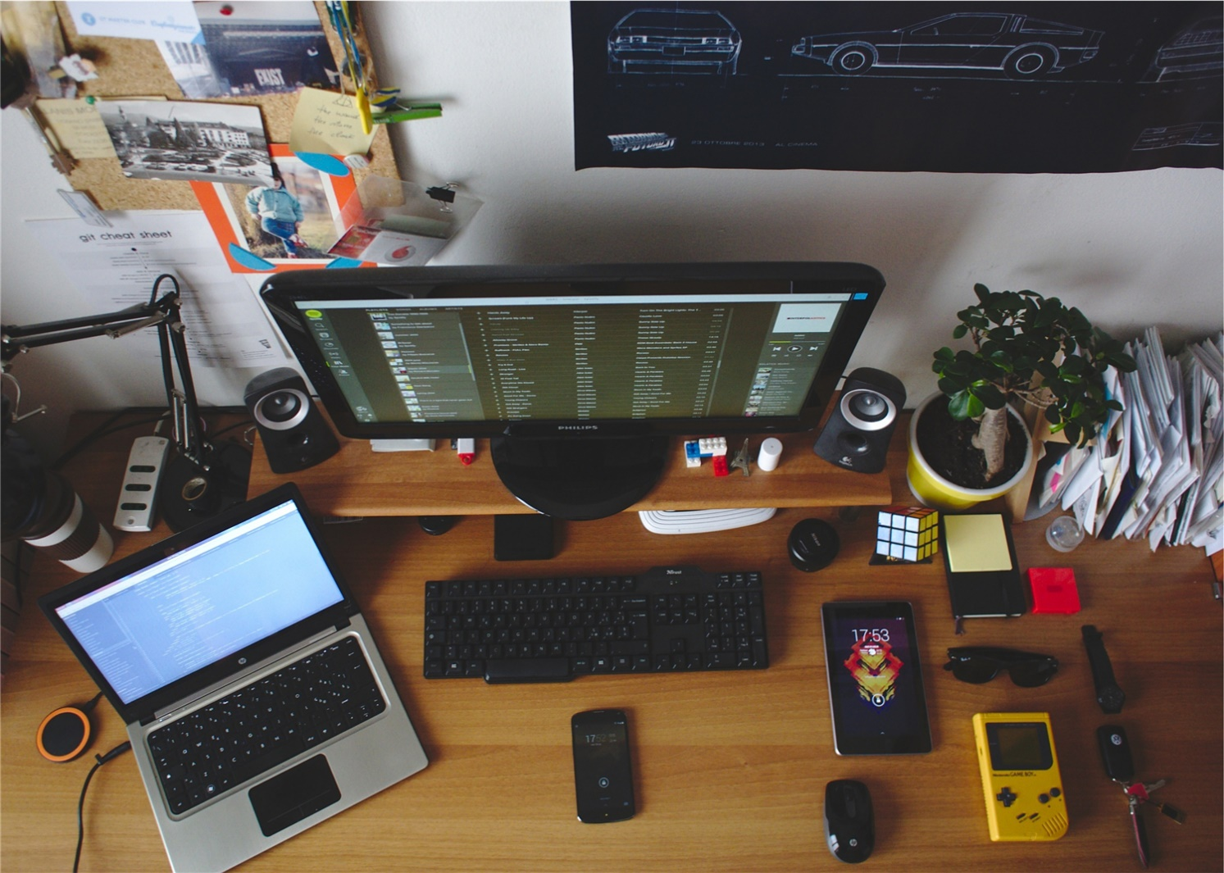
Add title text
The user can demonstrate on a projector or computer, or print the presentation and make it into a film
Add title text
The user can demonstrate on a projector or computer, or print the presentation and make it into a filmThe user cademonstrate on a projector or computer, or print the presentation and make it into a filmThe user can demonstrate on a projector or computer, or print the presentation and make it into a film

Slide 7

Add title text
The user can demonstrate on a projector or computer, or print the presentation and make it into a film
Add title text
Add title text
The user can demonstrate on a projector or computer, or print the presentation and make it into a film
The user can demonstrate on a projector or computer, or print the presentation and make it into a film

Slide 8
02
Add title text
The user can demonstrate on a projector or computer, or print the presentation and make it into a film

Slide 9
Add title text
The user can demonstrate on a projector or computer, or print the presentation and make it into a film
Add title text
The user can demonstrate on a projector or computer, or print the presentation and make it into a film
Add title text
The user can demonstrate on a projector or computer, or print the presentation and make it into a film
Add title text
The user can demonstrate on a projector or computer, or print the presentation and make it into a film

Slide 10
Add title text
The user can demonstrate on a projector or computer, or print the presentation and make it into a film
Add title text
Add title text
Add title text
Add title text
The user can demonstrate on a projector or computer, or print the presentation and make it
The user can demonstrate on a projector or computer, or print the presentation and make it
The user can demonstrate on a projector or computer, or print the presentation and make it

Slide 11

Add title text
The user can demonstrate on a projector or computer, or print the presentation and make it into a film
Add title text
The user can demonstrate on a projector or computer, or print the presentation and make it into a filmThe user can demonstrate on a projector or computer, or print the presentation and make it into a filmThe user can demonstrate on a projector or computer, or print the presentation and make it into a film
Add title text
Add title text
Add title text

Slide 12
Add title text
The user can demonstrate on a projector or computer, or print the presentation and make it into a film
30%
50%
70%
85%
Add title text
Add title text
Add title text
Add title text
The user can demonstrate on a projector or computer, or print the presentation and make it into a film
The user can demonstrate on a projector or computer, or print the presentation and make it into a film
The user can demonstrate on a projector or computer, or print the presentation and make it into a film
The user can demonstrate on a projector or computer, or print the presentation and make it into a film

Slide 13
03
Add title text
The user can demonstrate on a projector or computer, or print the presentation and make it into a film

Slide 14
Add title text
The user can demonstrate on a projector or computer, or print the presentation and make it into a film
Add title text
Add title text
Add title text
Add title text
The user can demonstrate on a projector or computer, or print the presentation and make it into a film
The user can demonstrate on a projector or computer, or print the presentation and make it into a film
The user can demonstrate on a projector or computer, or print the presentation and make it into a film
The user can demonstrate on a projector or computer, or print the presentation and make it into a film

Slide 15
Add title text
The user can demonstrate on a projector or computer, or print the presentation and make it into a film
Add title text
Add title text
The user can demonstrate on a projector or computer, or print the presentation and make it into a film
The user can demonstrate on a projector or computer, or print the presentation and make it into a film
Add title text
Add title text
The user can demonstrate on a projector or computer, or print the presentation and make it into a film
The user can demonstrate on a projector or computer, or print the presentation and make it into a film

Slide 16



Add title text
The user can demonstrate on a projector or computer, or print the presentation and make it into a film
Add title text
Add title text
Add title text
The user can demonstrate on a projector or computer, or print the presentation and make it into a film
The user can demonstrate on a projector or computer, or print the presentation and make it into a film
The user can demonstrate on a projector or computer, or print the presentation and make it into a film

Slide 17
Add title text
The user can demonstrate on a projector or computer, or print the presentation and make it into a film
Add title text
Add title text
The user can demonstrate on a projector or computer, or print the presentation and make it into a film
The user can demonstrate on a projector or computer, or print the presentation and make it into a film
Add title text
Add title text
The user can demonstrate on a projector or computer, or print the presentation and make it into a film
The user can demonstrate on a projector or computer, or print the presentation and make it into a film

Slide 18
Add title text
The user can demonstrate on a projector or computer, or print the presentation and make it into a film
Add title text
Add title text
The user can demonstrate on a projector or computer, or print the presentation and make it into a film
The user can demonstrate on a projector or computer, or print the presentation and make it into a film
Add title text
Add title text
The user can demonstrate on a projector or computer, or print the presentation and make it into a film
The user can demonstrate on a projector or computer, or print the presentation and make it into a film

Slide 19
04
Add title text
The user can demonstrate on a projector or computer, or print the presentation and make it into a film

Slide 20
Add title text
The user can demonstrate on a projector or computer, or print the presentation and make it into a film
Add title text
Add title text
Add title text
Add title text
$888
$888
$888
$888
The user can demonstrate on a projector or computer, or print the presentation and make it into a film
The user can demonstrate on a projector or computer, or print the presentation and make it into a film
The user can demonstrate on a projector or computer, or print the presentation and make it into a film
The user can demonstrate on a projector or computer, or print the presentation and make it into a film

Slide 21
Add title text
The user can demonstrate on a projector or computer, or print the presentation and make it into a film
Add title text
The user can demonstrate on a projector or computer, or print the presentation and make it into a filmThe user cademonstrate on a projector or computer, or print the presentation and make it into a filmThe user can demonstrate on a projector or computer, or print the presentation and make it into a film

Slide 22
Add title text
The user can demonstrate on a projector or computer, or print the presentation and make it into a film
Add text
Add text
Add text
Add text
Add text
Add text
Project Description
Add text
Add text
Project Description
Project Description
Add text
Add text
Add text
Project Description
Project Description
Add text
Add text
Add text
Project Description
Add text
Add text

Slide 23
Add title text
The user can demonstrate on a projector or computer, or print the presentation and make it into a film
Add title text
The user can demonstrate on a projector or computer, or print the presentation and make it into a film
The user can demonstrate on a projector or computer, or print the presentation and make it into a film
The user can demonstrate on a projector or computer, or print the presentation and make it into a film
Add title text
Add title text

Slide 24

Add title text
The user can demonstrate on a projector or computer, or print the presentation and make it into a film
Add title text
The user can demonstrate on a projector or computer, or print the presentation and make it into a filmThe user can demonstrate on a projector or computer, or print the presentation and make it into a filmThe user can demonstrate on a projector or computer, or print the presentation and make it into a filmThe user can demonstrate on a projector or computer, or print the presentation and make it into a filmThe user can demonstrate on a projector or computer, or print the presentation and make it into a filmThe user can demonstrate on a projector or computer, or print the presentation and make it into a film

Slide 25
THANK YOU
The user can demonstrate on a projector or computer, or print the presentation and make it into a film

