Slide 1
LOGO
Free
PowerPoint Templates
Insert the Subtitle of Your Presentation
REPORT ：FREEPPT7.COM TIME ：20XX

Slide 2
Contents
Add title text
Add title text
Add title text
Add title text
Add title text
01
02
03
04
05
When a cigarette falls in love with a match,it is destined to be hurt.
When a cigarette falls in love with a match,it is destined to be hurt.
When a cigarette falls in love with a match,it is destined to be hurt.
When a cigarette falls in love with a match,it is destined to be hurt.
When a cigarette falls in love with a match,it is destined to be hurt.

Slide 3
PART
01
Add title text
When a cigarette falls in love with a match,it is destined to be hurt.When a cigarette falls in love with a match,it is destined to be hurt.

Slide 4
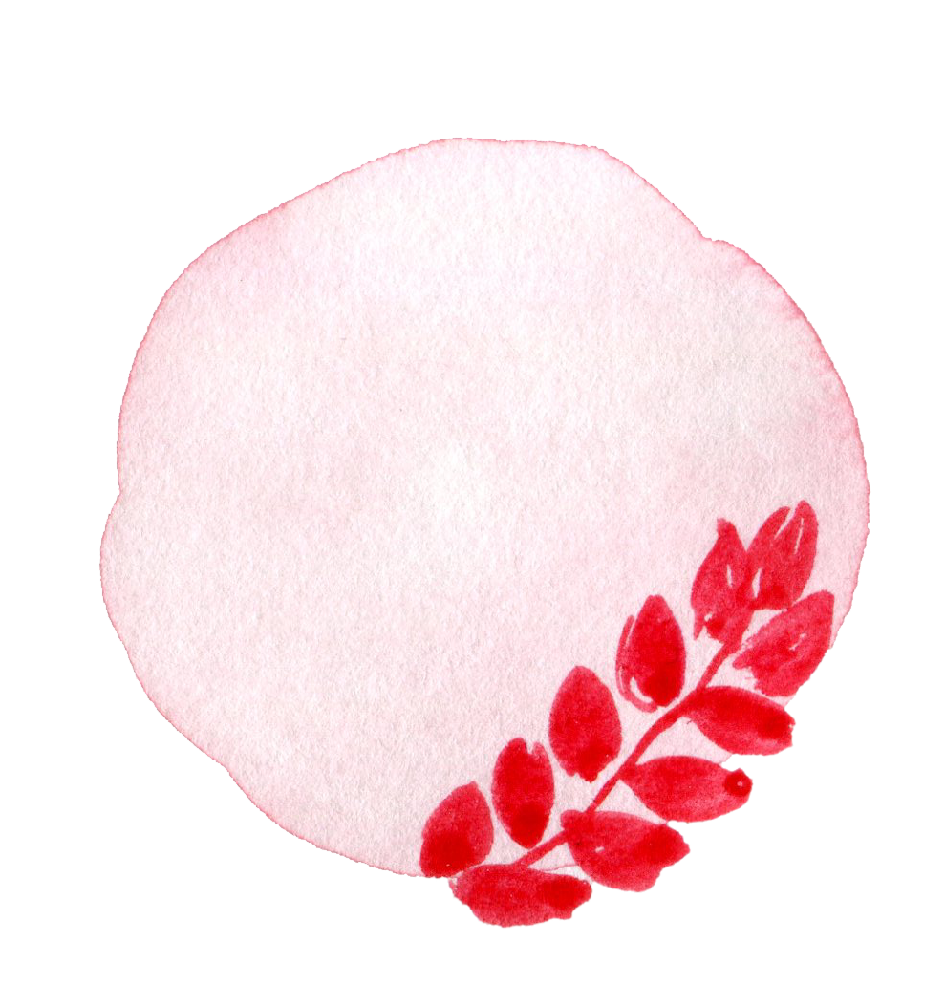
1
Add title text here
1
When a cigarette falls in love with a match,it is destined to be hurt.
2
When a cigarette falls in love with a match,it is destined to be hurt.
3
When a cigarette falls in love with a match,it is destined to be hurt.
Add title
4
When a cigarette falls in love with a match,it is destined to be hurt.
1
When a cigarette falls in love with a match,it is destined to be hurt.When a cigarette falls in love with a match,it is destined to be hurt.
2
When a cigarette falls in love with a match,it is destined to be hurt.When a cigarette falls in love with a match,it is destined to be hurt.
Add title

Slide 5
1
Add title text here
Add title text
When a cigarette falls in love with a match,it is destined to be hurt.When a cigarette falls in love with a match,it is destined to be hurt.When a cigarette falls in love with a match,it is destined to be hurt.
Add title
Add title text
When a cigarette falls in love with a match,it is destined to be hurt.When a cigarette falls in love with a match,it is destined to be hurt.When a cigarette falls in love with a match,it is destined to be hurt.
Add title text here
Add title text
When a cigarette falls in love with a match,it is destined to be hurt.When a cigarette falls in love with a match,it is destined to be hurt.When a cigarette falls in love with a match,it is destined to be hurt.

Slide 6
1
Add title text here
Add title text here
Add title text here
Add title text here
When a cigarette falls in love with a match,it is destined to be hurt.When a cigarette falls in love with a match,it is destined to be hurt.
When a cigarette falls in love with a match,it is destined to be hurt.When a cigarette falls in love with a match,it is destined to be hurt.
When a cigarette falls in love with a match,it is destined to be hurt.When a cigarette falls in love with a match,it is destined to be hurt.

Slide 7
1
Add title text here
01
Add title text
When a cigarette falls in love with a match,it is destined to be hurt.When a cigarette falls in love with a match,it is destined to be hurt.
Add title text
02
When a cigarette falls in love with a match,it is destined to be hurt.When a cigarette falls in love with a match,it is destined to be hurt.
Add title text
03
When a cigarette falls in love with a match,it is destined to be hurt.When a cigarette falls in love with a match,it is destined to be hurt.

Slide 8
PART
02
Add title text
When a cigarette falls in love with a match,it is destined to be hurt.When a cigarette falls in love with a match,it is destined to be hurt.

Slide 9
2
Add title text here
When a cigarette falls in love with a match,it is destined to be hurt.When a cigarette falls in love with a match,it is destined to be hurt.
Add title
Add title
When a cigarette falls in love with a match,it is destined to be hurt.When a cigarette falls in love with a match,it is destined to be hurt.
Add title text
Add title
When a cigarette falls in love with a match,it is destined to be hurt.When a cigarette falls in love with a match,it is destined to be hurt.
Add title
When a cigarette falls in love with a match,it is destined to be hurt.When a cigarette falls in love with a match,it is destined to be hurt.

Slide 10
2
Add title text here
Add title text
Add title text
Add title text
Add title text
Add title text
When a cigarette falls in love with a match,it is destined to be hurt.
When a cigarette falls in love with a match,it is destined to be hurt.
When a cigarette falls in love with a match,it is destined to be hurt.
When a cigarette falls in love with a match,it is destined to be hurt.
When a cigarette falls in love with a match,it is destined to be hurt.

Slide 11
2
Add title text here
Add title text here
Add title text here
When a cigarette falls in love with a match,it is destined to be hurt.When a cigarette falls in love with a match,it is destined to be hurt.
When a cigarette falls in love with a match,it is destined to be hurt.When a cigarette falls in love with a match,it is destined to be hurt.
Add title
Add title

Slide 12
2
Add title text here
Add title text
Add title text
1
4
When a cigarette falls in love with a match,it is destined to be hurt.
When a cigarette falls in love with a match,it is destined to be hurt.
Add title text
Add title text
2
5
When a cigarette falls in love with a match,it is destined to be hurt.
When a cigarette falls in love with a match,it is destined to be hurt.
Add title text
Add title text
3
6
When a cigarette falls in love with a match,it is destined to be hurt.
When a cigarette falls in love with a match,it is destined to be hurt.

Slide 13
PART
03
Add title text
When a cigarette falls in love with a match,it is destined to be hurt.When a cigarette falls in love with a match,it is destined to be hurt.

Slide 14
3
Add title text here
Add title text
When a cigarette falls in love with a match,it is destined to be hurt.When a cigarette falls in love with a match,it is destined to be hurt.
Add title text
Add title text
Add title text
Add title text
Add title text
When a cigarette falls in love with a match,it is destined to be hurt.When a cigarette falls in love with a match,it is destined to be hurt.
Add title text
When a cigarette falls in love with a match,it is destined to be hurt.When a cigarette falls in love with a match,it is destined to be hurt.

Slide 15
3
Add title text here
Add title text
When a cigarette falls in love with a match,it is destined to be hurt.When a cigarette falls in love with a match,it is destined to be hurt.
Add title text
When a cigarette falls in love with a match,it is destined to be hurt.When a cigarette falls in love with a match,it is destined to be hurt.
Add title text
When a cigarette falls in love with a match,it is destined to be hurt.When a cigarette falls in love with a match,it is destined to be hurt.
Add title text
When a cigarette falls in love with a match,it is destined to be hurt.When a cigarette falls in love with a match,it is destined to be hurt.

Slide 16
3
Add title text here
Add title text
When a cigarette falls in love with a match,it is destined to be hurt.When a cigarette falls in love with a match,it is destined to be hurt.When a cigarette falls in love with a match,it is destined to be hurt.When a cigarette falls in love with a match,it is destined to be hurt.

Slide 17
3
Add title text here
Add title text
Add title text
Add title text
When a cigarette falls in love with a match,it is destined to be hurt.When a cigarette falls in love with a match,it is destined to be hurt.
When a cigarette falls in love with a match,it is destined to be hurt.When a cigarette falls in love with a match,it is destined to be hurt.
When a cigarette falls in love with a match,it is destined to be hurt.When a cigarette falls in love with a match,it is destined to be hurt.

Slide 18
PART
04
Add title text
When a cigarette falls in love with a match,it is destined to be hurt.When a cigarette falls in love with a match,it is destined to be hurt.

Slide 19
4
Add title text here
Add title text
VS
Add title text
When a cigarette falls in love with a match,it is destined to be hurt.When a cigarette falls in love with a match.
When a cigarette falls in love with a match,it is destined to be hurt.When a cigarette falls in love with a match.
Add title text
When a cigarette falls in love with a match,it is destined to be hurt.When a cigarette falls in love with a match.When a cigarette falls in love with a match,it is destined to be hurt.When a cigarette falls in love with a match.When a cigarette falls in love with a match,it is destined to be hurt.When a cigarette falls in love with a match.

Slide 20
4
Add title text here
Add title text
When a cigarette falls in love with a match,it is destined to be hurt.When a cigarette falls in love with a match,it is destined to be hurt.When a cigarette falls in love with a match.
When a cigarette falls in love with a match,it is destined to be hurt.When a cigarette falls in love with a match,it is destined to be hurt.When a cigarette falls in love with a match.
When a cigarette falls in love with a match,it is destined to be hurt.When a cigarette falls in love with a match,it is destined to be hurt.When a cigarette falls in love with a match.
Add title

Slide 21
4
Add title text here
When a cigarette falls in love with a match,it is destined to be hurt.When a cigarette falls in love with a match.
When a cigarette falls in love with a match,it is destined to be hurt.When a cigarette falls in love with a match.
When a cigarette falls in love with a match,it is destined to be hurt.When a cigarette falls in love with a match.
Add title text
Add title text
Add title text
Add title text
Add title text
When a cigarette falls in love with a match,it is destined to be hurt.When a cigarette falls in love with a match.
When a cigarette falls in love with a match,it is destined to be hurt.When a cigarette falls in love with a match.

Slide 22
4
Add title text here
Add title text
Add title text
Add title text
Add title text
When a cigarette falls in love with a match,it is destined to be hurt.When a cigarette falls in love with a match,it is destined to be hurt.
When a cigarette falls in love with a match,it is destined to be hurt.When a cigarette falls in love with a match,it is destined to be hurt.
When a cigarette falls in love with a match,it is destined to be hurt.When a cigarette falls in love with a match,it is destined to be hurt.
When a cigarette falls in love with a match,it is destined to be hurt.When a cigarette falls in love with a match,it is destined to be hurt.

Slide 23
PART
05
Add title text
When a cigarette falls in love with a match,it is destined to be hurt.When a cigarette falls in love with a match,it is destined to be hurt.

Slide 24
行业PPT模板http://www.freeppt7.com/hangye/
5
Add title text here
Add title text
When a cigarette falls in love with a match,it is destined to be hurt.When a cigarette falls in love with a match.
Add title text
When a cigarette falls in love with a match,it is destined to be hurt.When a cigarette falls in love with a match.
Add title text
When a cigarette falls in love with a match,it is destined to be hurt.When a cigarette falls in love with a match.
Notes:
Template from: https://www.freeppt7.com/

Slide 25
LOGO
Thanks
Thanks for your watching
REPORT ：FREEPPT7.COM TIME ：20XX

Slide 26
We respect your valuable time with freeppt7!
If you have any questions, please reach us
Do you have a design request, please visit our redesign page.
CREDIT: Freeppt7.com created this PowerPoint template.
Let this slide be kept for attribution.
www.freeppt7.com

